Slide 1


COVID-19
Protective
Measures
www.reopeningsafely.ca
Compiled and Edited by Akash Kapoor & Gwendolyn DelGuidice
for Akash Kapoor Advisors Inc.

Slide 2


Disclaimer
The content of this Re-Opening Safely Playbook Covid-19 Protection Measures presentation (hereinafter referred to as the “Playbook”) is provided for general information purposes. The content should not be considered as legal, consulting or any other professional advice. This Playbook is to be understood as a guideline on what to consider when Re-Opening a workplace during the COVID-19 pandemic. The health and safety of workers is our number one priority and our hope in sharing this information is that it may be of assistance to our collective colleagues and partner businesses.
Please be advised that some or all of the information contained in this document may not be applicable to some businesses or workplaces. We strongly recommend that before implementing any of the ideas contained herein you carefully evaluate, and consult with outside legal counsel familiar with your organization’s particular factual situation regarding the legality, applicability and potential efficacy of this information in your place of business before making any decisions.
Akash Kapoor Advisors Inc. assumes no responsibility or liability for any errors or omissions in the content of the Playbook and for any unwanted or unintended consequences arising out of or related to the adoption, or decision not to adopt, any of the practices or procedures contained in the Playbook.
This Playbook is to be used as a corporate and recommended practice guideline and aligns with the applicable authorities such as the Public Health Agency of Canada and the World Health Organization (WHO) recommendations to the greatest extent possible.
The Playbook is a working document and will be updated on a best efforts basis from time to time to reflect changes in directives and to include new recommended practices as they become available given the fluidity of this situation. While we have made every attempt to ensure the information contained in the Playbook has been obtained from reliable sources, all information in the Playbook is provided “as is,” with no guarantee of completeness, accuracy, timeliness or of the results obtained from the use of this information, and without warranty of any kind, express or implied, including, but not limited to warranties of performance, merchantability and fitness for a particular purpose.
This Playbook provides general recommendations for use in most workplaces. Due to circumstances that may be unique to a particular workplace, there may be some situations in which a workplace will require accommodation(s) to implement the recommendations of the Playbook. Such accommodations may need to be authorised by management or the organization’s Health and Safety committee if applicable.
BASIC EMPLOYEE COVID AWARENESS | 2

Slide 3
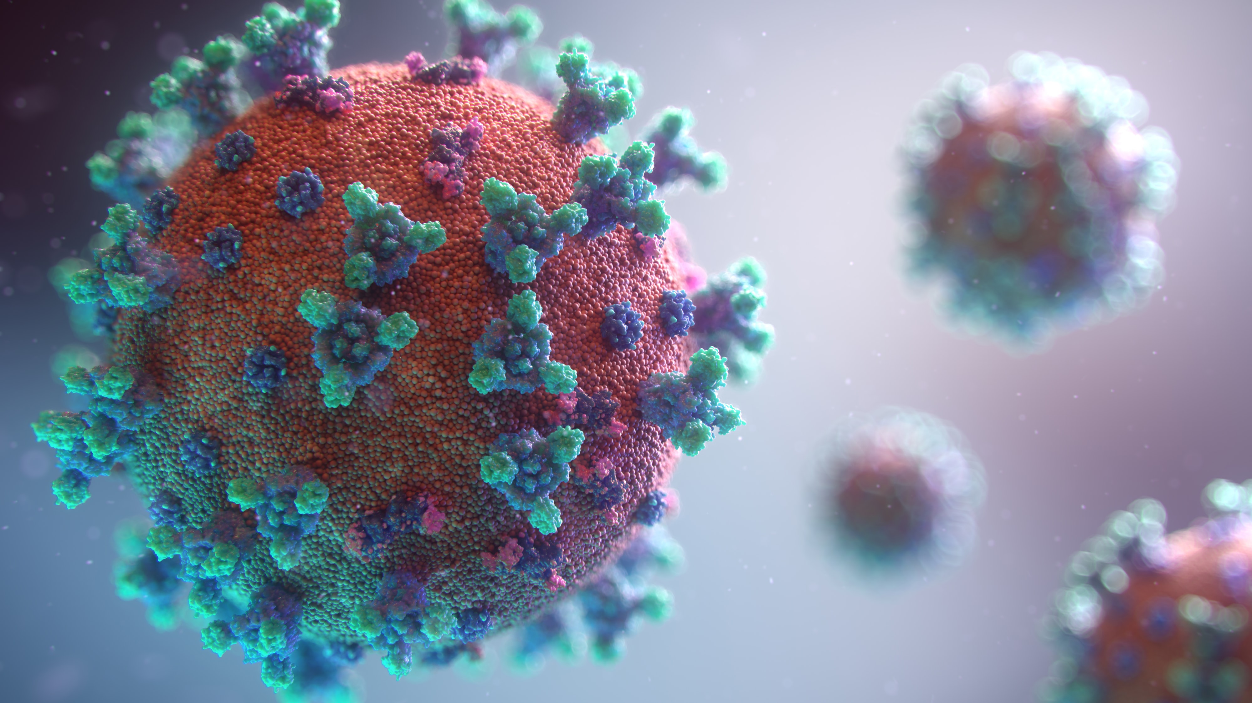

COVID-19
Protective Measures
Safe workplaces
are a result of the dedication of everyone at our company
BASIC EMPLOYEE COVID AWARENESS | 3

Slide 4
COVID-19
Protective Measures
Working together, we can mitigate or eliminate hazards and risks and get results the right way
BASIC EMPLOYEE COVID AWARENESS | 4

Slide 5


COVID-19 Protective Measures
Recently, our company has implemented several measures, including:
BASIC EMPLOYEE COVID AWARENESS | 5

Slide 6
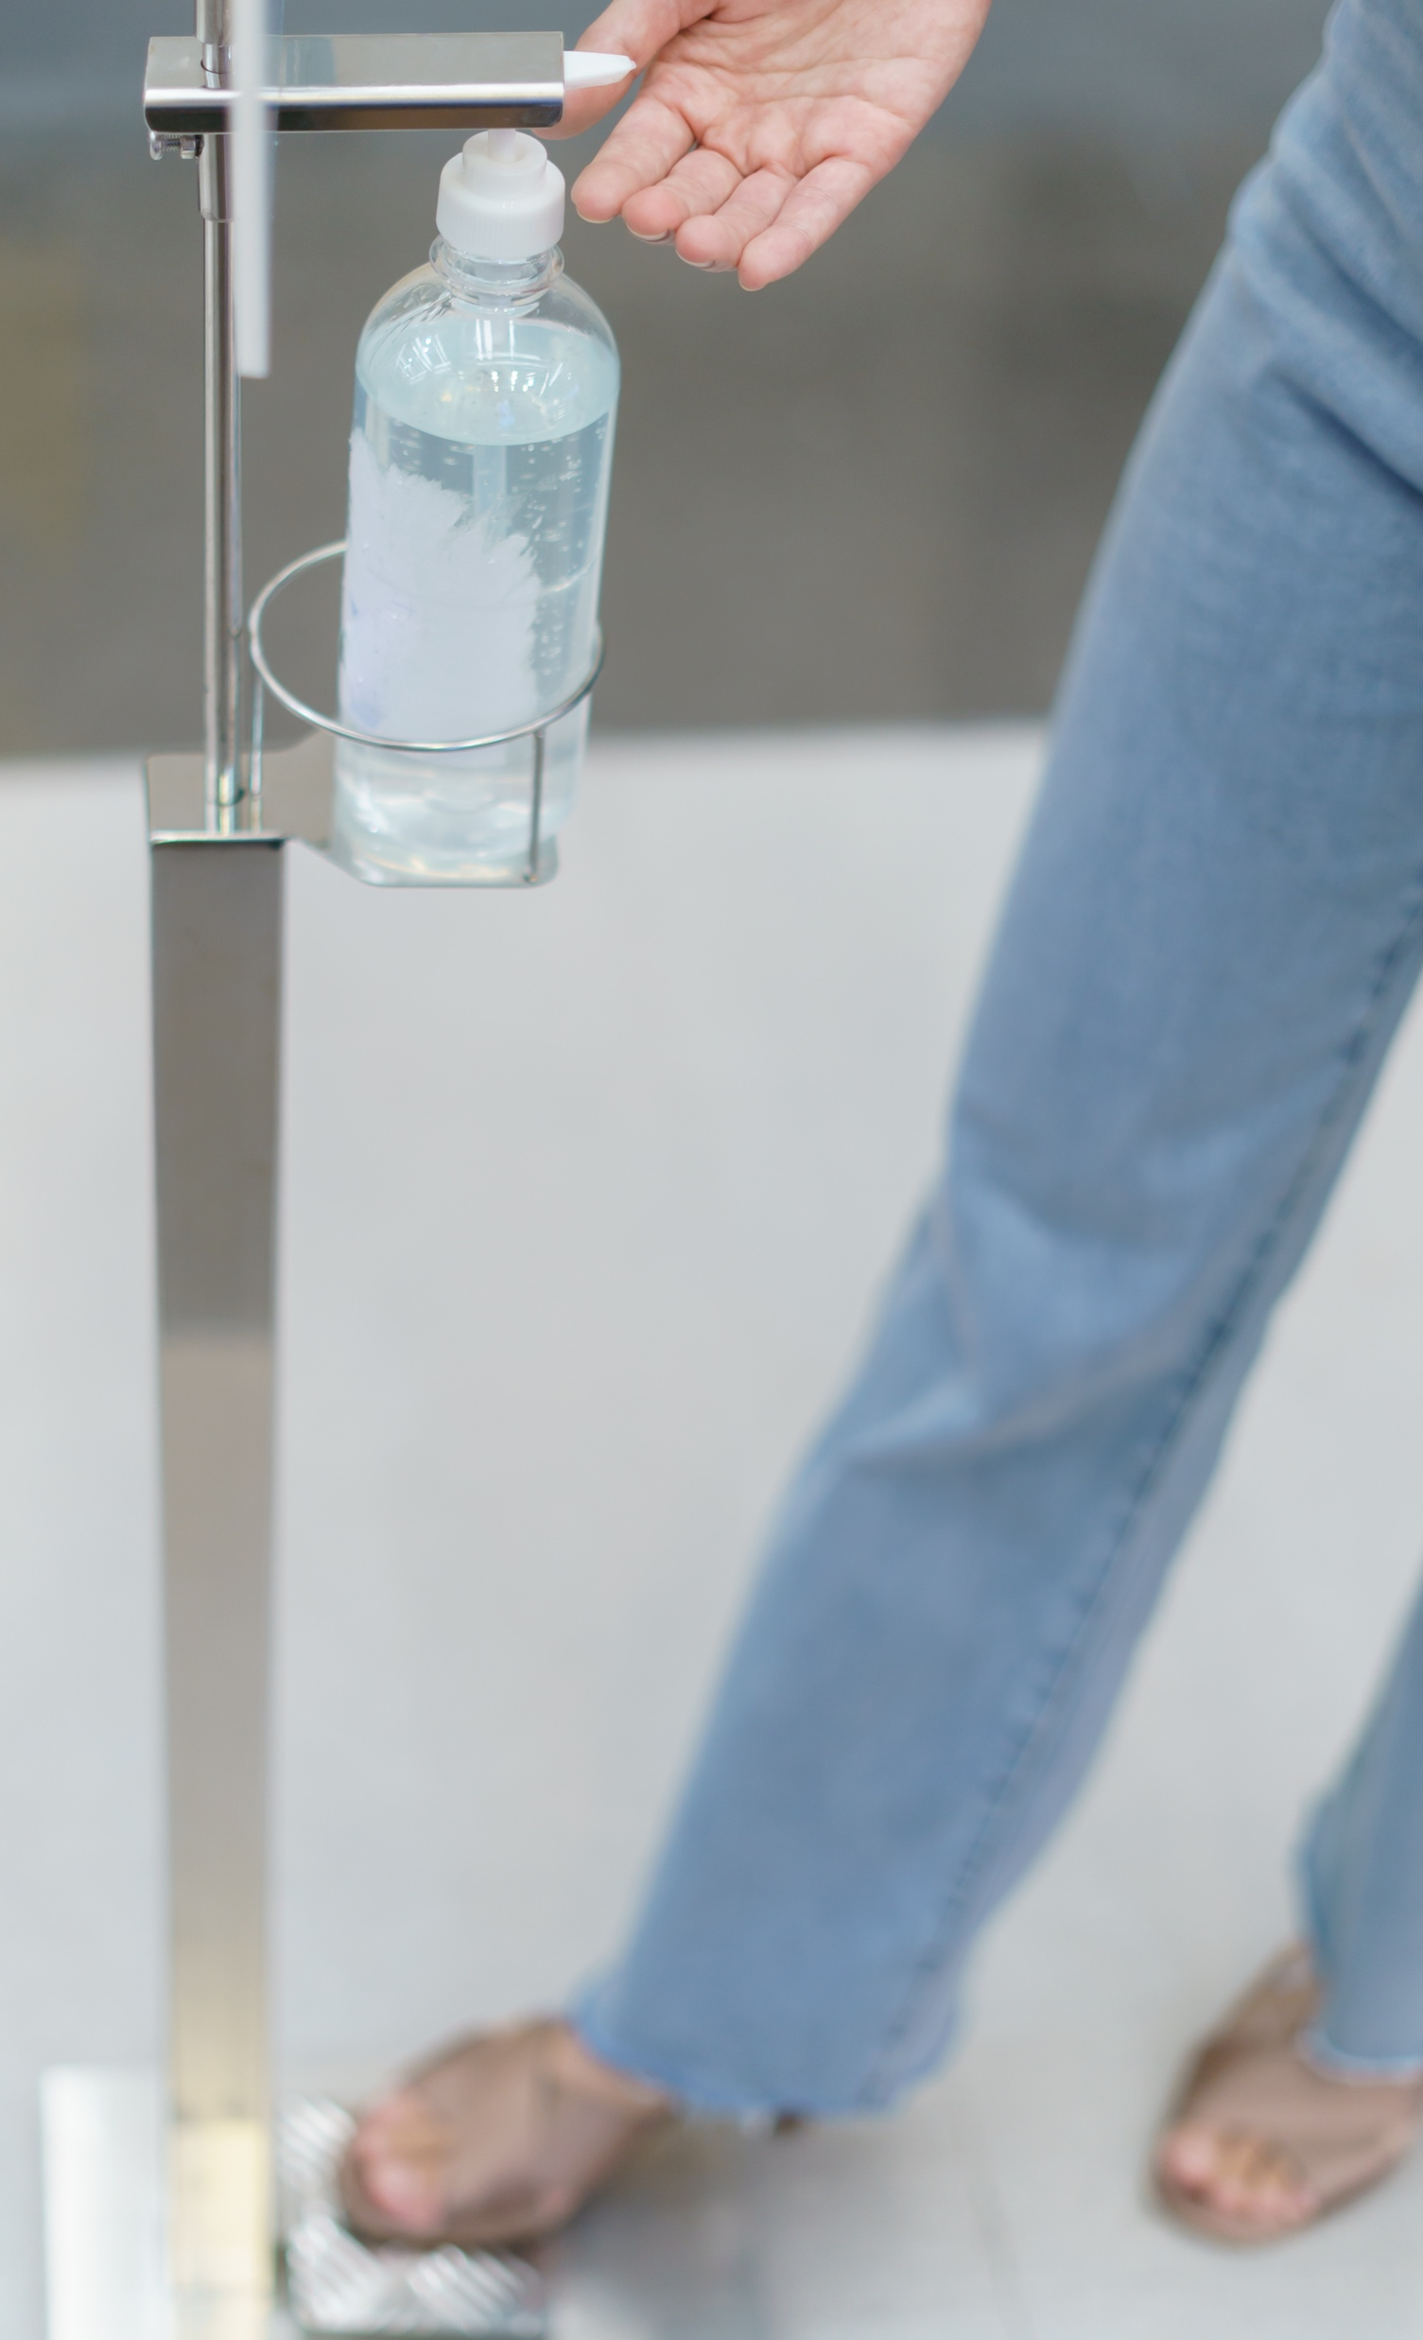

COVID-19 Protective Measures
Recently, our company has implemented several measures, including:
1
Installing additional hand sanitizer dispensers and more frequently cleaning often-touched surfaces and common areas
BASIC EMPLOYEE COVID AWARENESS | 6

Slide 7
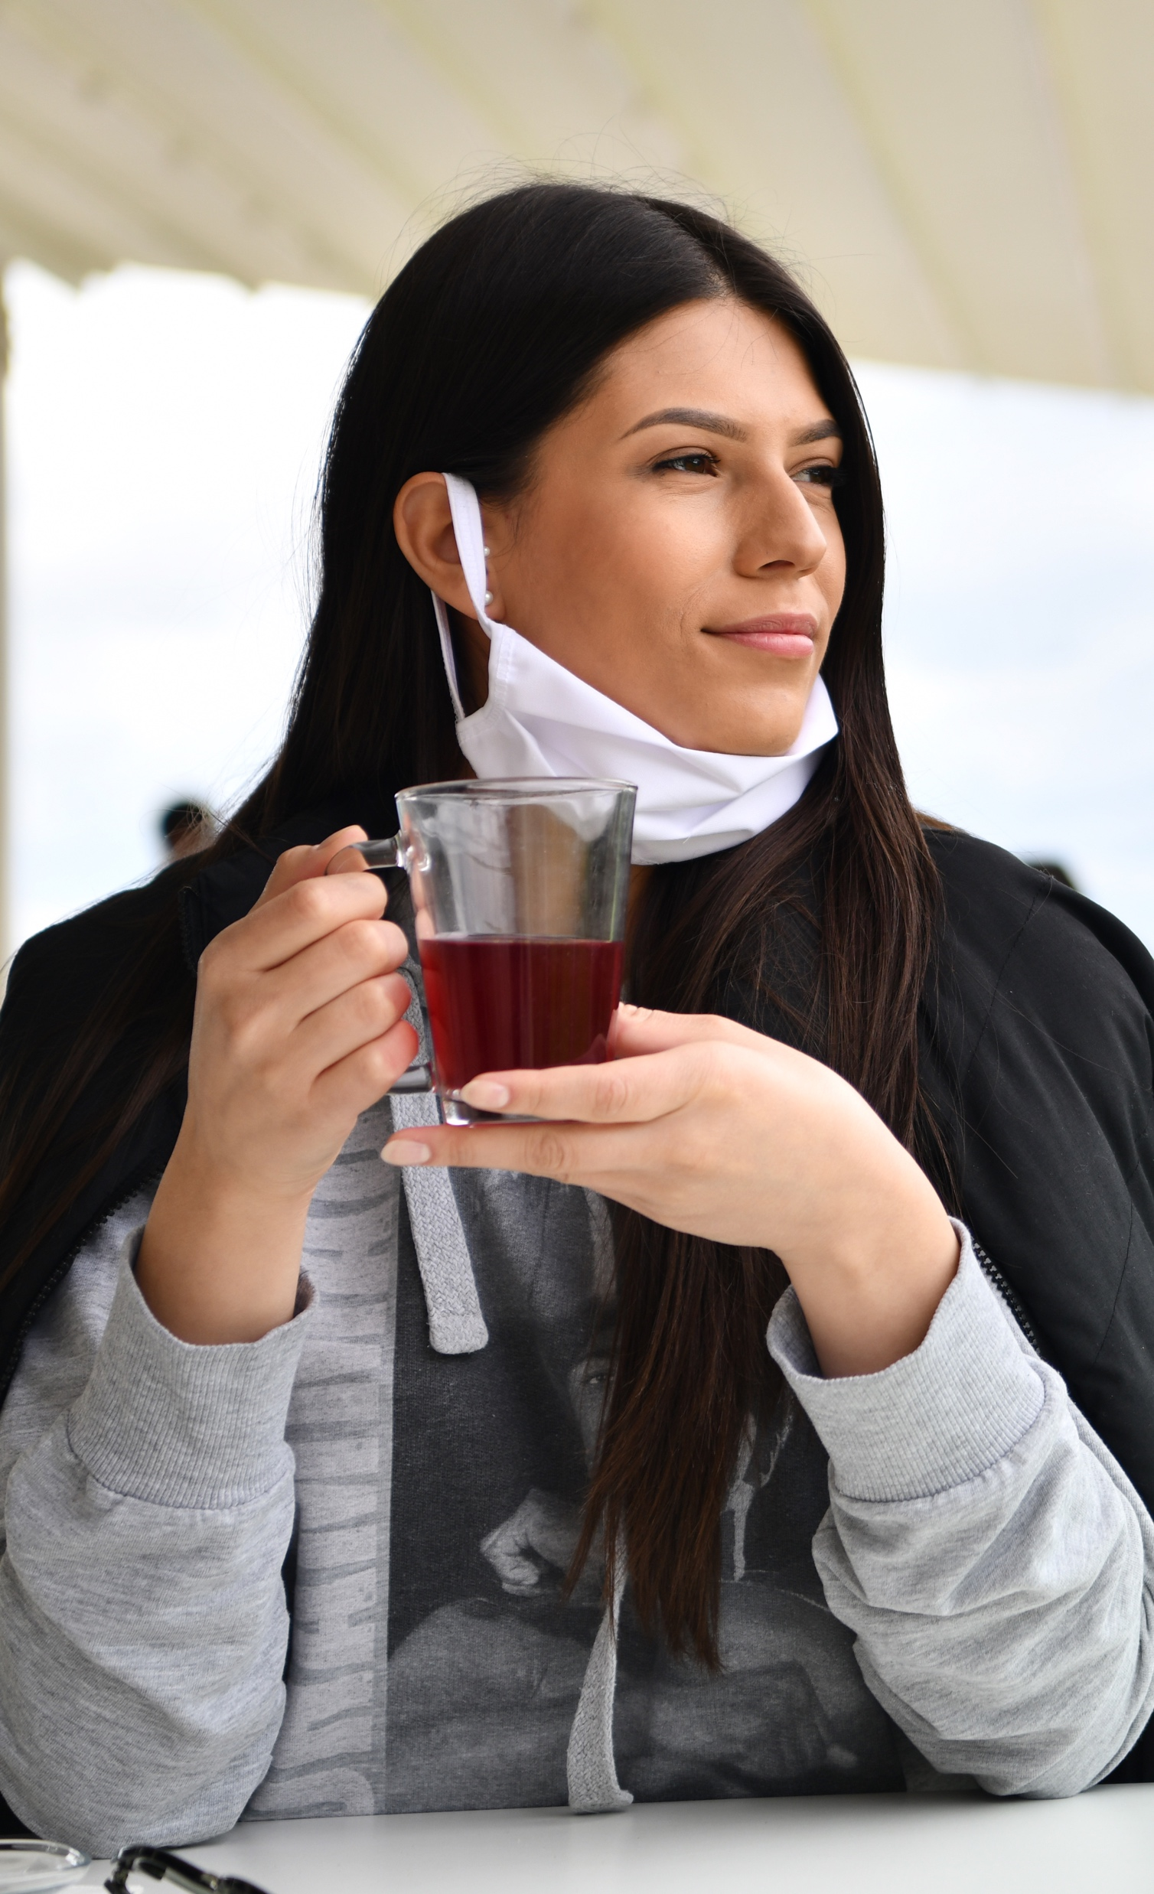

COVID-19 Protective Measures
Recently, our company has implemented several measures, including:
1 | 2
Installing additional hand sanitizer dispensers and more frequently cleaning often-touched surfaces and common areas | Managing start times and shift changes and staggering lunch breaks to thoroughly disinfect common areas and promote social distancing
2 meters
BASIC EMPLOYEE COVID AWARENESS | 7

Slide 8
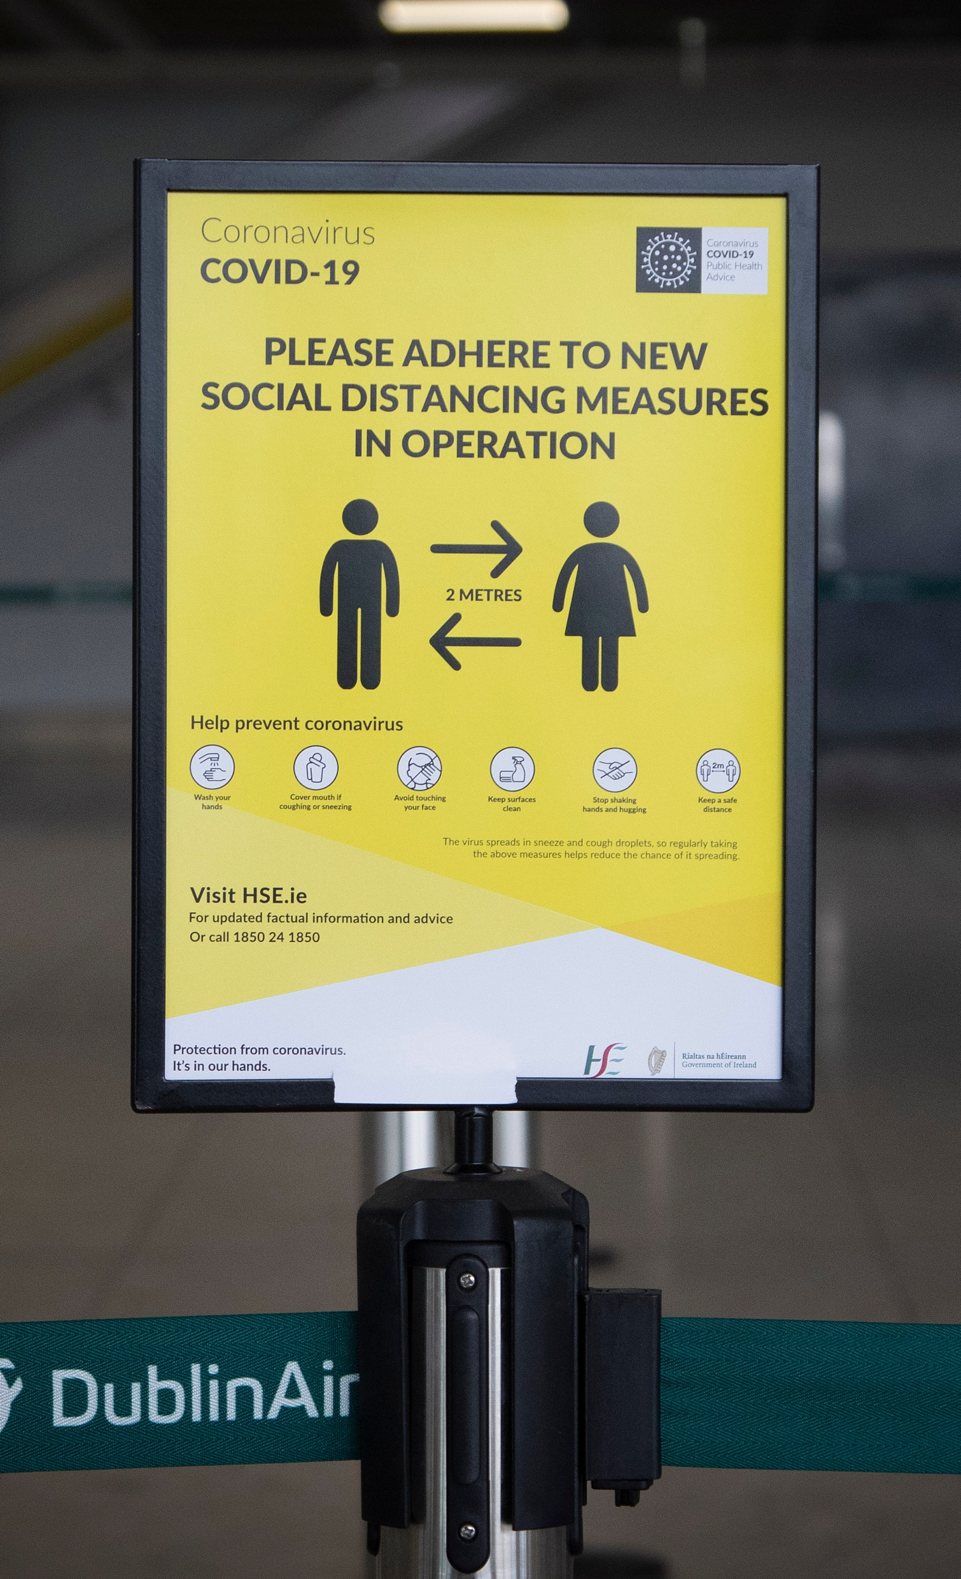
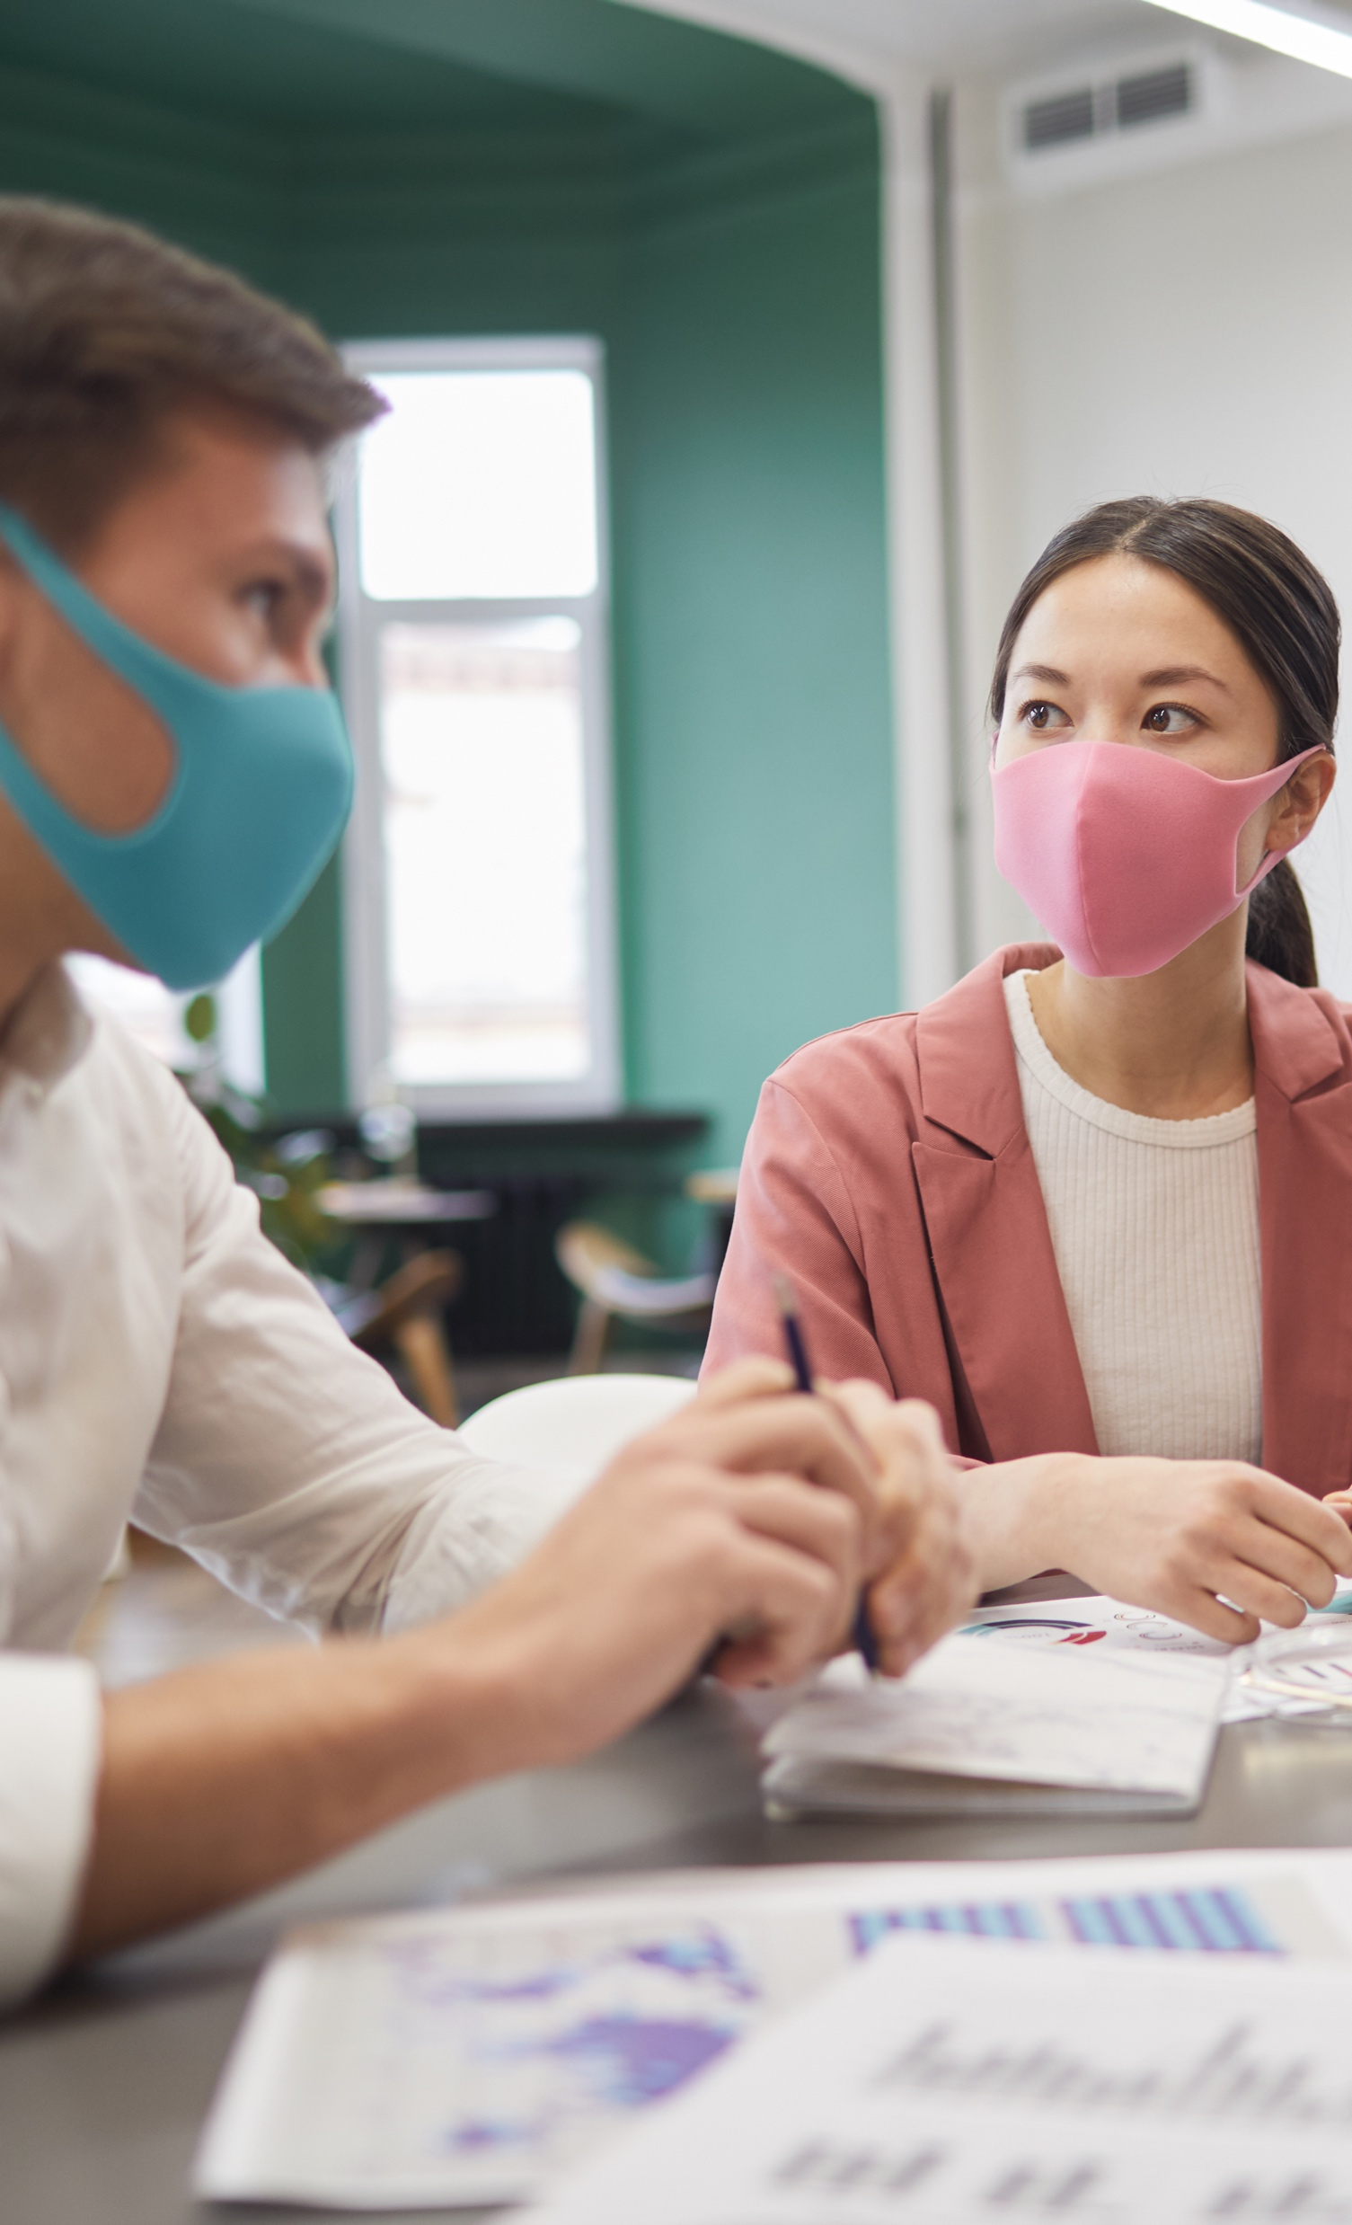

COVID-19 Protective Measures
Recently, our company has implemented several measures, including:
1 | 2 | 3
Installing additional hand sanitizer dispensers and more frequently cleaning often-touched surfacse and common areas | Managing start times and shift changes and staggering lunch breaks to thoroughly disinfect common areas and promote social distancing | Placing signage throughout buildings to remind employees of proper preventative measures
BASIC EMPLOYEE COVID AWARENESS | 8

Slide 9
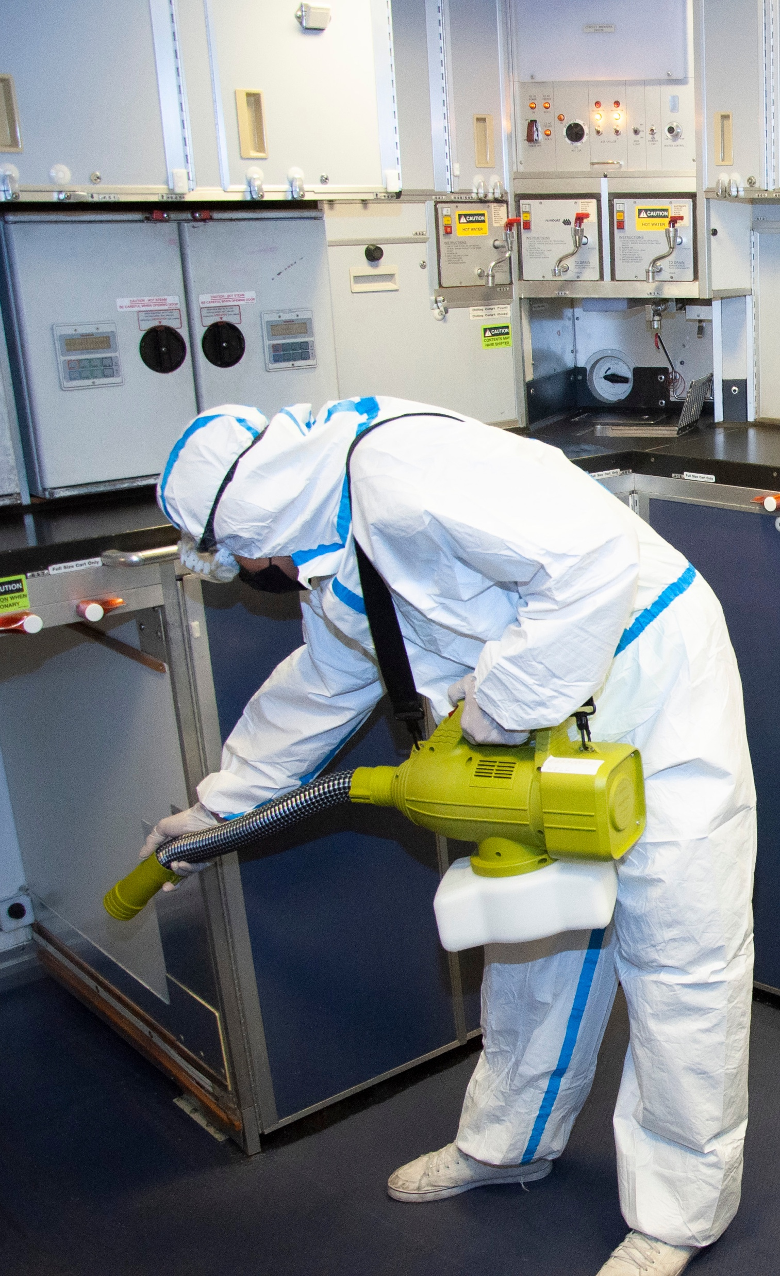

COVID-19 Protective Measures
Recently, our company has implemented several measures, including:
1 | 2 | 3 | 4
Installing additional hand sanitizer dispensers and more frequently cleaning often-touched surfaces and common areas | Managing start times and shift changes and staggering lunch breaks to thoroughly disinfect common areas and promote social distancing | Placing signage throughout buildings to remind employees of proper preventative measures | Temporarily closing facilities with confirmed COVID-19 cases for deep cleaning and disinfection
BASIC EMPLOYEE COVID AWARENESS | 9

Slide 10

COVID-19 Protective Measures
Recently, our company has implemented several measures, including:
1 | 2 | 3 | 4 | 5
Installing additional hand sanitizer dispensers and more frequently cleaning often-touched surfaces and common areas | Managing start times and shift changes and staggering lunch breaks to thoroughly disinfect common areas and promote social distancing | Placing signage throughout buildings to remind employees of proper preventative measures | Temporarily closing facilities with confirmed COVID-19 cases for deep cleaning and disinfection | Limiting the number of participants at in-person meetings and practicing proper social distancing of 2 meters (6 feet)
BASIC EMPLOYEE COVID AWARENESS | 10

Slide 11
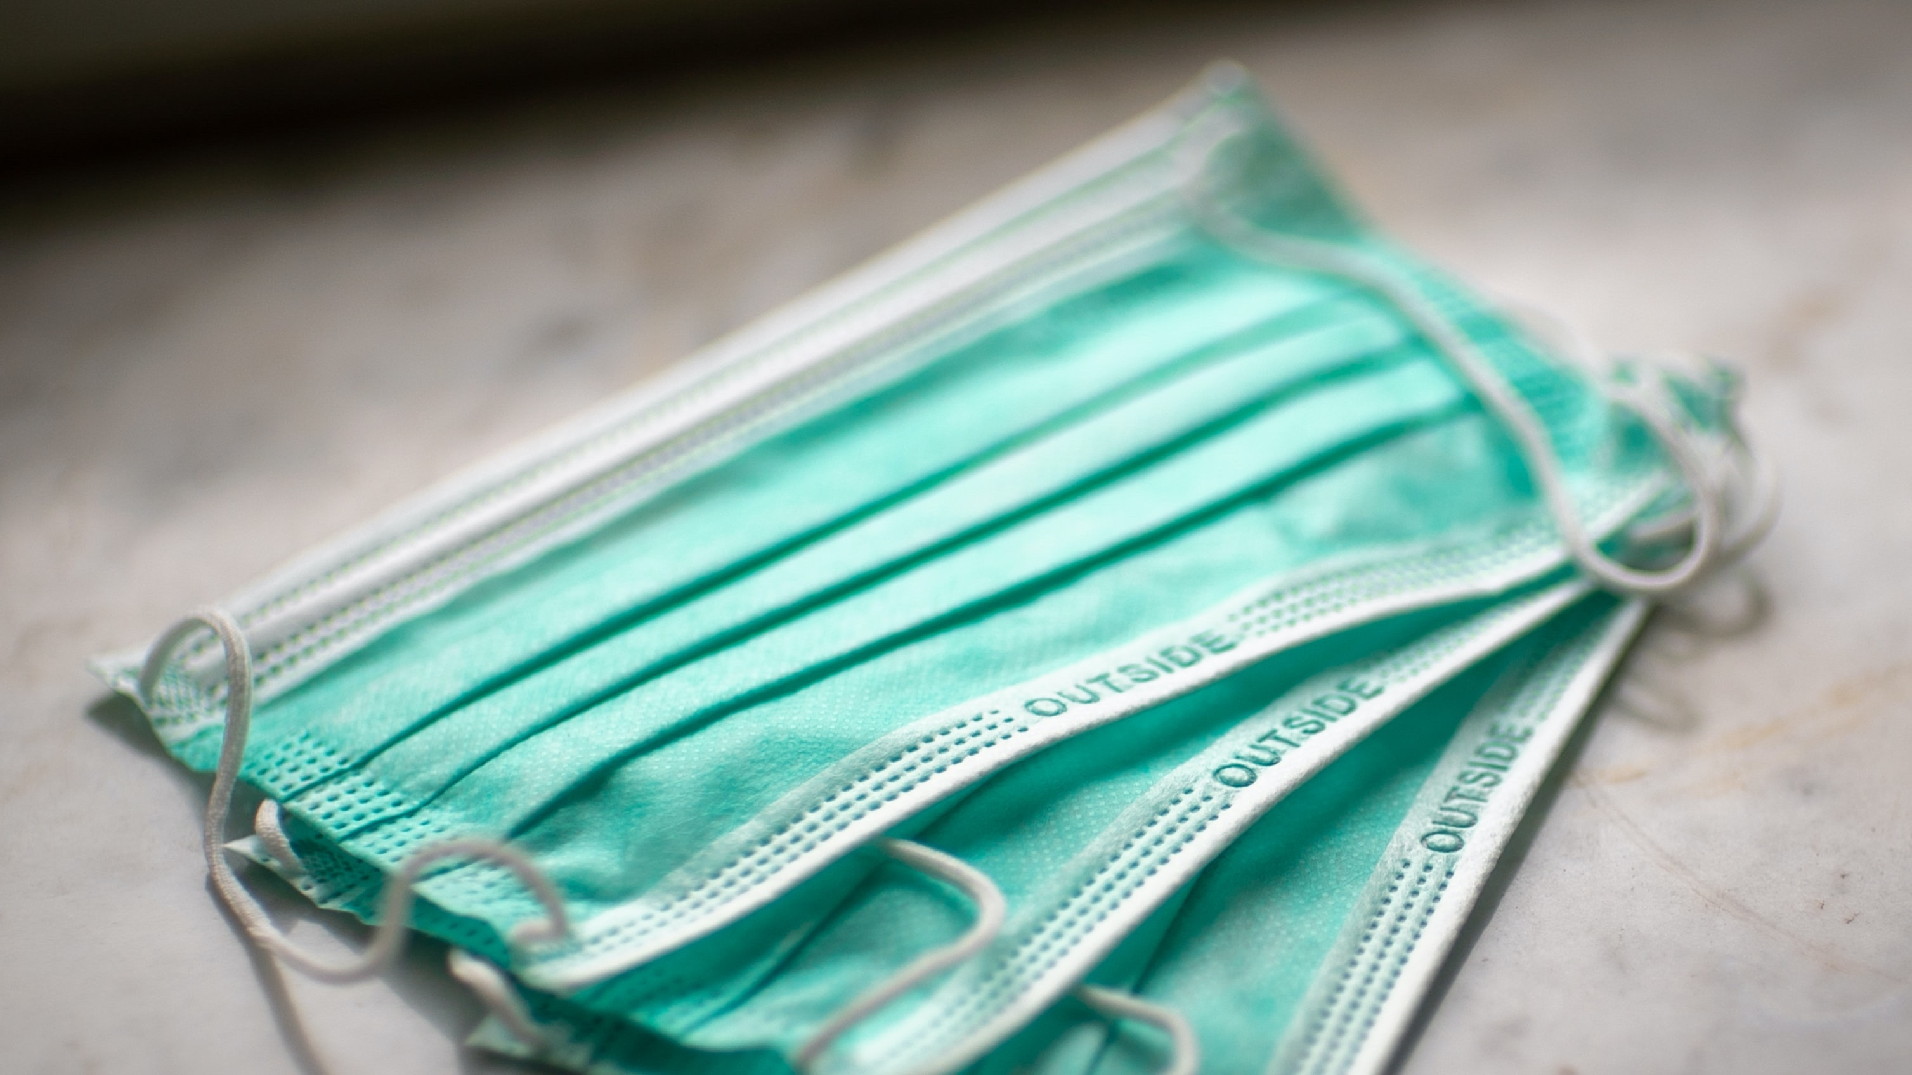


COVID-19 Protective Measures
The following are additional practices that will help ensure the
safety of all our team members
BASIC EMPLOYEE COVID AWARENESS | 11

Slide 12
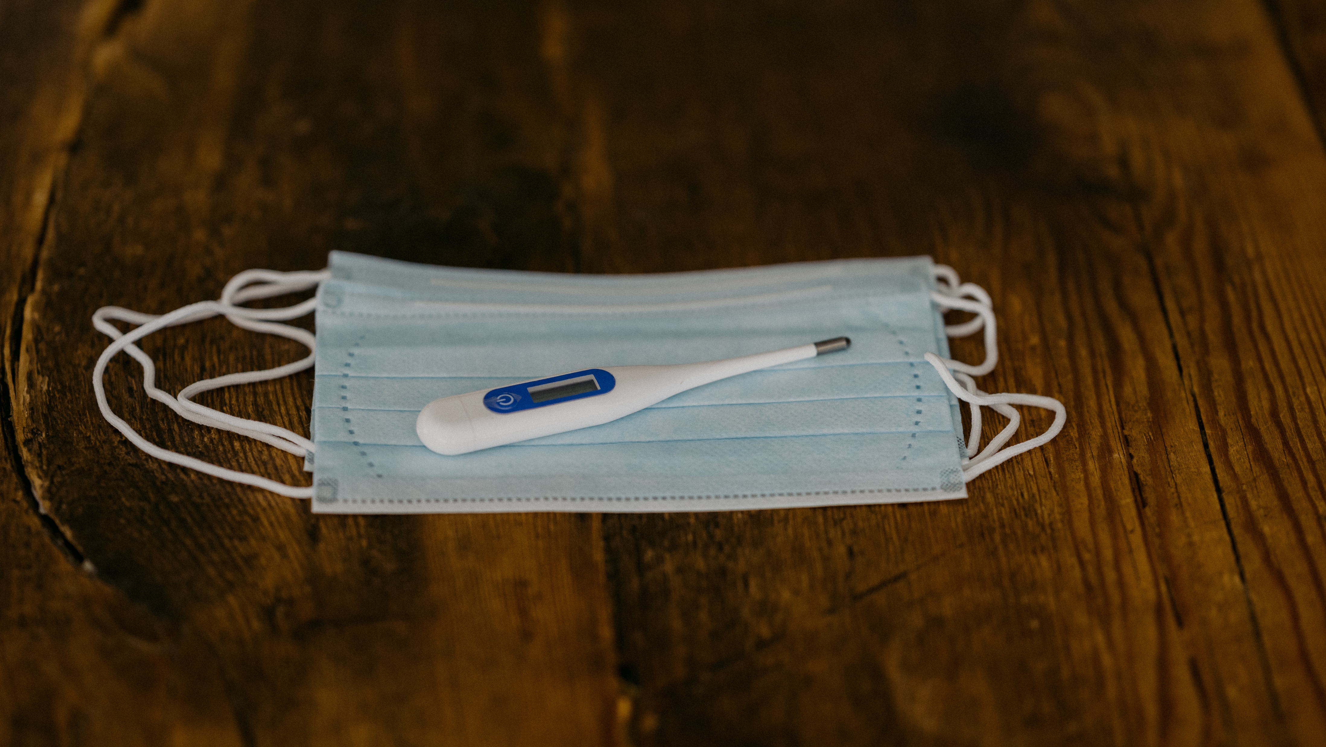
Daily Self-Screening
BASIC EMPLOYEE COVID AWARENESS | 12

Slide 13
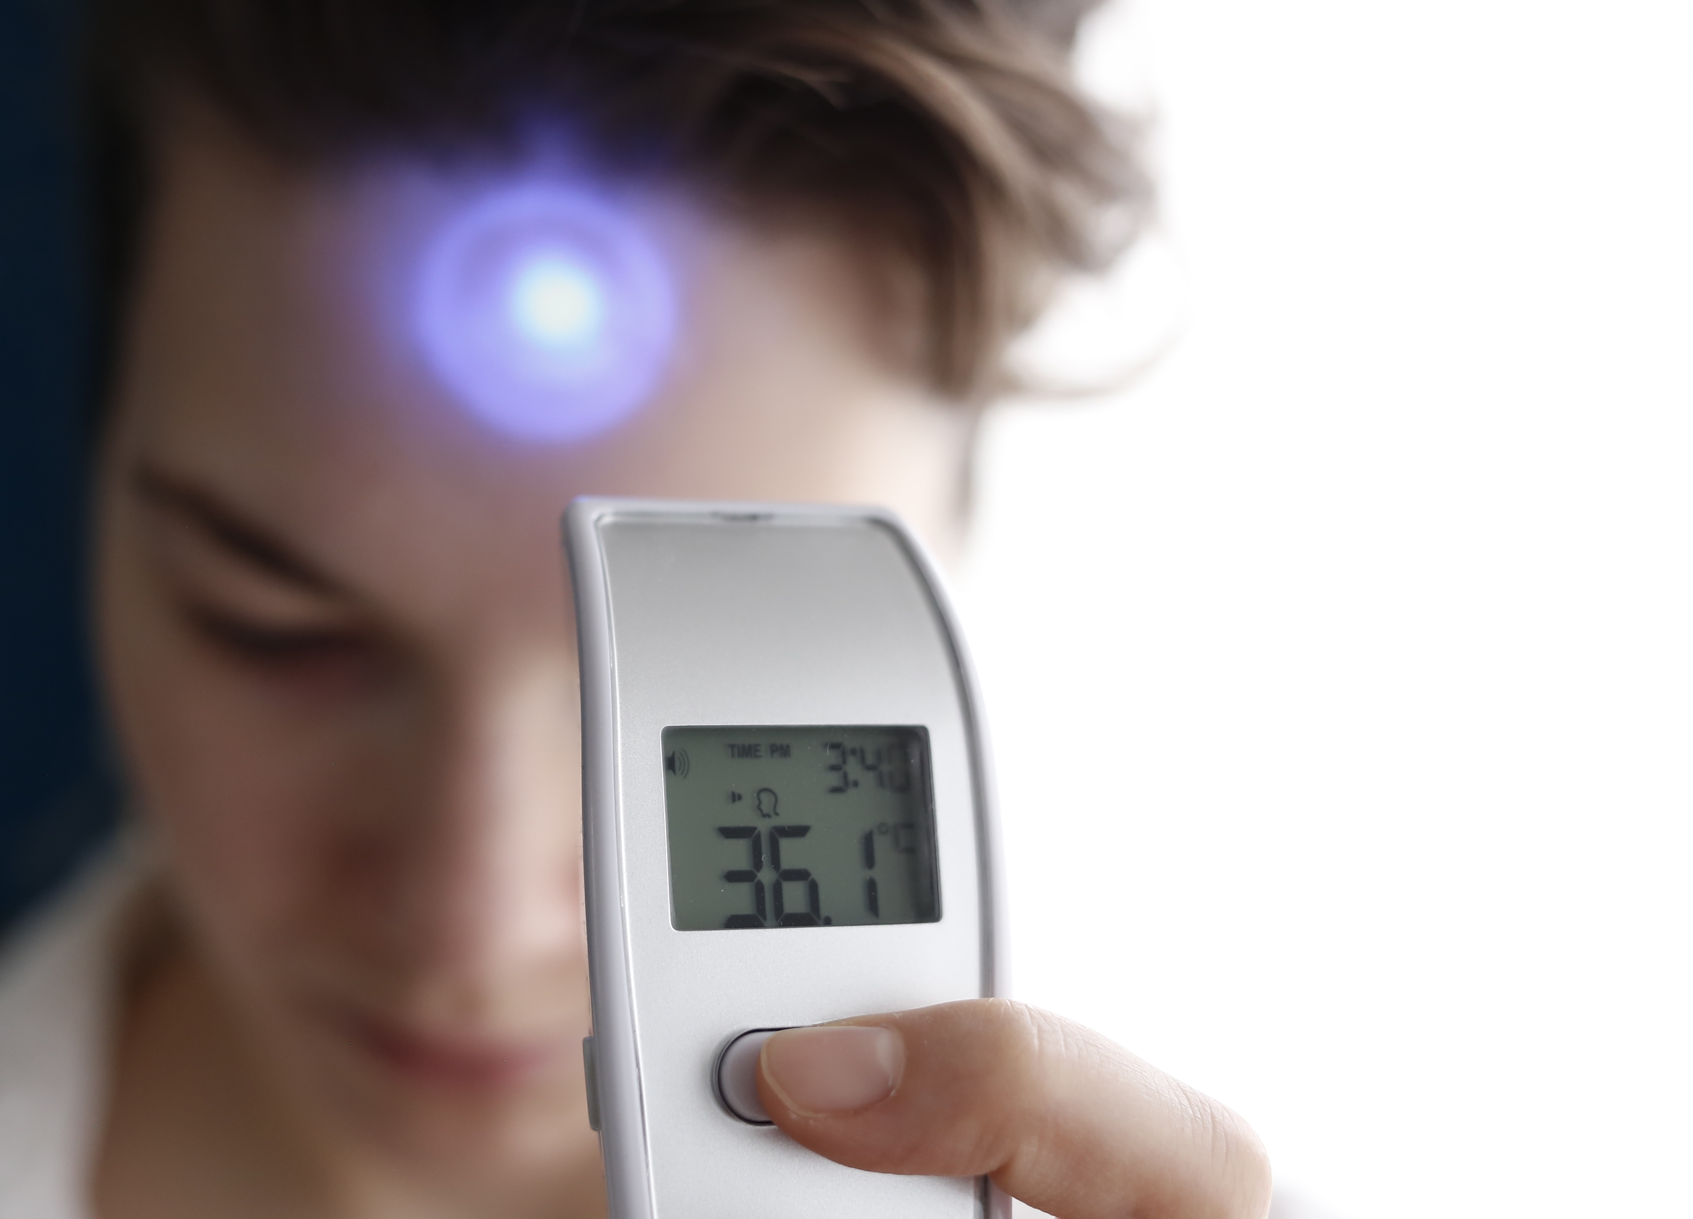
COVID-19 Protective Measures
Daily Self-Screening
Complete this daily self-screening assessment before coming to work
BASIC EMPLOYEE COVID AWARENESS | 13

Slide 14

2 meters
Daily Self-Screening
Complete this daily self-screening assessment before coming to work
Do one or more of the following common
COVID-19 symptoms
below currently apply
to you?
BASIC EMPLOYEE COVID AWARENESS | 14

Slide 15
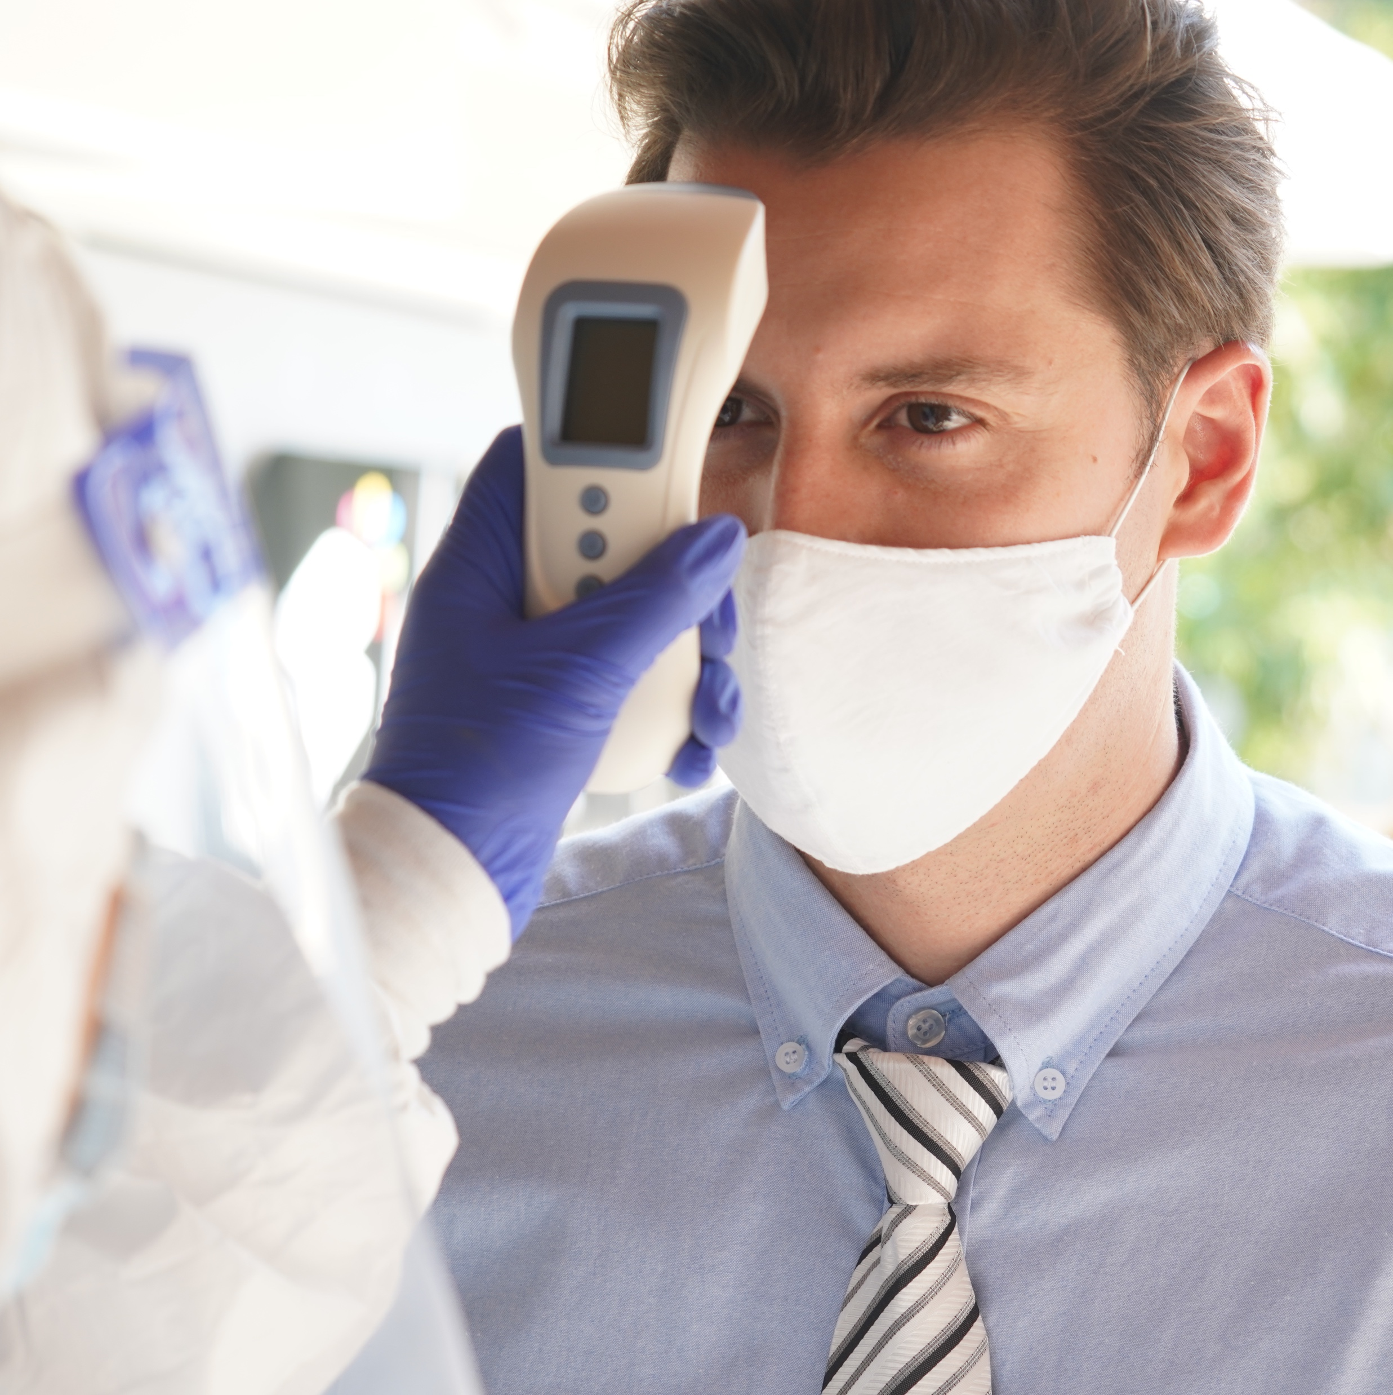
2 meters
Daily Self-Screening
Complete this daily self-screening assessment before coming to work
Temperature >38°C (100.4°F) or higher
Do one or more of the following common
COVID-19 symptoms
below currently apply
to you?
BASIC EMPLOYEE COVID AWARENESS | 15

Slide 16
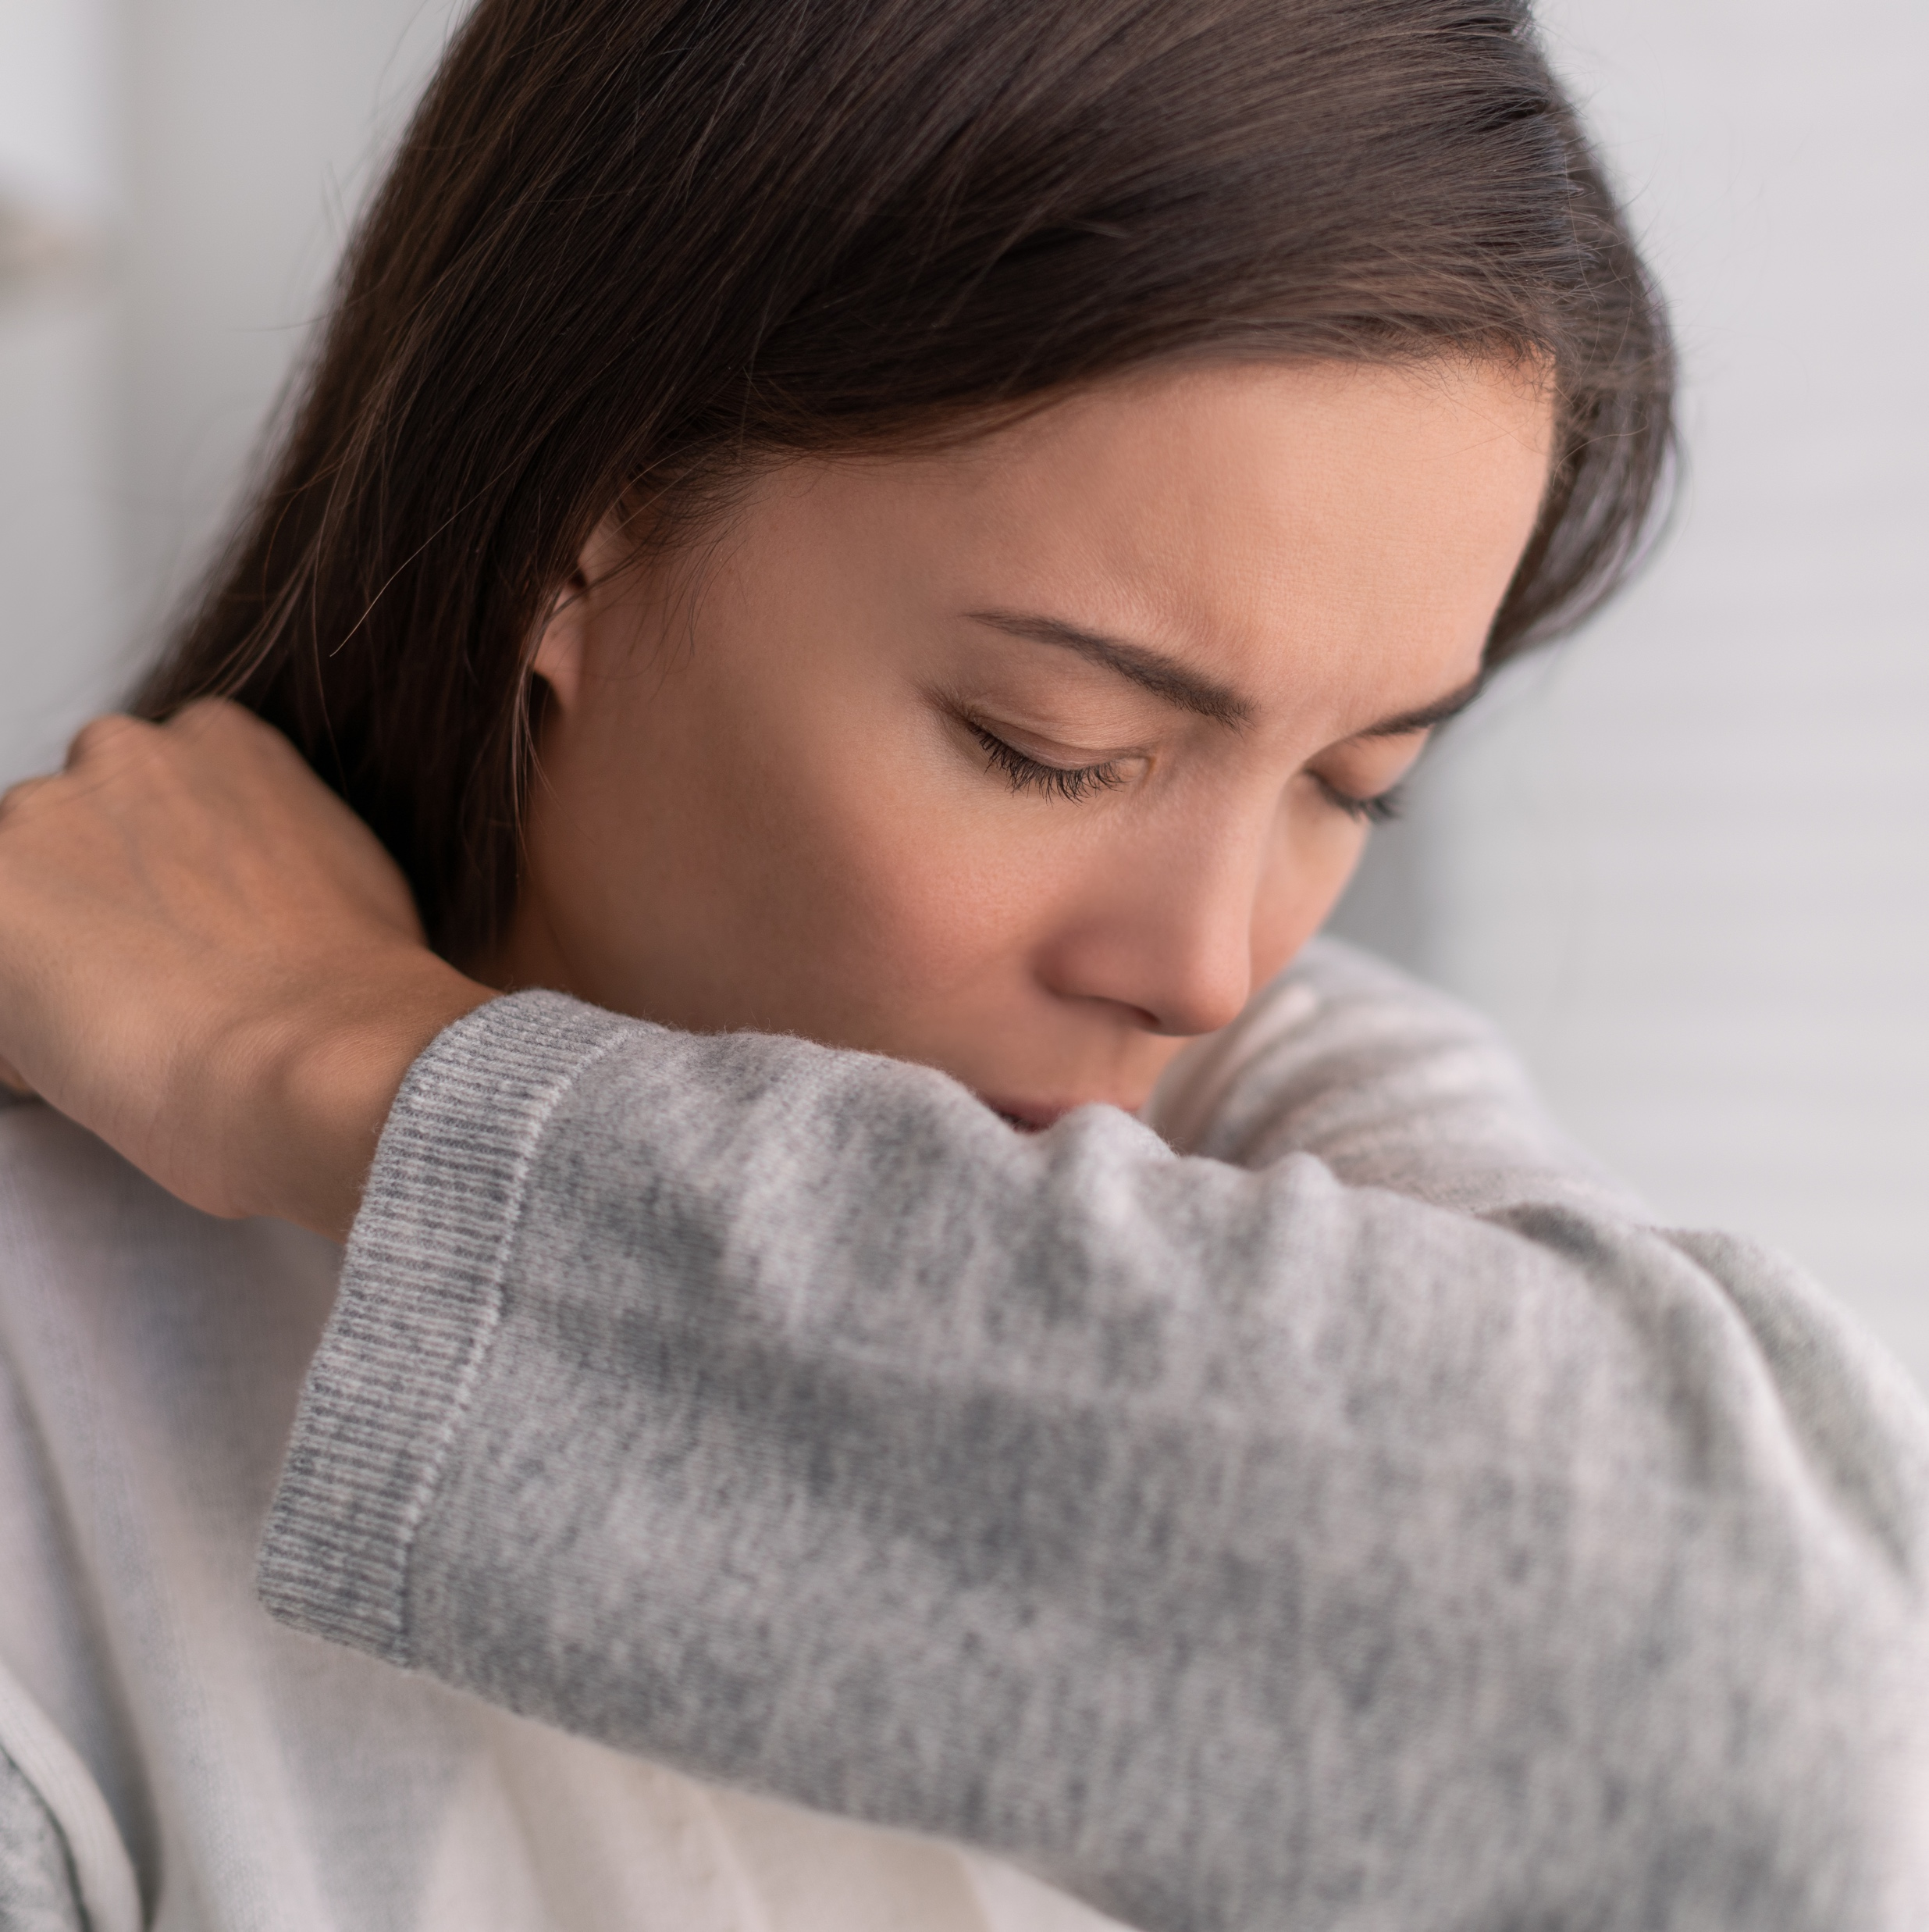
2 meters
Daily Self-Screening
Complete this daily self-screening assessment before coming to work
Temperature >38°C (100.4°F) or higher
Frequent unexplained cough
Do one or more of the following common
COVID-19 symptoms
below currently apply
to you?
BASIC EMPLOYEE COVID AWARENESS | 16

Slide 17
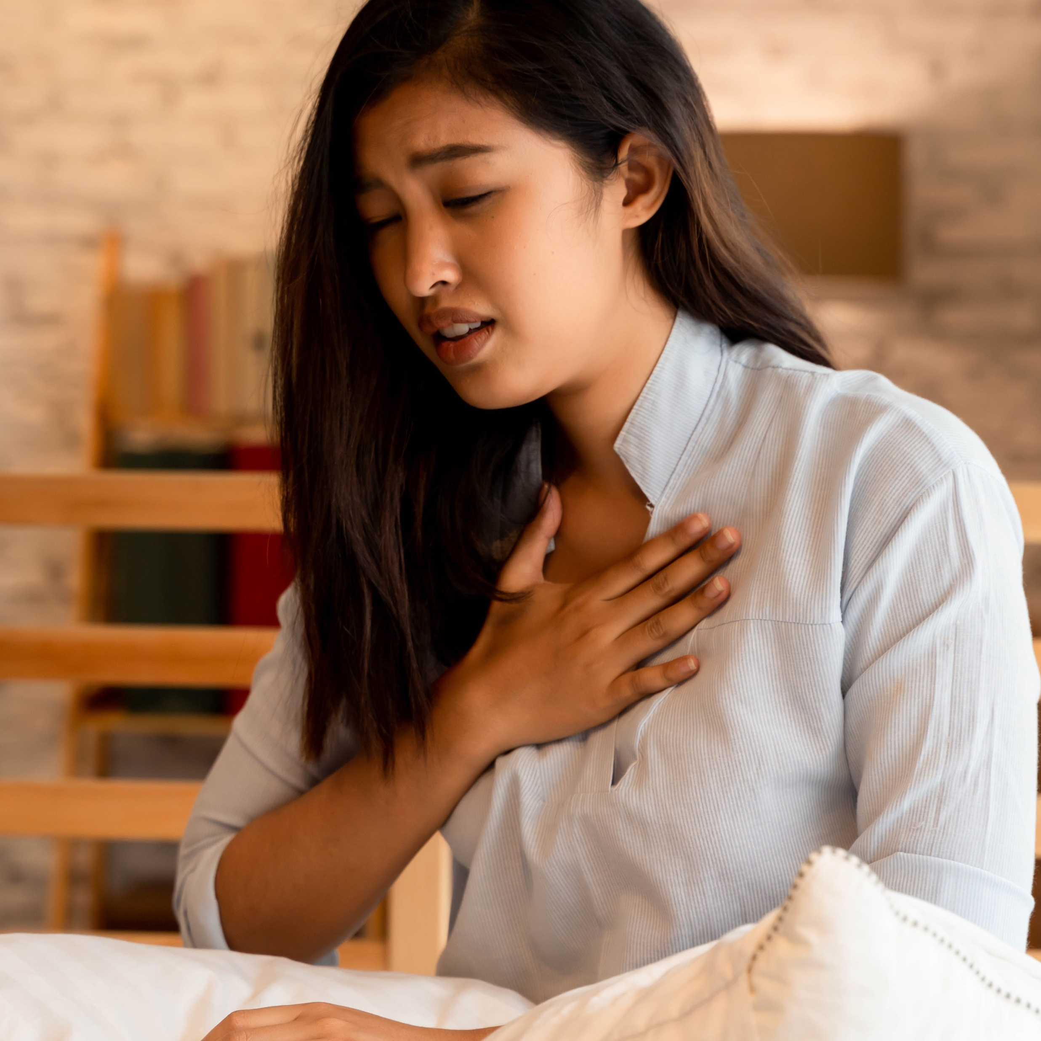
2 meters
Daily Self-Screening
Complete this daily self-screening assessment before coming to work
Temperature >38°C (100.4°F) or higher
Frequent unexplained cough
Unexplained shortness of breath or difficulty breathing
Do one or more of the following common
COVID-19 symptoms
below currently apply
to you?
BASIC EMPLOYEE COVID AWARENESS | 17

Slide 18
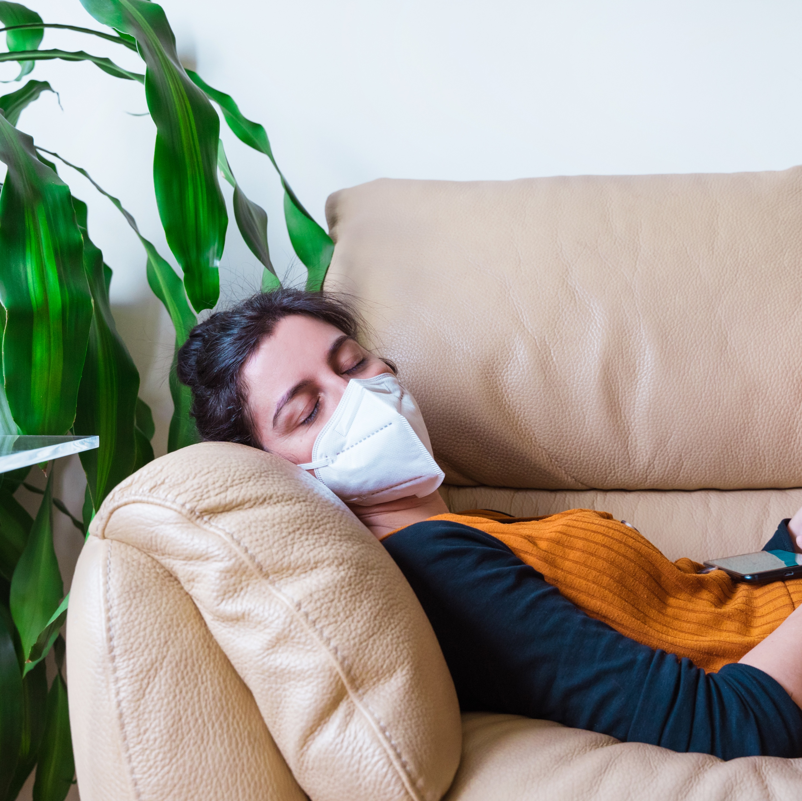
2 meters
Daily Self-Screening
Complete this daily self-screening assessment before coming to work
Temperature >38°C (100.4°F) or higher
Frequent unexplained cough
Unexplained shortness of breath or difficulty breathing
Unexplained tiredness
Do one or more of the following common
COVID-19 symptoms
below currently apply
to you?
BASIC EMPLOYEE COVID AWARENESS | 18

Slide 19


2 meters
Daily Self-Screening
Complete this daily self-screening assessment before coming to work
If the answer is YES, you may
have symptoms of COVID-19.
Temperature >38°C (100.4°F) or higher
Frequent unexplained cough
Unexplained shortness of breath or difficulty breathing
Unexplained tiredness
Do one or more of the following common
COVID-19 symptoms
below currently apply
to you?
We ask you to please seek medical attention, contact your Human Resources representative, and remain off company property for 14 days.
BASIC EMPLOYEE COVID AWARENESS | 19

Slide 20
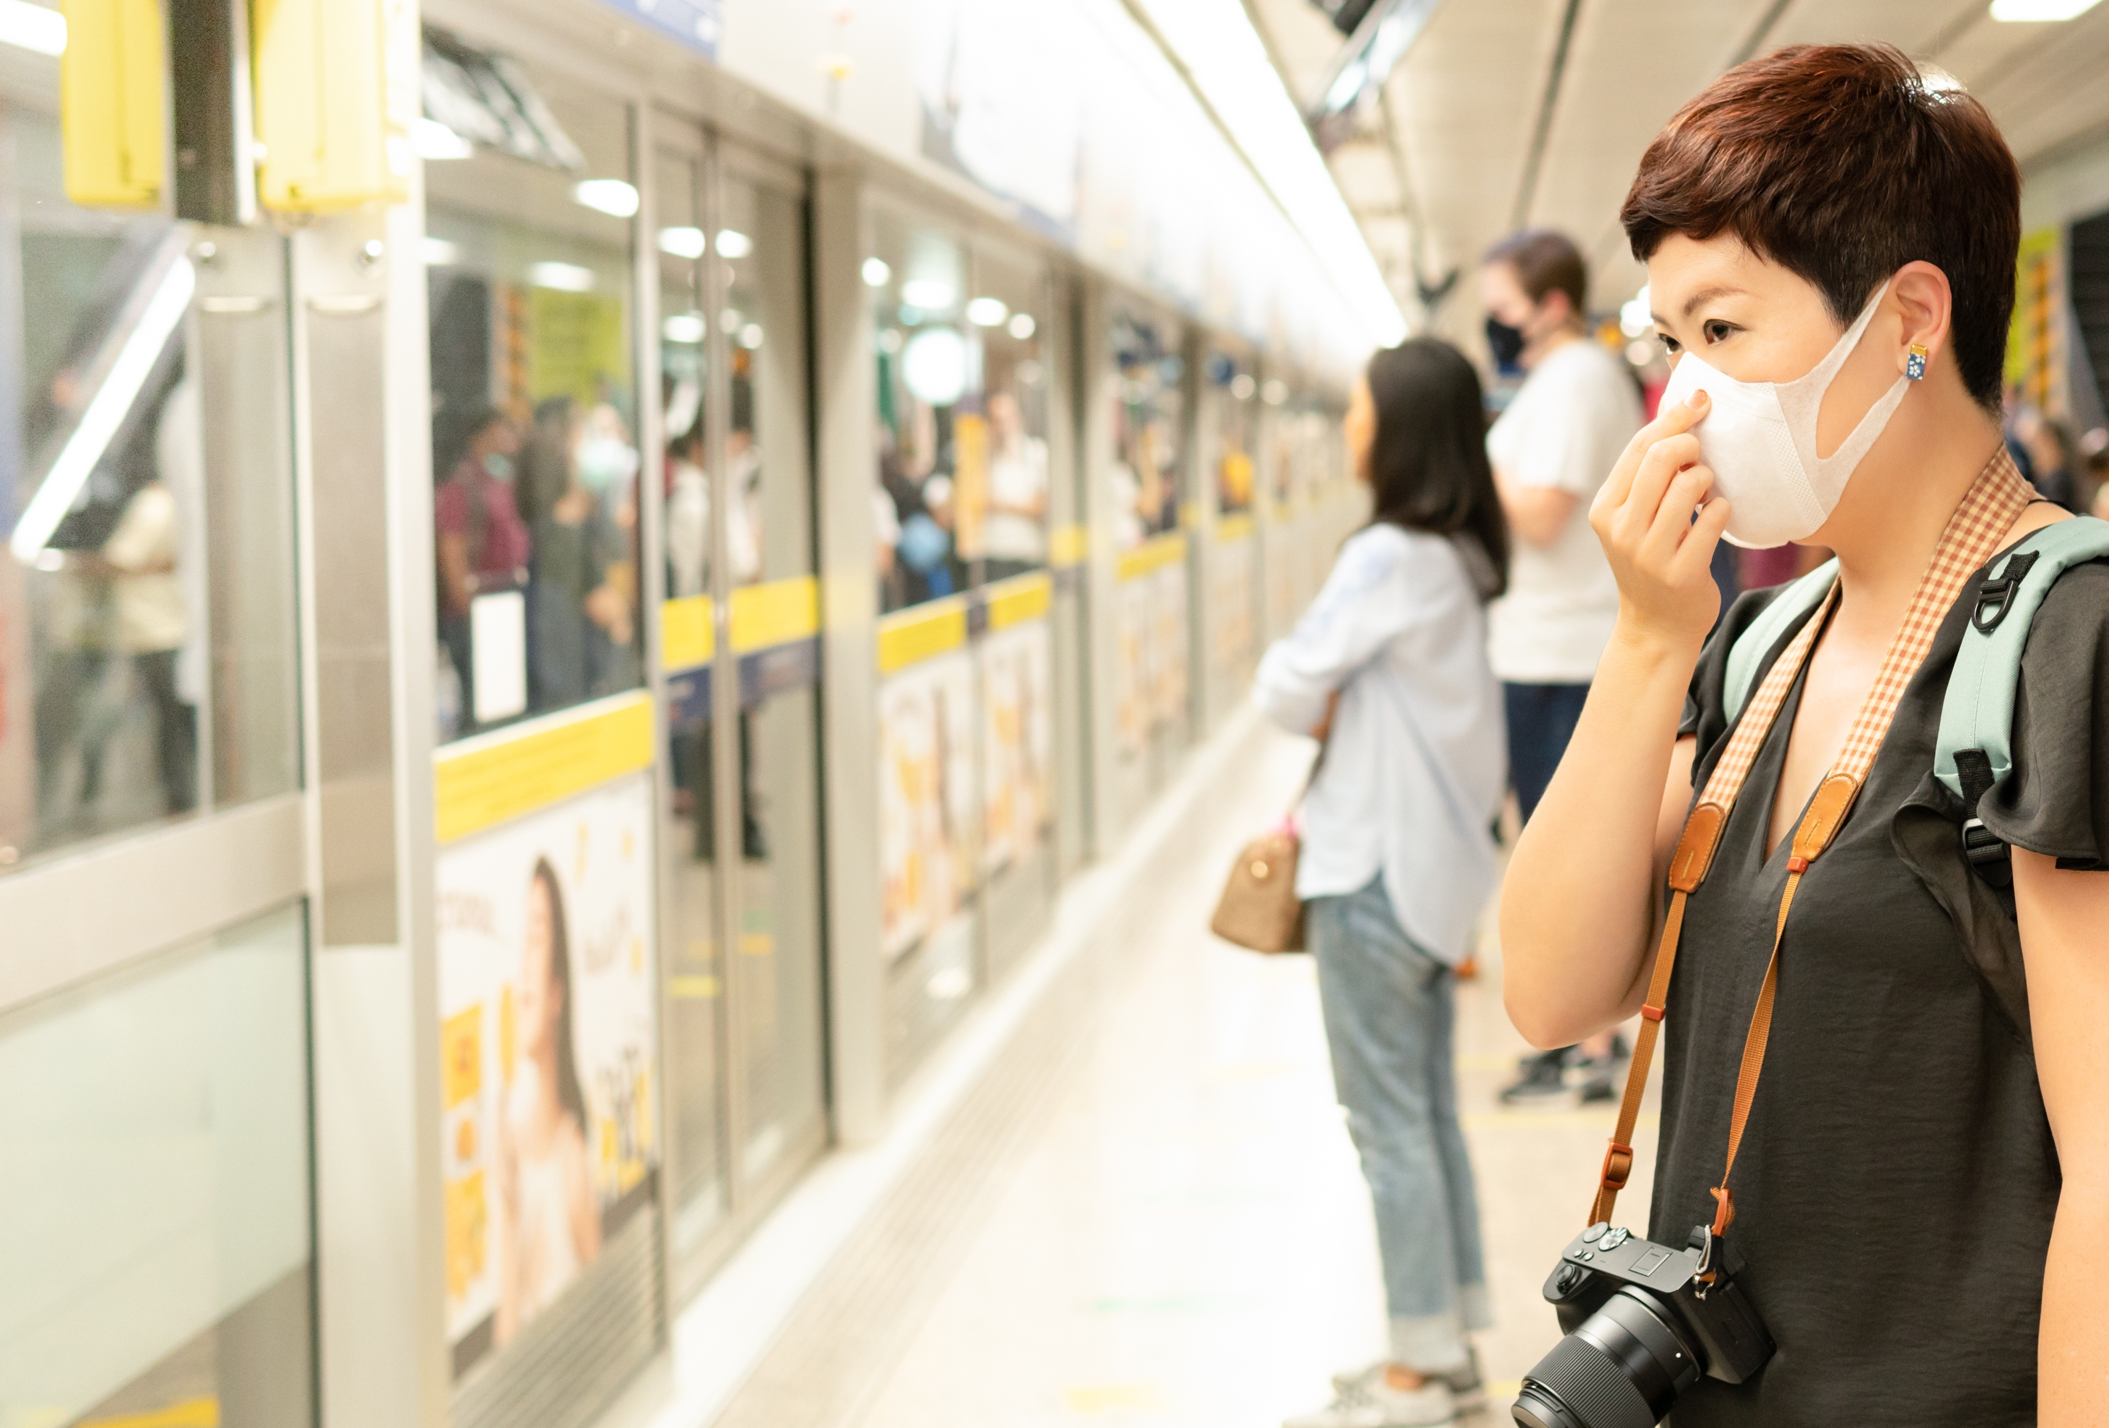
Daily Self-Screening
Complete this daily self-screening assessment
before coming to work
Daily Self-Screening
Complete this daily self-screening assessment before coming to work
Have you had physical exposure to a person suffering from Coronavirus symptoms?
BASIC EMPLOYEE COVID AWARENESS | 20

Slide 21

Daily Self-Screening
Complete this daily self-screening assessment
before coming to work
Daily Self-Screening
Complete this daily self-screening assessment before coming to work
Have you had physical exposure to a person suffering from Coronavirus symptoms?
If the answer is YES,
please contact Human Resources prior to coming to work so that a determination can be made whether you should remain off-Site from our Company Facility for 14 days following the last potential exposure to the COVID-19 virus.
BASIC EMPLOYEE COVID AWARENESS | 21

Slide 22
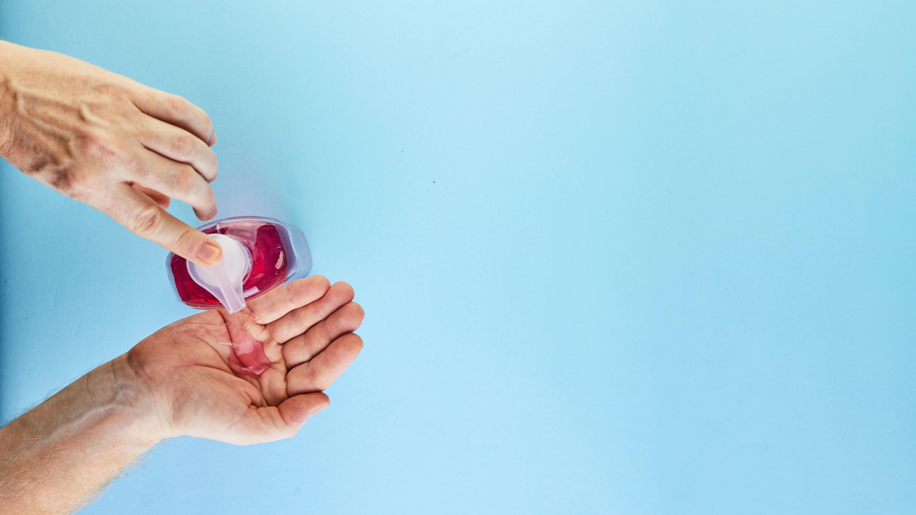
Personal
Hygiene Tips
BASIC EMPLOYEE COVID AWARENESS | 22

Slide 23


Personal Hygiene Tips
Wash your hands frequently with soap and water for at least 20 seconds
BASIC EMPLOYEE COVID AWARENESS | 23

Slide 24

Personal Hygiene Tips
Wash your hands frequently with soap and water for at least 20 seconds | If you are unable to wash your hands with soap and water, use antibacterial gel with at least 70% alcohol
BASIC EMPLOYEE COVID AWARENESS | 24

Slide 25

Personal Hygiene Tips
Wash your hands frequently with soap and water for at least 20 seconds | If you are unable to wash your hands with soap and water, use antibacterial gel with at least 70% alcohol | When sneezing or coughing, cover your nose and mouth with the inner angle or your arm or use a disposable handkerchief
BASIC EMPLOYEE COVID AWARENESS | 25

Slide 26

Re-Opening Safely – the Framework
Personal Hygiene Tips
Wash your hands frequently with soap and water for at least 20 seconds | If you are unable to wash your hands with soap and water, use antibacterial gel with at least 70% alcohol | When sneezing or coughing, cover your nose and mouth with the inner angle or your arm or use a disposable handkerchief | Don’t touch your face, including your mouth, ears, eyes and nose
BASIC EMPLOYEE COVID AWARENESS | 26

Slide 27





Social
Distancing
Tips
BASIC EMPLOYEE COVID AWARENESS | 27

Slide 28


Social Distancing
Tips
BASIC EMPLOYEE COVID AWARENESS | 28

Slide 29


Keep a distance of 2 meters
(6 feet) between people
Social Distancing
Tips
BASIC EMPLOYEE COVID AWARENESS | 29

Slide 30

Keep a distance of 2 meters
(6 feet) between people
Avoid physical contacts such as hand greetings, kissing and hugging
Social Distancing
Tips
BASIC EMPLOYEE COVID AWARENESS | 30

Slide 31

Keep a distance of 2 meters
(6 feet) between people
Avoid physical contacts such as hand greetings, kissing and hugging
Social Distancing
Tips
Avoid contact with
anyone who is sick
BASIC EMPLOYEE COVID AWARENESS | 31

Slide 32

Keep a distance of 2 meters
(6 feet) between people
Avoid physical contacts such as hand greetings, kissing and hugging
Social Distancing
Tips
Avoid going to crowded places, and if it is inevitable, don’t take minors or older people with you
Avoid contact with
anyone who is sick
BASIC EMPLOYEE COVID AWARENESS | 32

Slide 33
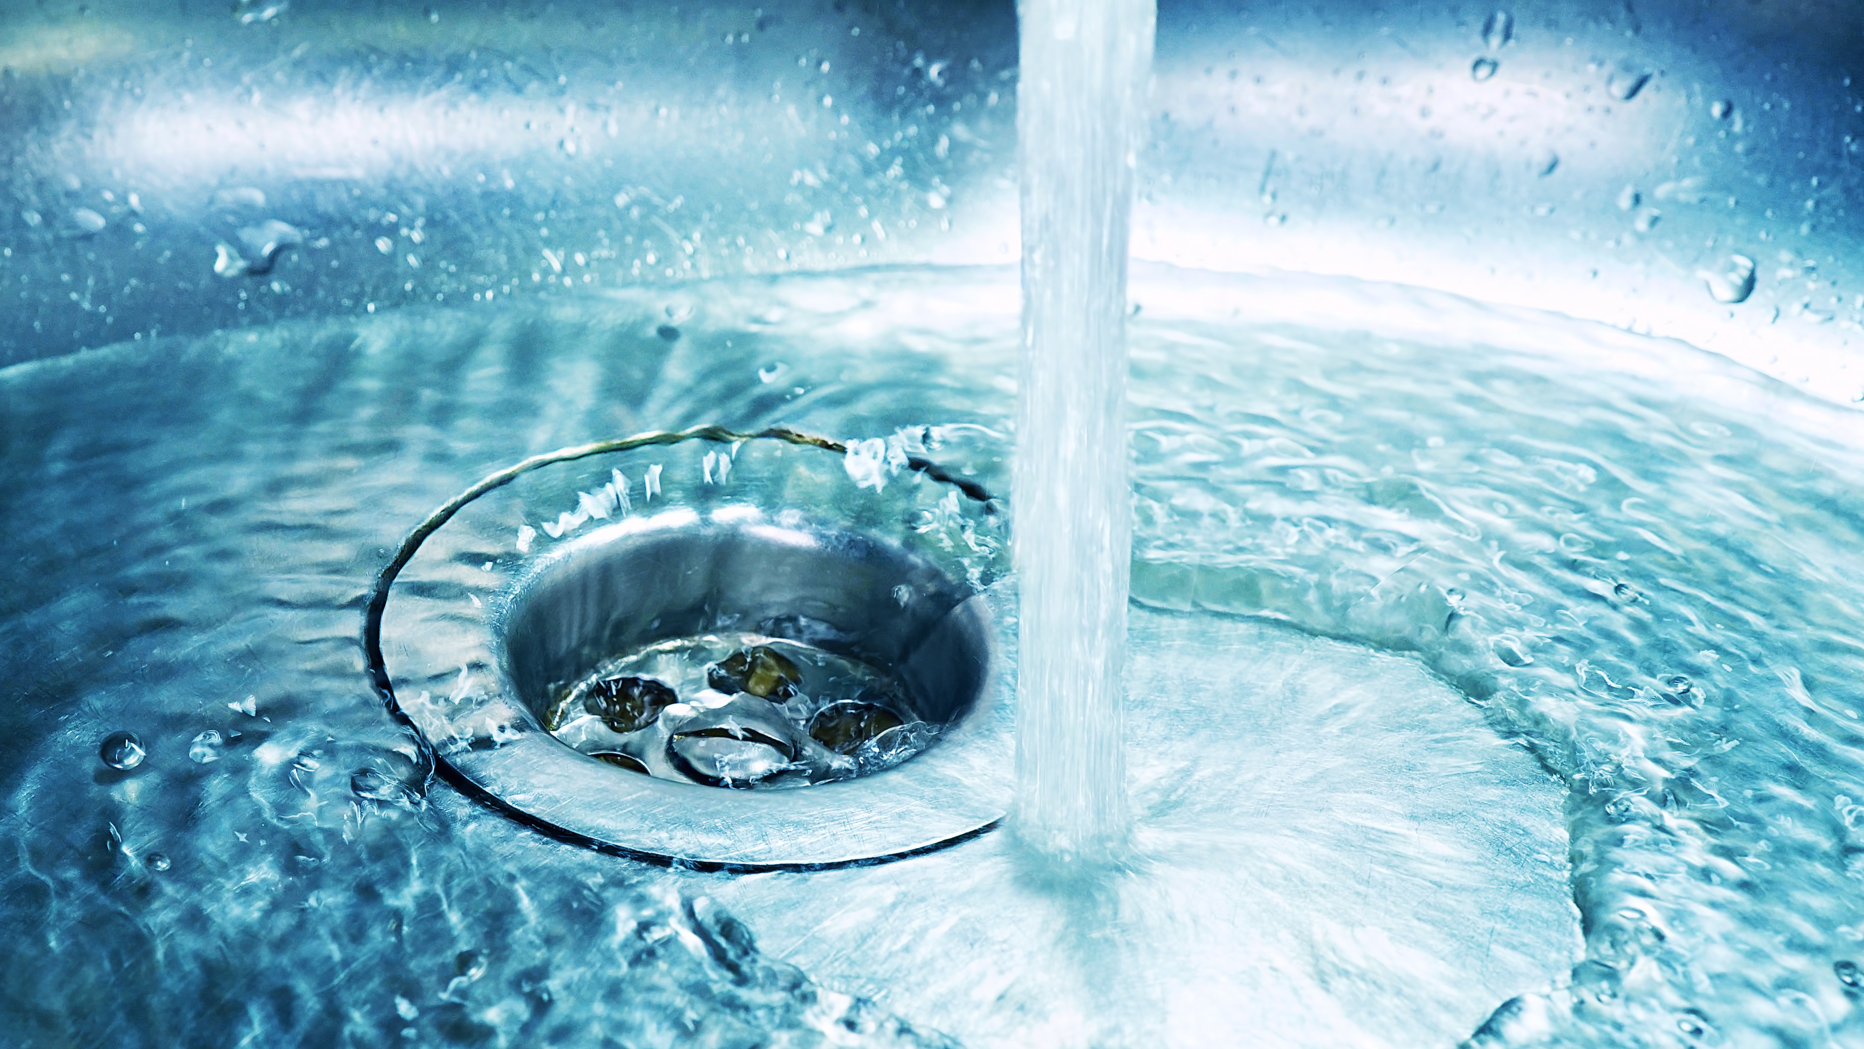
Hand Washing
Instructions
BASIC EMPLOYEE COVID AWARENESS | 33

Slide 34

Daily Self-Screening
Complete this daily self-screening assessment before coming to work
Hand Washing Instructions
Wet hands with water and enough soap to cover all surfaces
BASIC EMPLOYEE COVID AWARENESS | 34

Slide 35

Hand Washing Instructions
Wet hands with water and enough soap to cover all surfaces | Rub hands palm to palm, also with fingers interlaced for 20 seconds
BASIC EMPLOYEE COVID AWARENESS | 35

Slide 36

Hand Washing Instructions
Wet hands with water and enough soap to cover all surfaces | Rub hands palm to palm, also with fingers interlaced for 20 seconds | Rinse hands with running water
BASIC EMPLOYEE COVID AWARENESS | 36

Slide 37

Hand Washing Instructions
Wet hands with water and enough soap to cover all surfaces | Rub hands palm to palm, also with fingers interlaced for 20 seconds | Rinse hands with running water | Dry your hands thoroughly with a single use towel
BASIC EMPLOYEE COVID AWARENESS | 37

Slide 38
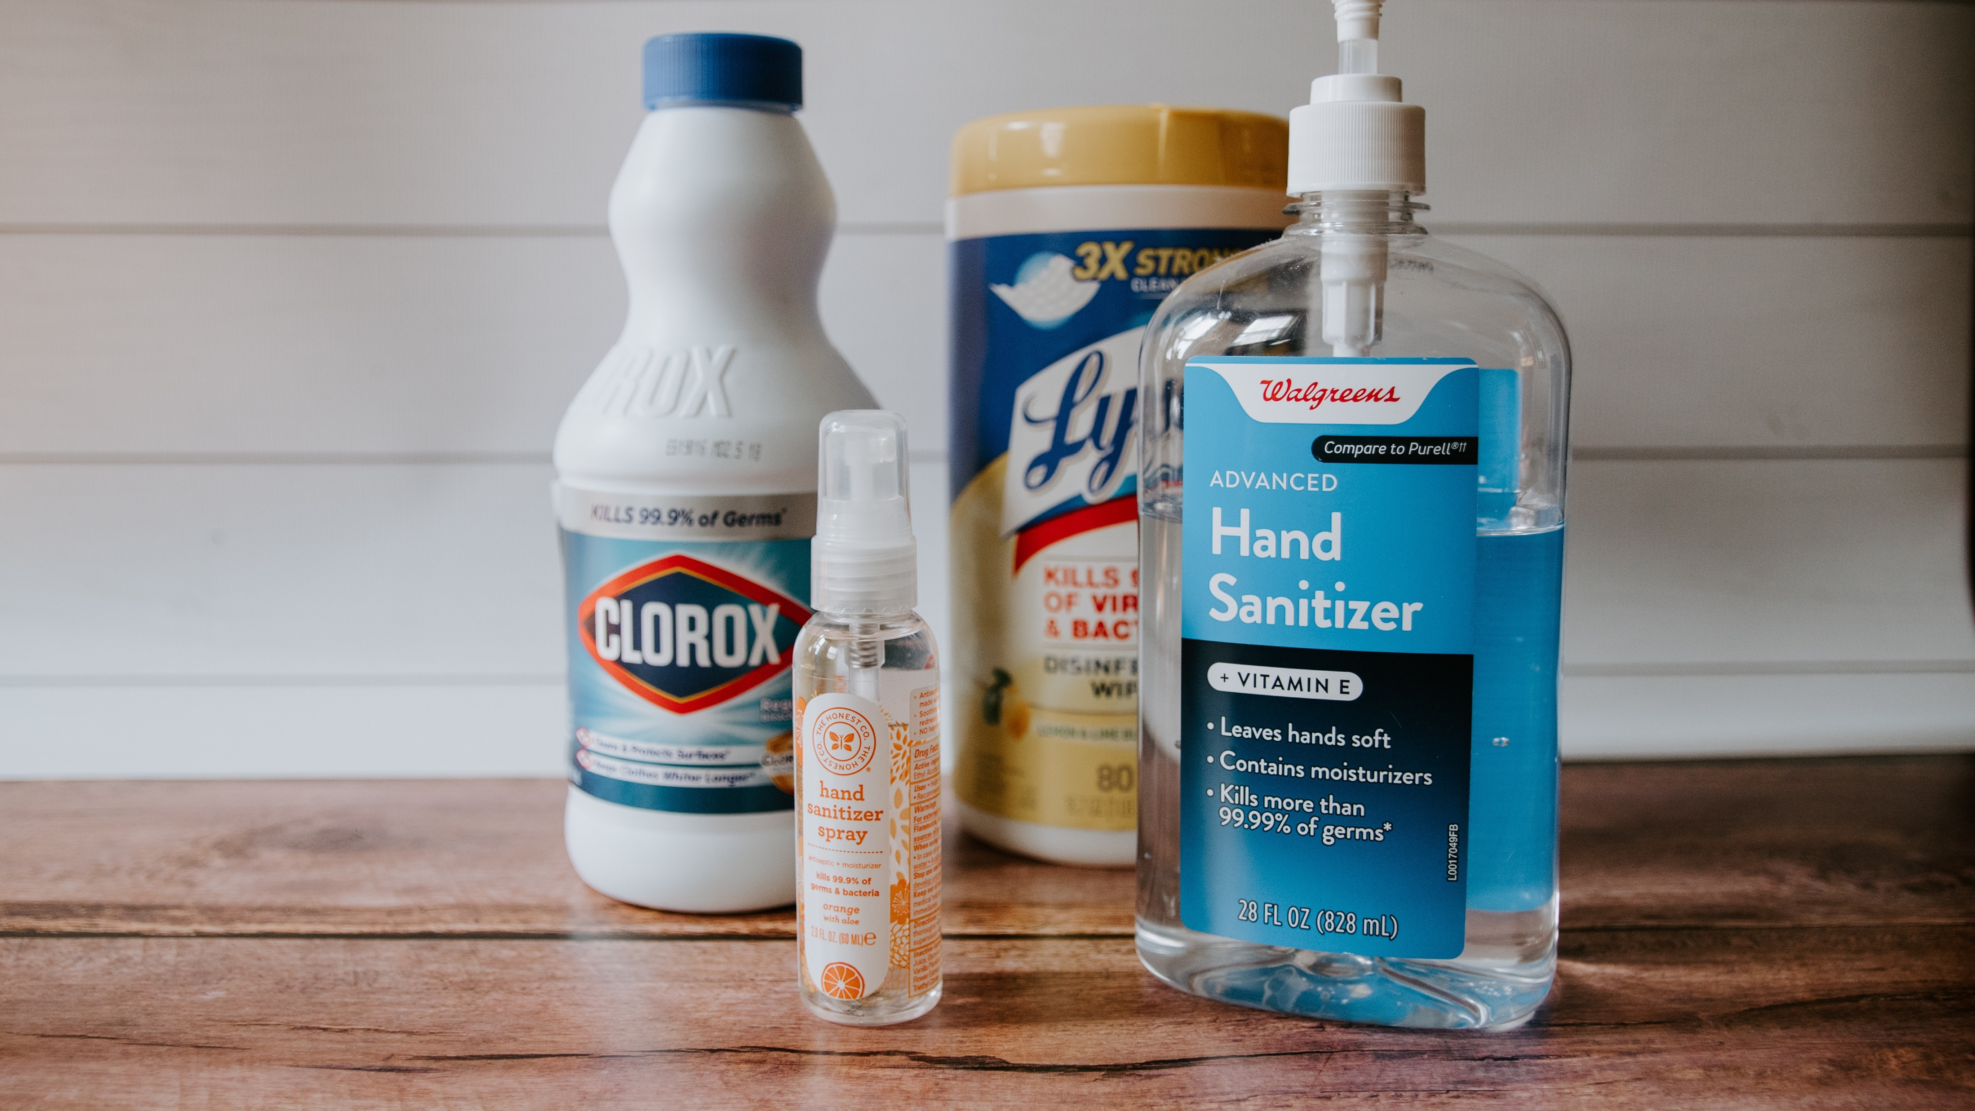
Sanitize and
Disinfection
BASIC EMPLOYEE COVID AWARENESS | 38

Slide 39
Sanitize and Disinfection
Providers or employees should sanitize
and disinfect all areas of the Site with
special attention to:
BASIC EMPLOYEE COVID AWARENESS | 39

Slide 40
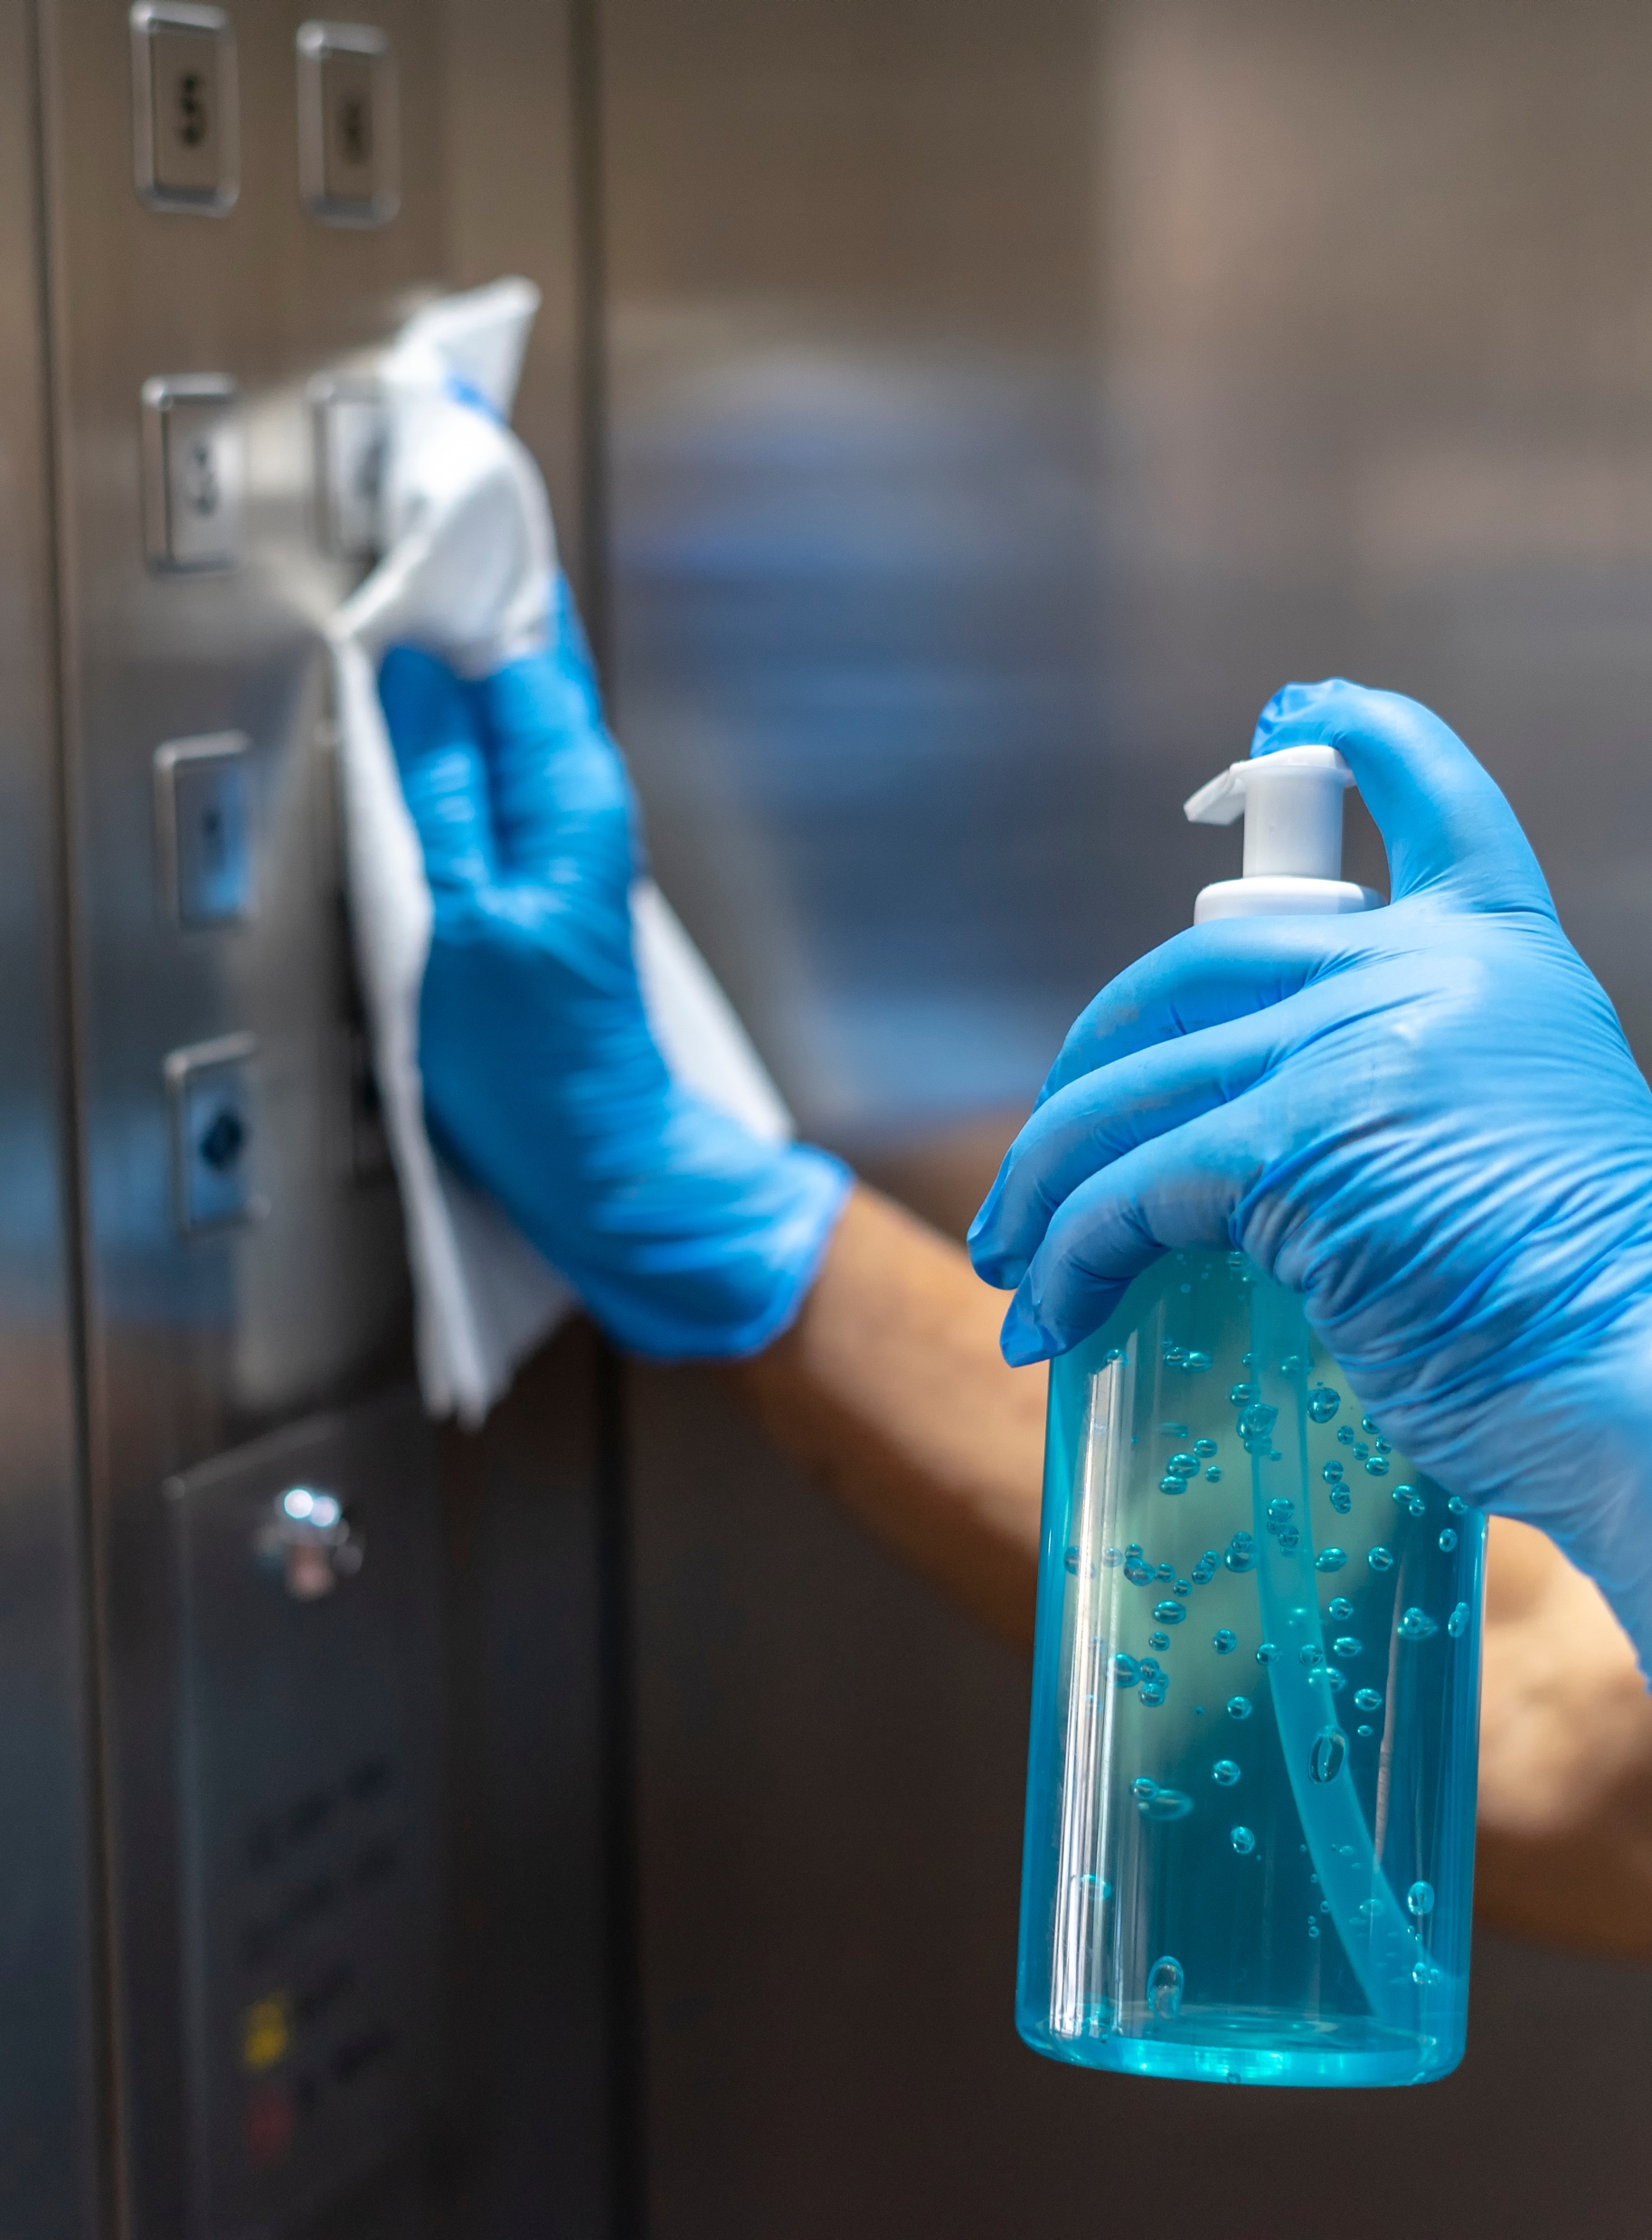

1 |  | Door handles and Elevator buttons
Sanitize and Disinfection
Providers or employees should sanitize
and disinfect all areas of the Site with
special attention to:
BASIC EMPLOYEE COVID AWARENESS | 40

Slide 41


2 meters
1 |  | Door handles and Elevator buttons
2 |  | Workstations, Equipment and Tools
Sanitize and Disinfection
Providers or employees should sanitize
and disinfect all areas of the Site with
special attention to:
BASIC EMPLOYEE COVID AWARENESS | 41

Slide 42
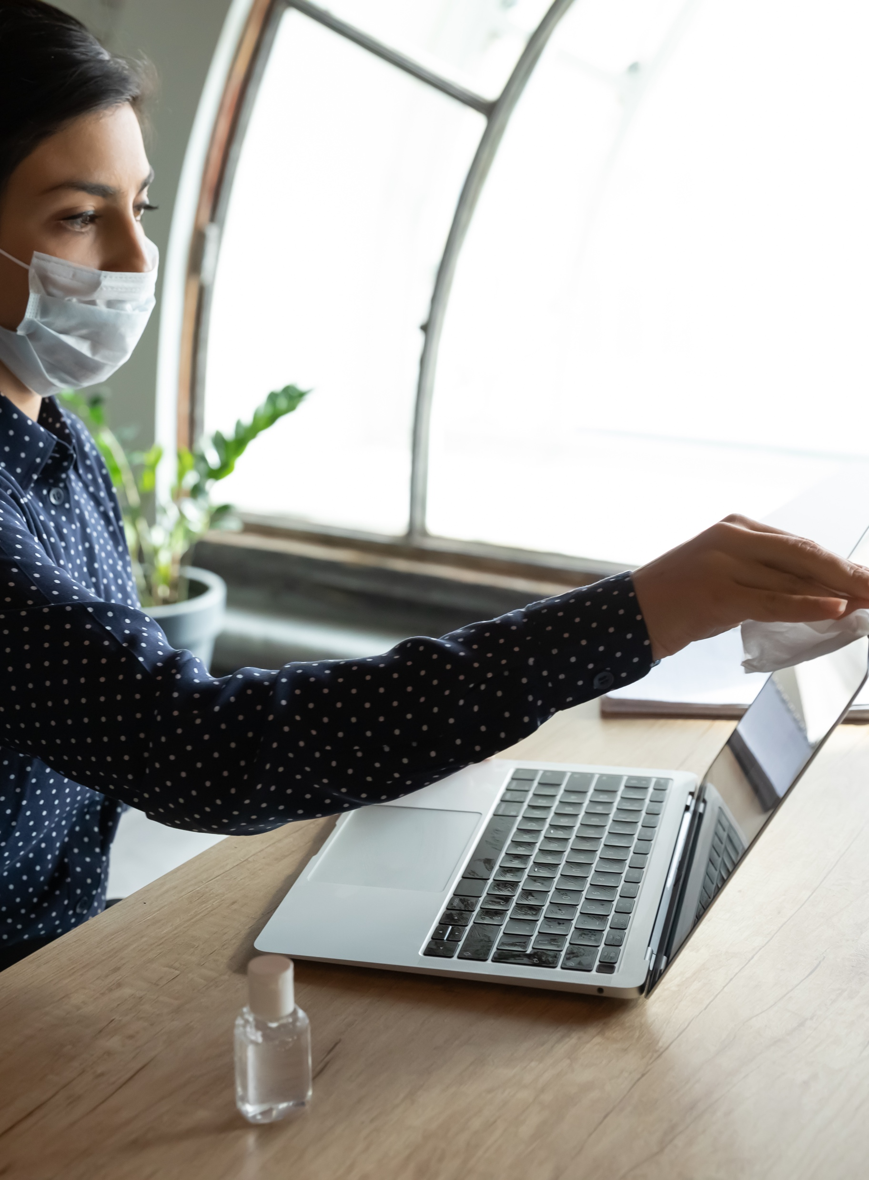

2 meters
1 |  | Door handles and Elevator buttons
2 |  | Workstations, Equipment and Tools
3 |  | Screens, Buttons and Doorknobs
Sanitize and Disinfection
Providers or employees should sanitize
and disinfect all areas of the Site with
special attention to:
BASIC EMPLOYEE COVID AWARENESS | 42

Slide 43
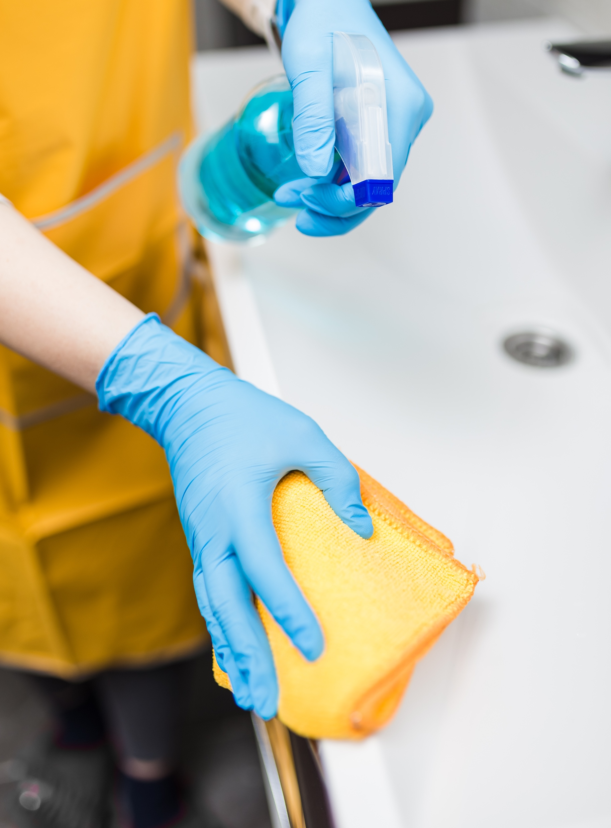

2 meters
1 |  | Door handles and Elevator buttons
2 |  | Workstations, Equipment and Tools
3 |  | Screens, Buttons and Doorknobs
4 |  | Restrooms
Sanitize and Disinfection
Providers or employees should sanitize
and disinfect all areas of the Site with
special attention to:
BASIC EMPLOYEE COVID AWARENESS | 43

Slide 44
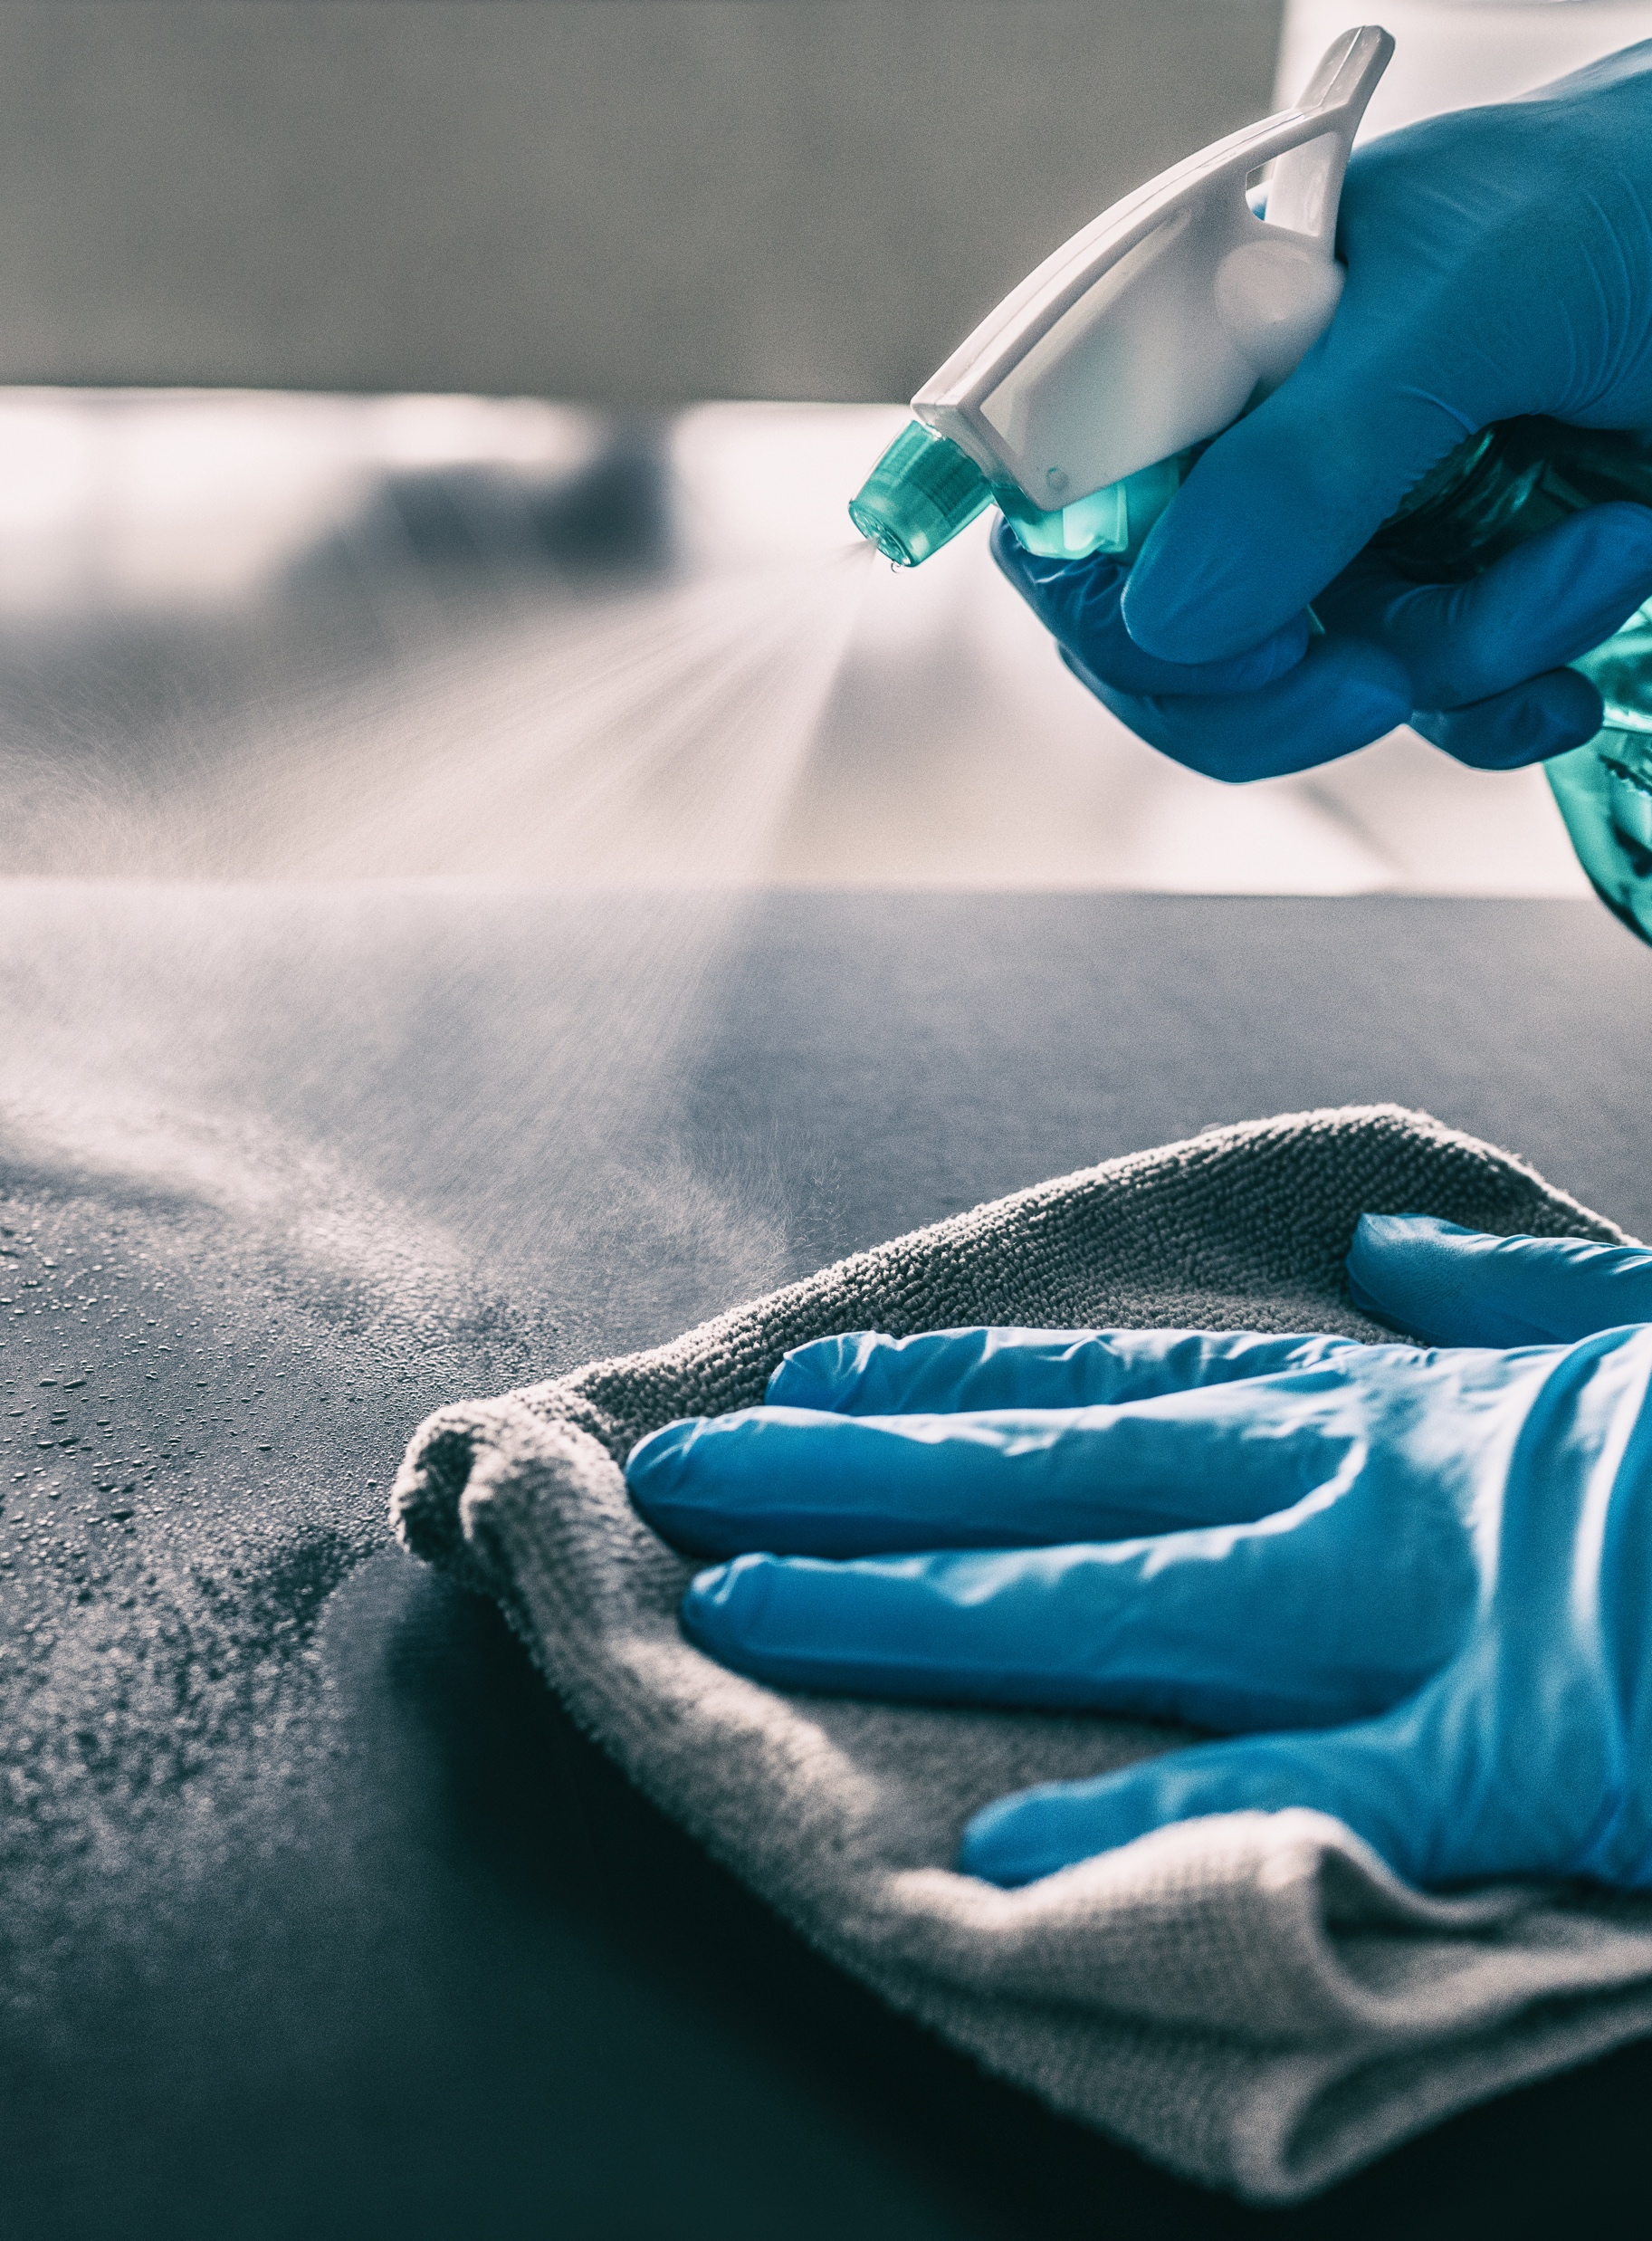

2 meters
1 |  | Door handles and Elevator buttons
2 |  | Workstations, Equipment and Tools
3 |  | Screens, Buttons and Doorknobs
4 |  | Restrooms
5 |  | Kitchens/Cafeterias
Sanitize and Disinfection
Providers or employees should sanitize
and disinfect all areas of the Site with
special attention to:
BASIC EMPLOYEE COVID AWARENESS | 44

Slide 45
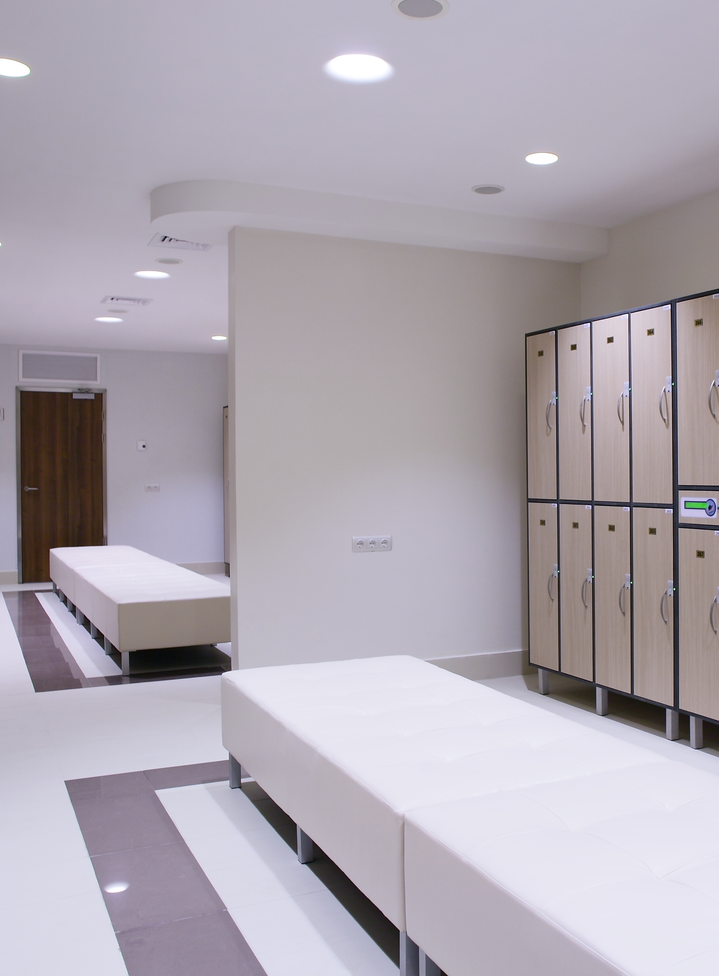

2 meters
1 |  | Door handles and Elevator buttons
2 |  | Workstations, Equipment and Tools
3 |  | Screens, Buttons and Doorknobs
4 |  | Restrooms
5 |  | Kitchens/Cafeterias
6 |  | Change Rooms/Lockers
Sanitize and Disinfection
Providers or employees should sanitize
and disinfect all areas of the Site with
special attention to:
BASIC EMPLOYEE COVID AWARENESS | 45

Slide 46
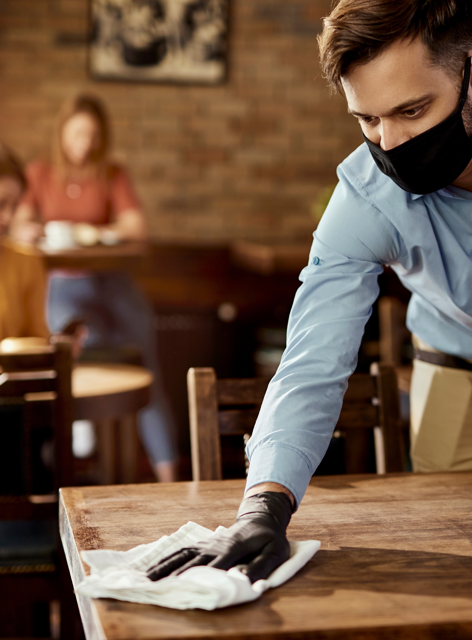
2 meters
1 |  | Door handles and Elevator buttons
2 |  | Workstations, Equipment and Tools
3 |  | Screens, Buttons and Doorknobs
4 |  | Restrooms
5 |  | Kitchens/Cafeterias
6 |  | Change Rooms/Lockers
7 |  | Common surface areas
Sanitize and Disinfection
Providers or employees should sanitize
and disinfect all areas of the Site with
special attention to:
BASIC EMPLOYEE COVID AWARENESS | 46

Slide 47
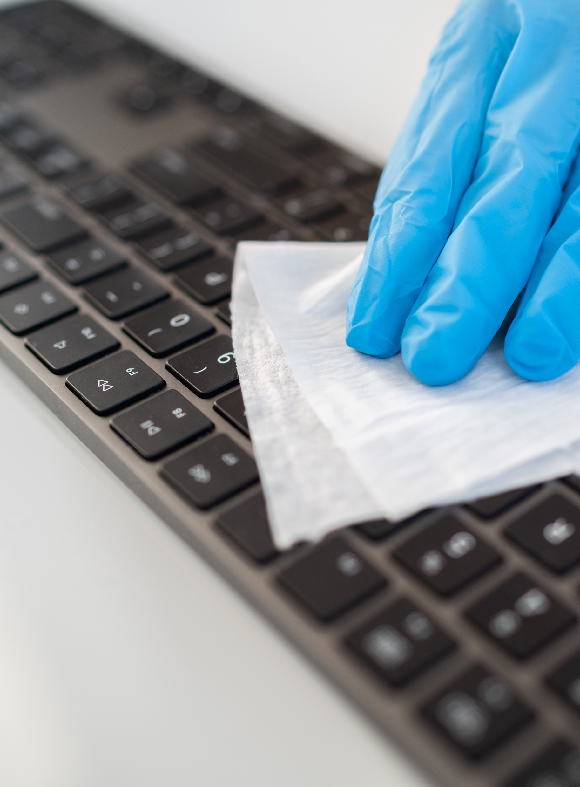

2 meters
1 |  | Door handles and Elevator buttons
2 |  | Workstations, Equipment and Tools
3 |  | Screens, Buttons and Doorknobs
4 |  | Restrooms
5 |  | Kitchens/Cafeterias
6 |  | Change Rooms/Lockers
7 |  | Common surface areas
8 |  | Computer screens and Keyboards
Sanitize and Disinfection
Providers or employees should sanitize
and disinfect all areas of the Site with
special attention to:
BASIC EMPLOYEE COVID AWARENESS | 47

Slide 48
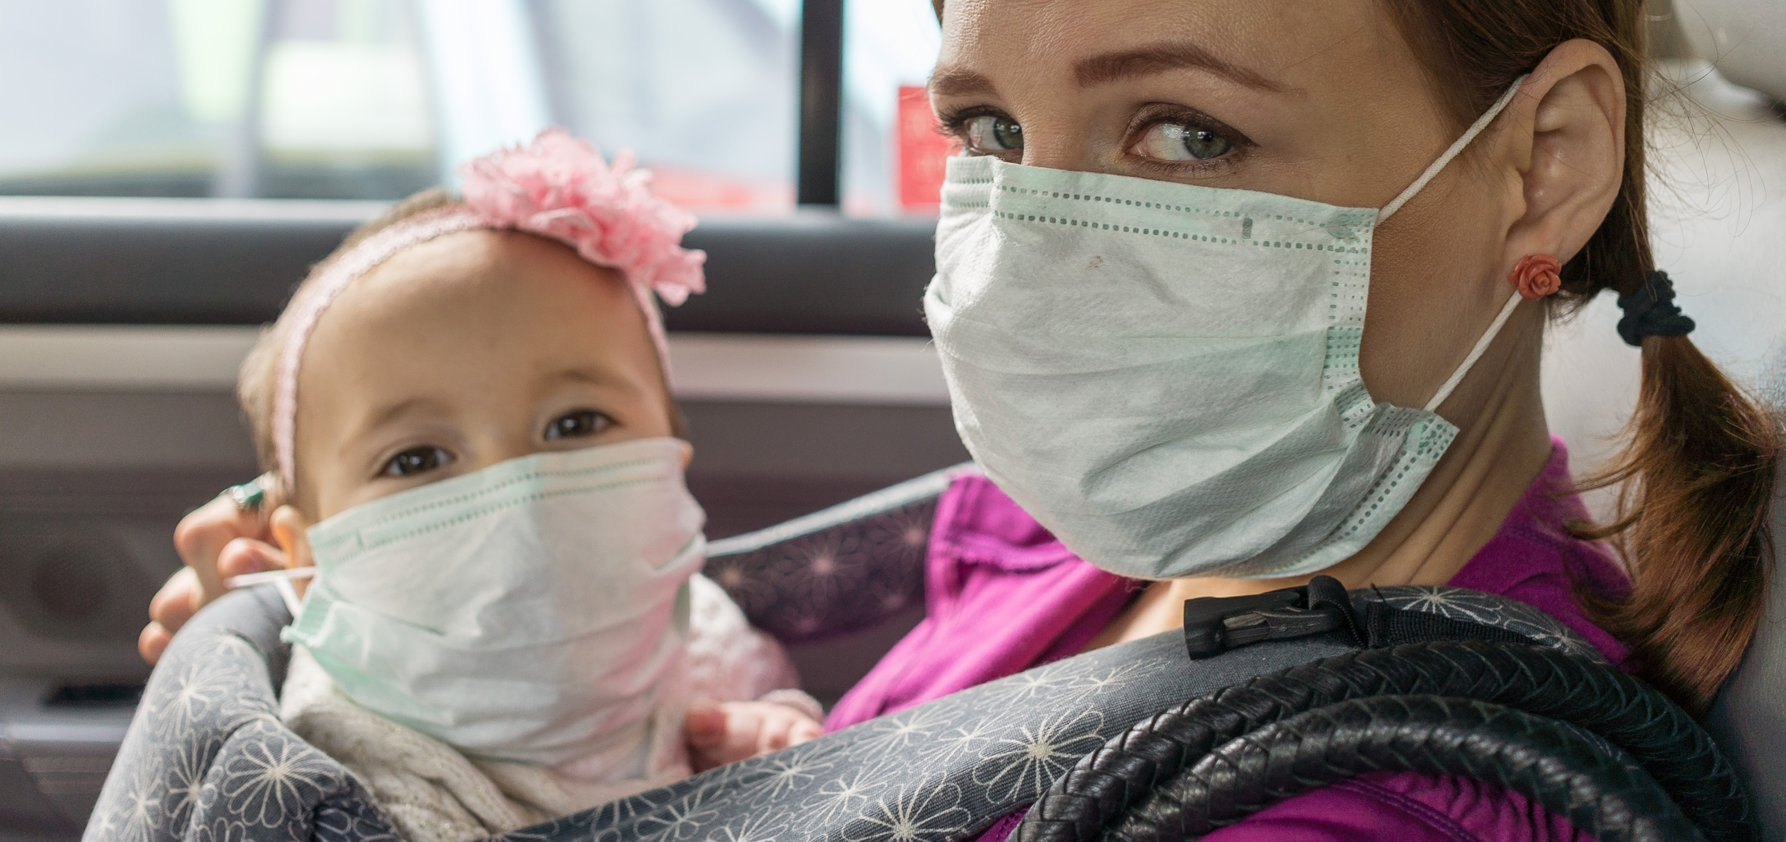
COVID-19 Protective Measures
BASIC EMPLOYEE COVID AWARENESS | 48

Slide 49
Return to Work
Orientation
COVID-19 Protective Measures
Safe operations are critical
to the long-term success of everyone in our company
Compiled and Edited by Akash Kapoor & Gwendolyn DelGuidice
for Akash Kapoor Advisors Inc.
BASIC EMPLOYEE COVID AWARENESS | 49

Slide 50

COVID-19
Protective
Measures
Stay safe!

Slide 51




Contact Information
Local Site Leader email / phone number:
XXXX-1234-1234
Local HR email / phone number:
XXXX-1234-1234
Further Information
Public Health Agency of Canada
https://www.canada.ca/en/public-health/services/diseases/coronavirus-disease-covid-19.html
World Health Organization (WHO)
https://www.who.int/emergencies/diseases/novel-coronavirus-2019
Re-Opening Safely
www.reopeningsafely.ca
www.reopeningsafely.ca

