Slide 1




Re-Opening Safely Playbook
A Summary Guide for COVID-19 Pandemic Preparedness and Response
www.reopeningsafely.ca
www.reopeningsafely.ca
Compiled and Edited by Akash Kapoor & Gwendolyn DelGuidice for Akash Kapoor Advisors Inc.

Slide 2

Disclaimer
The content of this Re-Opening Safely Playbook Summary Presentation (hereinafter referred to as the “Playbook”) is provided for general information purposes. The content should not be considered as legal, consulting or any other professional advice. This Playbook is to be understood as a guideline on what to consider when re-opening a workplace during the COVID-19 pandemic. The health and safety of workers is our number one priority and our hope in sharing this information is that it may be of assistance to our collective colleagues and partner businesses.
Please be advised that some or all of the information contained in this document may not be applicable to some businesses or workplaces. We strongly recommend that before implementing any of the ideas contained herein you carefully evaluate and consult with outside legal counsel familiar with your organization’s particular factual situation regarding the legality, applicability and potential efficacy of this information in your place of business before making any decisions.
Akash Kapoor Advisors Inc. assumes no responsibility or liability for any errors or omissions in the content of the Playbook and for any unwanted or unintended consequences arising out of or related to the adoption, or decision not to adopt, any of the practices or procedures contained in the Playbook.
This Playbook is to be used as a corporate and recommended practice guideline and aligns with the applicable authorities such as the Public Health Agency of Canada and the World Health Organization (WHO) recommendations to the greatest extent possible.
The Playbook is a working document and will be updated on a best efforts basis from time to time to reflect changes in directives and to include new recommended practices as they become available given the fluidity of this situation. While we have made every attempt to ensure the information contained in the Playbook has been obtained from reliable sources, all information in the Playbook is provided “as is,” with no guarantee of completeness, accuracy, timeliness or of the results obtained from the use of this information, and without warranty of any kind, express or implied, including, but not limited to warranties of performance, merchantability and fitness for a particular purpose.
This Playbook provides general recommendations for use in most workplaces. Due to circumstances that may be unique to a particular workplace, there may be some situations in which a workplace will require accommodation(s) to implement the recommendations of the Playbook. Such accommodations may need to be authorised by management or the organization’s Health and Safety committee if applicable.
RE-OPENING SAFELY: EXECUTIVE PRESENTATION | 2

Slide 3




Re-Opening Safely
Re-Opening Safely
Key Elements
The Playbook
The safety and well-being of our staff, clients and communities we are a part of is paramount in our approach to Re-Opening Safely. This Summary and the Playbook are intended to provide general guidance, operational protocols and suggestions for reinforcing safe practices for all employees on the Company Sites, and suggestions for the responsibilities and needs of the Company to adhere to the protocols and guidance provided herein. This Summary also provides a Suggested Timeline on slides 18-20 and an Overview of all the Topics and Tasks in the Re-Opening Safely Playbook on slides 21-22.
Framework
Other Considerations
The Playbook
Pre-Return to Work Goals
RE-OPENING SAFELY: EXECUTIVE PRESENTATION | 3

Slide 4



Re-Opening Safely
Re-Opening Safely
Key Elements
Framework
The Framework provides the overarching strategic view of considering Re-Opening in the midst of a pandemic scenario. It includes the 3 Major Strategic Pieces for a company to Re-Open and how the Playbook addresses them. The Key Stakeholders and drivers of those thematic pieces are represented with the sub-elements within each of the 3 major themes. We believe these represent the majority of the considerations needed to assess a Re-Opening Protocol. See slide 8.
Framework
Other Considerations
The Playbook
Pre-Return to Work Goals
RE-OPENING SAFELY: EXECUTIVE PRESENTATION | 4

Slide 5



Re-Opening Safely
Re-Opening Safely
Key Elements
Key Elements
The Key Elements summarises the overarching operating themes that we try to consider in Re-Opening Safely. The 6 Major Operational Pieces are summarised in slides 9-14, labeled as Key Elements 1-6.
Framework
Other Considerations
The Playbook
Pre-Return to Work Goals
RE-OPENING SAFELY: EXECUTIVE PRESENTATION | 5

Slide 6

Re-Opening Safely
Re-Opening Safely
Key Elements
Other Considerations
The Re-Opening Safely Playbook is to be used as a Corporate and Recommended Practice Guideline and it does not cover all topics related to the Business Operations of the Company and its Sites. Management must still be aware of these important topics and discuss and consider them as part of the Business Operations prior to Re-Opening any Site. See slides 15-16.
Framework
Other Considerations
The Playbook
Pre-Return to Work Goals
RE-OPENING SAFELY: EXECUTIVE PRESENTATION | 6

Slide 7
Re-Opening Safely
Re-Opening Safely
Key Elements
Pre-Return to Work Goals
The Pre-Return to Work Goals provide key decision points, important considerations and objectives to complete, prior to even opening. See slide 17.
Framework
Other Considerations
The Playbook
Pre-Return to Work Goals
RE-OPENING SAFELY: EXECUTIVE PRESENTATION | 7

Slide 8
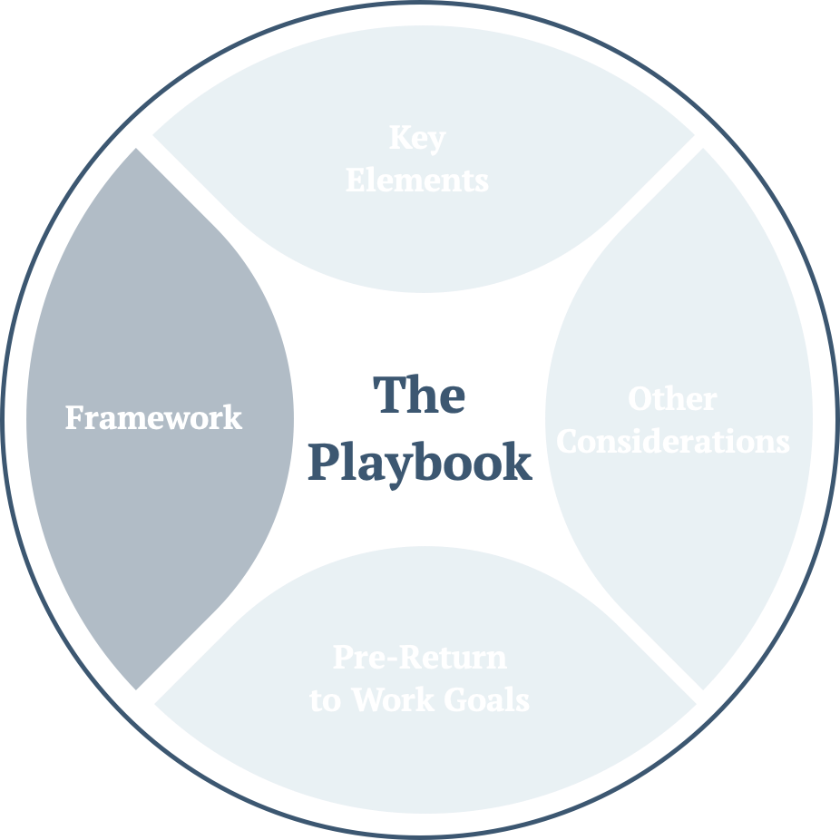
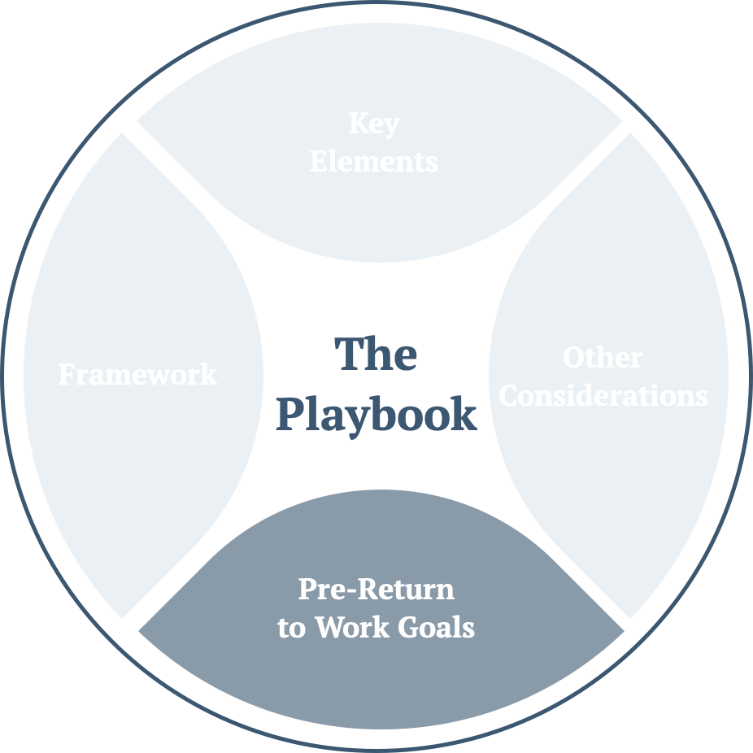
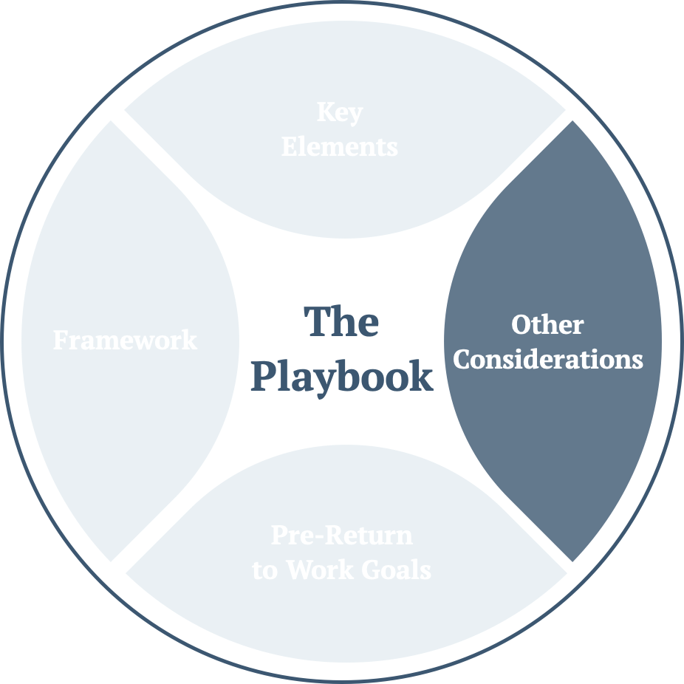
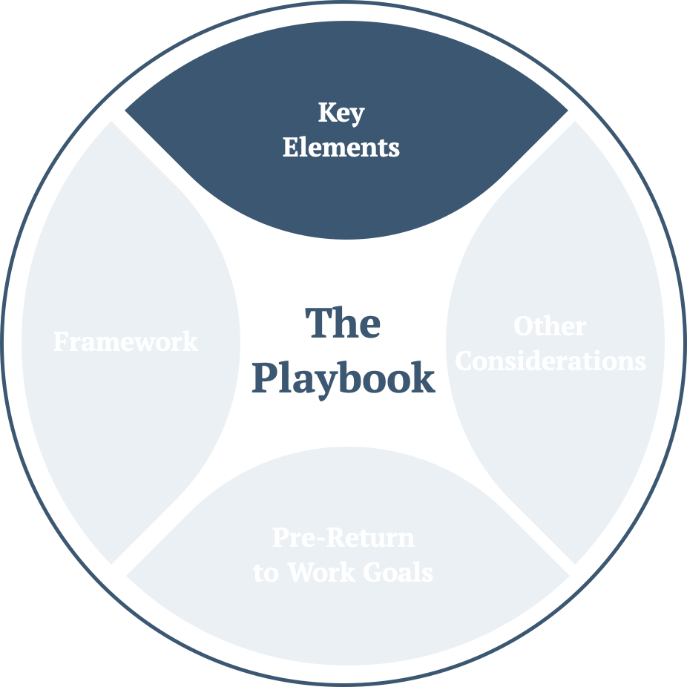
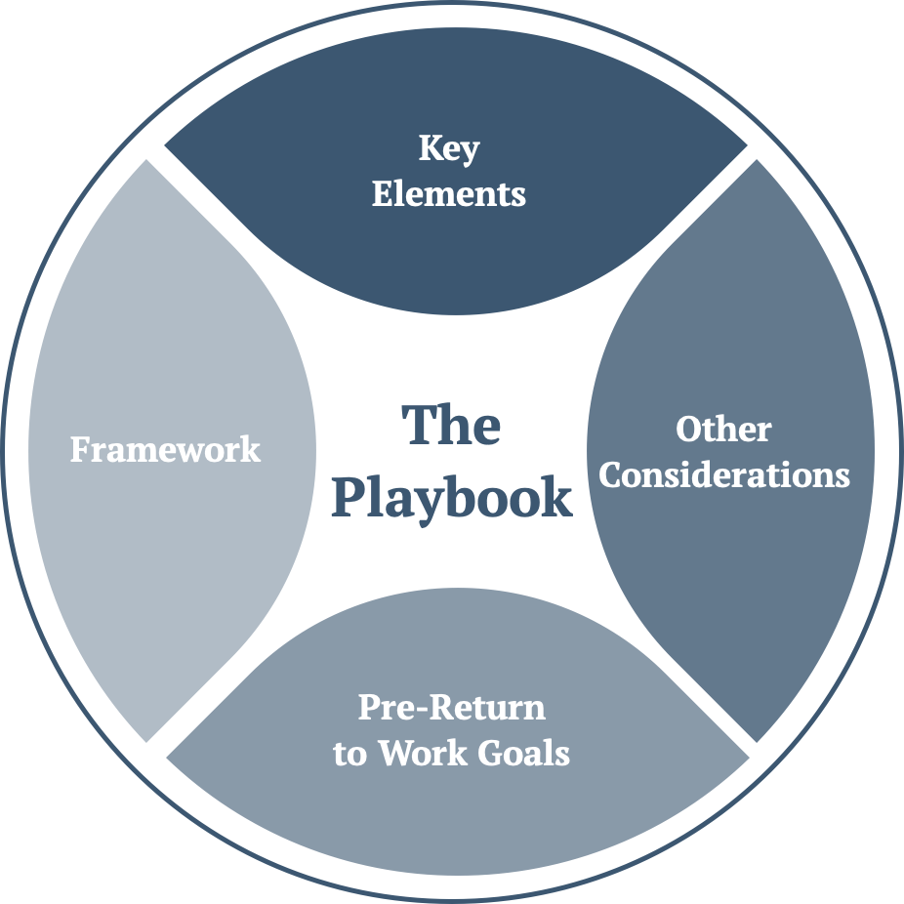
Re-Opening Safely – The Framework
Governance & Risk | People Health & Safety | Workplace Preparation & Management
Executive, Board, Legal | Employees, Visitors, Contractors | Site/Unit Managers, Leaders
Pandemic Response Team Return to work approach Government (local, national) guidelines, local health guidelines Governance requirements Insurance & legal review Employment standards/employment law review Risk analysis – mitigation plan | Employee ability & readiness to return Employee remote/virtual work Travel guidelines PPE Employee training, certification Employee health & wellness Physical Distancing guidelines On-Site protocols | Workplace design In-house & remote/virtual technology readiness Cleaning, disinfecting & sanitization protocols Workforce management, workplace flow Visitor/contractor access On-Site protocols
RE-OPENING SAFELY: EXECUTIVE PRESENTATION | 8

Slide 9
Re-Opening Safely
Element 1 – Setting Up The Pandemic Response Team
Key Decision Points | Important Considerations | Objectives – What needs to be done
Set-up the Pandemic Response Team Appoint and train appropriate Leaders for the Pandemic Response Team Assign Leaders Site Responsibilities Have all the sections and topics been addressed by the Pandemic Response Team and the issues, modifications and any other considerations been addressed, audited, signed off and brought to the Executive for final approval and sign-off? | Prior to the selection of PRT members: Consider the potential size of this team which will be dependant on the size of your office One person can potentially occupy various roles or roles can be divided between various people | Has the Pandemic Response Team been Set Up? Have all members of the PRT must be properly trained and understand the full responsibility of each role? Has a plan to adopt the protocols included in the Playbook across Sites been established? Have Site-specific protocols been developed?
RE-OPENING SAFELY: EXECUTIVE PRESENTATION | 9

Slide 10
Re-Opening Safely
Element 2 – Cleaning & Disinfection Protocols, PPE
Key Decision Points | Important Considerations | Objectives – What needs to be done
Labour resources for Sanitization and Disinfection Determine the Company’s position on Masks and other PPE for employees – medical, non-medical, self- supplied, company-supplied? Have PPE and Disinfectant supply inventories been completed? Have the order and re-order protocols been put in place and vetted for potential supply disruption? Have additional redundancies been considered and implemented? | Ongoing protocols will be addressed, trained for and assigned. Site-specific circumstances must be taken into consideration for the sanitization and disinfection protocols on-Site Foreign Items and Lunch Bags in the Office Address tight control on access (entrance and exit) to facilities during the deep-cleaning protocols | Have Sites been disinfected prior to return to work? Have the General Disinfection Measures been implemented? Have the weekly checklists been reviewed and introduced? Have all PRT member and employees reviewed, understood and prepared for the Deep-Cleaning and Disinfection Protocol, should it be triggered? Has an external company been identified and approved that can carry out the deep cleaning activity?
RE-OPENING SAFELY: EXECUTIVE PRESENTATION | 10

Slide 11
Re-Opening Safely
Element 3 – Physical Distancing In The Workplace
Key Decision Points | Important Considerations | Objectives – What needs to be done
Capacity of Physical Spaces – For example, Site capacity, number of chairs per room, people in rooms, restroom and lunchroom capacity | Should security be stationed near entry doors at opening and closing office hours? How should waiting lines be accommodated during inclement weather? How and when should PPE be handed out? Do you have the ability to prop doors open at start/end times and during shift change to minimize door handle touching or to install toe kicks on the doors? How to disinfect time clocks each time it is touched by an employee? For example: Station an employee to observe the time clock at a safe 2 meters distance to disinfect the computer clock if it is inadvertently touched to avoid holding up the line Is it practical and effective to do away with punching in and out for a few weeks and pay employees an automatic 40 hours and reconcile the time post? Remote work may be assigned when possible or when mandated by the government to keep the operation efficient and communications flowing | Review and Understand the Physical Distancing Protocol Complete and Continue to adhere to the Physical Distancing guidelines Considerations – No external food, protocols for bringing food, external device management, supply purchasing, staggered start times and finish times etc. Physical and Visual Markers on-Site to assist with adherence to Protocols Lines and markers — may come in the form of tape, decals or paint Office work should be organized to ensure Physical Distancing: a physical separation of 2 meters minimum between employees — Avoid face-to-face desk layouts Provide alternative measures to mitigate their exposure, such as: Face masks, Face shields, Body orientation, or Physical barriers installed where practical Meeting rooms should be organized to hold only the number of chairs compliant with the appropriate spacing Increase cleaning intervals to ensure a clean environment at all times
RE-OPENING SAFELY: EXECUTIVE PRESENTATION | 11

Slide 12
Re-Opening Safely
Element 4 – Implementing New Structures In The Workplace
Key Decision Points | Important Considerations | Objectives – What needs to be done
Professional Health Care Worker Should a dedicated resource be hired, brought in house? Who can fill the role at the Company Sites in lieu of an on-Site reference? Are there Physical changes required at Sites? Have they been executed to? Has the signage and floor markers been distributed and put into the appropriate locations on-Site for maximum visibility and effectiveness? Have Site specific needs been addressed and modified for use in the Playbook? | Client Intake Client Return Client Interaction Physical Barriers for Client Interaction with staff Physical Changes for Internal Distancing Protocols on-Site Physical area for Isolation Protocols and Quarantine Physical Changes to common Bathrooms, Kitchen Facilities Inventory Supply Intake and Storage HVAC/Ventilation system maintenance and Compliance to Protocol Door, Cupboard, Handle maintenance and Disinfection PPE Disposal (storage in-between, handling, etc.) Common use items throughout Facilities Use of common elements (Fridge, Lockers, Cupboards, Coffee Machines and Other Appliances) Refresher of Medical Equipment Storage, Disposal in light of current COVID-19 protocols Entering, Exiting Protocols, and Material/Contracting required Physical Signage | Visitor/Client Interaction Physical Changes for Internal Distancing Protocols Physical Area for Isolation Protocols and Quarantine Physical Changes to common Bathrooms, Kitchen Facilities Inventory Supply Intake and Storage HVAC/Ventilation system maintenance and Compliance to Protocol Door, Cupboard, Handle maintenance and Disinfection – how to and what to do? PPE Disposal (storage in-between, handling, etc.) Common use items throughout Facilities Use of common elements (Fridge, Lockers, Cupboards, Coffee Machines and Other Appliances Entering, Exiting Protocols and Material/Contracting required Physical Signage
RE-OPENING SAFELY: EXECUTIVE PRESENTATION | 12

Slide 13
Re-Opening Safely
Element 5 – Daily Health Screening, Screening Of Visitors
Key Decision Points | Important Considerations | Objectives – What needs to be done
Medical certificates – will they be required for Return to Work Protocols? Public Transportation – What are the Protocols for employees arriving through public transportation? On-Site screening Protocols must be discussed, decided and assigned | If an employee is deemed symptomatic upon reporting to work or is deemed symptomatic during the employee’s shift or after the employee has spent any time in the Facility, reference the Isolation Protocol If the employee is confirmed positive for COVID-19 by a medical professional, reference the Self-Quarantine and Return to Work Protocol | Provide all employees with a Self-Screening document and links to Public Health Agency of Canada Site for on-line Self-Screening Tool Prepare the Human Resources Team to receive inquiries or reports of symptomatic employees prior to shift Temperature reading Observation for overt symptoms Verbal/non-verbal confirmation of daily self-screening Preparing and implementing visitor restrictions Host Directions for Visitors and Contractors
RE-OPENING SAFELY: EXECUTIVE PRESENTATION | 13

Slide 14
Re-Opening Safely
Element 6 – Protocols For Isolating Employees
Key Decision Points | Important Considerations | Objectives – What needs to be done
Has the Company contracted a third-party resource(s) for Deep-Cleaning Protocol upon triggering? | Where possible, the Isolation Room should be an exterior room (building or tent structure) If unavailable, an enclosed area away from the general population can be used | Review and Understand the Protocol Identify and Train a volunteer Isolation Coordinator Establish a protocol to isolate employees if they are symptomatic on-Site. This includes: Isolation Room PPE Communication with Health Authorities and transportation based on their instructions Disinfection of the room Print out forms and protocol to be available as needed Review and modify the Procedure as suited for your Site
RE-OPENING SAFELY: EXECUTIVE PRESENTATION | 14

Slide 15
Re-Opening Safely – Other Considerations
Other Considerations
The Re-Opening Safely Playbook is to be used as a Corporate and Recommended Practice Guideline and it does not cover all topics related to the Business Operations of the Company and its Sites. Management must still be aware of these important topics and discuss and consider them as part of the Business Operations prior to Re-Opening any Site, as they will pertain directly to the safety of all employees and will result in a smoother transition into new protocol and improve the flow of operation. Enforcement – what to do in instances of non-compliance with Guidelines and Protocols Specific Employment Standards – local jurisdictional standards, specific laws regarding employment and human resource management Specific vendors for materials and inventory, as well as cleaning, considered in the Playbook Individual Company and department processes Remote, staggered and virtual work scheduling and considerations (see below) Building, Landlord or Property Manager Protocols and Guidelines – Coordination and Compliance with building Guidelines and Protocols is imperative to create a consistent, seamless and safe environment for all employees Legal and Insurance reviews with appropriate Stakeholders Governance reviews with Board and appropriate Stakeholders
RE-OPENING SAFELY: EXECUTIVE PRESENTATION | 15

Slide 16
Re-Opening Safely – Other Considerations
Labour – Remote & Virtual Work
Where possible, the use of Remote Work and Virtual environments is encouraged. The Physical Distancing requirements, the fluidity and divergence of local guideline and the ultimate safety of the employees (travel, high touch points, proximity to potentially asymptomatic colleagues) suggest that the continuation of Remote Work and Virtual environments is recommended and preferred where possible. Management should discuss who is essential on-Site and who is non-essential on-Site All non-essential should be prioritized for remote work
*Essential vs Non-Essential - in this context, refers to the absolute physical need to be on the physical Site for logistical purposes. For example: if an employee does not have access to a particular technology required to fulfill duties and obligations, or if manual labour on-Site is required or any other reason that the duties and obligations of the particular role cannot be fulfilled through a Virtual or Remote protocol, then they will be considered Essential to be present on-Site.
Virtual environments for remote workers should be solidified and contracts negotiated Virtual environments for on-Site workers should also be encouraged in order to adhere to the Physical Distancing Guidelines and Protocols in the Playbook Management and HR, along with Site Leaders must consider and discuss scheduling, potential rotation of on-Site employees and the physical considerations of staggering employees seated in proximity to each other in the seat configuration on-Site Management and HR, along with Site Leaders must consider and discuss workflow in this hybrid environment, employee engagement strategies and enough flexibility to encourage new ideas and strategies to maintain and enhance the Company culture Policies to engage in virtual 1 on 1 sessions to provide direct feedback, coaching and maintain connection must be considered and implemented Policies to maintain performance expectations and reviews must be enforced Maintain clear communication lines and respect in all communications. Discuss transparency as a key trait to maintain camaraderie, foster loyalty and maintain accountability in communication Discuss what happens if an employee refuses to work citing COVID-19 and safety and have clear and consistent communications prepared to address concerns and questions Management must consider the potential of labour continuity and disruption due to potential illness or absenteeism
RE-OPENING SAFELY: EXECUTIVE PRESENTATION | 16

Slide 17
Re-Opening Safely – Pre-Return To Work
Key Decision Points | Important Considerations | Objectives – What needs to be done
Decide and Hire external company for Deep-Cleaning prior to Re-Opening In order to avoid peak travel times/periods, how will flexibility in shift timing be assessed? Are there back-up plans for disruption in essential on-Site staff due to potential COVID-19 related absence or other absence? How will employee schedules be adjusted to accommodate the guidance and protocols in the Playbook? Site Leaders have co-ordinated with Building managers and Landlords to ensure the Guidance and Protocols for the Site are consistent and delineation of responsibility clear and documented When will the Company send the surveys included in the Playbook to employees prior to returning to work? | All key decision points have been reviewed and considered prior to the Site Re-Opening These decision points pertain directly to the execution and enforcement of the guidance and protocols in the Playbook They will directly impact the safety of all employees and will result in a smoother transition into new protocols and improve the flow of operation | Establish a sanitary baseline in the office and Sites BEFORE they re-open The Head Office and the Sites should be 100% disinfected prior to anyone returning to work Address tight control on access (entrance and exit) to facilities during the Deep-Cleaning Protocols Ongoing protocols will be addressed, trained for, and assigned If your business has remained open during this time Begin by resetting the baseline: Consider authorizing a deep clean during an off-day Consider staggering shifts to avoid physical overlap between employees Consider implementing and using the Employee Protocols in the Playbook at these Sites also Prepare for if/when an active employee/visitor/contractor tests positive for COVID-19? Pandemic Response Team has been established and prepped Determine the Site’s various Capacity limits and how will the requirements for adherence to Physical Distancing Protocols and employee safety be achieved?
RE-OPENING SAFELY: EXECUTIVE PRESENTATION | 17

Slide 18
Re-Opening Safely – Timelines
The First 10 Days
Key Elements The First 10 days provide the foundation for the execution of the Playbook. Prior to the First 10 days, the Pre-Return to Work Goals must be achieved and executed. All of the Key Elements highlighted above must have been: Implemented Communicated to employees Read, understood and acknowledged by all employees. The acknowledgement, initial training and sign-off of having read and understood All documentation received must be completed, received and compiled prior to Return to Work | Baseline After a baseline is set for Sites that are Re-Opening through a deep-cleaning and virtual/on-line training materials for all employees, the opening of the office and the next 10 days are for setting the tone and monitoring compliance to the Protocols presented. Training — All returning employees must attend the mandatory Day 1 training and re-review the Training materials. | Set-up, Monitoring, Compliance, Modifications The PRT, Site Leaders and Executive must ensure the protocols are set-up, monitor compliance and discuss any changes and modifications to make the guidelines and protocols more effective for the safety of the employees. | Employee Survey – Feedback Employee surveys will gauge important initial feedback that can guide the PRT and Executive assessment of the Guidelines and Protocols in the Playbook.
RE-OPENING SAFELY: EXECUTIVE PRESENTATION | 18

Slide 19
Re-Opening Safely – Timelines
The First 30 Days
Key Elements The First 30 days provide insight into the execution of the Playbook and setting the tone, monitoring compliance and assessing the effectiveness of the Protocols On-Site. | Mid-term After a baseline is set for Sites that are Re-Opening through a deep-cleaning and virtual/on-line training materials for all employees, the opening of the office and the next 30 days are for setting the tone and monitoring compliance to the Protocols presented. | Training – Continuous Review All new employees must attend the mandatory Day 1 training and re-review the Training materials that were sent prior to their start date. Regular training updates must be provided to ensure all employees are kept current with modifications to the Playbook and changes to the timing and outlook for the provisions in the Playbook. | Monitoring, Compliance, Modifications The PRT, Site Leaders and Executive must continue to ensure and monitor compliance to the Guidelines and Protocols in the Playbook and discuss any changes and modifications to make the guidelines and protocols more effective for the safety of the employees. | Employee Survey – Feedback Employee surveys will continue to gauge important feedback from the field.
RE-OPENING SAFELY: EXECUTIVE PRESENTATION | 19

Slide 20
Re-Opening Safely – Timelines
The Next 90 Days and Beyond
Key Elements The next 90 days and beyond provides the rationale for systematic and long-term changes to the business from the Pandemic. | Long-term: Re-assess the External Environment (Continue every 30 days thereafter) As execution and monitoring to the Protocols and Guidelines in the Playbook continues, the longer-term outlook must provide for monitoring of local regulation, changes to the pandemic response and the business strategy. | On-going Monitoring, Compliance, Modifications (Continue every 30 days thereafter) As in the first 30 days, the PRT, Site Leaders and Executive must continue to ensure and monitor compliance to the Guidelines and Protocols in the Playbook and discuss any changes and modifications to make the guidelines and protocols more effective for the safety of the employees, taking into the account the External environment. | Employee Survey – Feedback (Continue every 30 days thereafter) Employee surveys continue to gauge important feedback that can guide the PRT and Executive Teams in their analysis of all aspects of the business as it relates to Pandemic Planning, Analysis and Execution.
RE-OPENING SAFELY: EXECUTIVE PRESENTATION | 20

Slide 21
Re-Opening Safely – PLAYBOOK Overview
Topic | Tasks
Pandemic Response Team (PRT) | Set up the Pandemic Response Team (PRT) Have a plan in place to adopt this corporate framework and develop site-specific protocols
Preventative Material Inventory | Confirm operations has an adequate supply of Disinfectant Supplies and has the minimum quantity on-Site with the amounts on order with lead time Confirm stock of PPE and has the minimum quantity on-Site and on order with lead time, along with required users of such materials Have touchless thermometers on-Site for employee screening
Personal Protective Equipment | Review and understand protocol for PPE Responsibility for ensuring there are adequate supplies, there are multiple supplier contacts and appropriate lead times for ordered materials
Disinfection Measures | Disinfect Sites prior to anyone returning to work Replace HVAC air filters or clean/disinfect Implement the General Disinfection Procedures
Deep-Cleaning and Disinfection Protocol | Review, understand, and prepare for the triggering of the Deep-Cleaning and Disinfection Protocol; identify and external company, coordination and supervision of cleaning process, PPE requirements and disposal
Inbound Packages | Manage incoming packages/supplies in accordance with playbook standards
Audit Checklist | Implement Audit Communicate results and follow-up on any non-conformities
Isolation Protocol & Coordinator Training | Review and understand protocol Isolation Coordinator (volunteer) identified and trained Protocol in place to isolate employees if symptomatic on-Site Print out forms and protocol to be available as needed
Physical Distancing Protocol | Review and understand protocol Complete and continue to adhere to the Physical Distancing including any considerations on external items Implement and adhere to physical/visual markers
RE-OPENING SAFELY: EXECUTIVE PRESENTATION | 21
RE-OPENING SAFELY: EXECUTIVE PRESENTATION | 21

Slide 22
Re-Opening Safely – PLAYBOOK Overview
Topic | Tasks
Daily Self-Screening and On-Site Health Screening Protocol | Daily Self-Screening protocol is distributed to all employees for voluntary, home self-screening HR team prepared to receive inquiries or reports of symptomatic employees prior to shift/start of work Ensure protocol for pre-shift screening prior to Site entry Ensure barriers are in place to prevent anyone from missing screening protocol Review and understand “Overview of Health Screening Procedure”
Employee Travel Protocol | Review and understand protocol — monitoring updated travel information Assess need for business travel — cancel/postpone all non-essential travel Before, While, and After Travelling procedure for all travelling employees Create an active database to log all employee travel
Self-Quarantining and Return to Work Protocol | Review and understand protocol and adjust as necessary for local, legal and cultural environment
Visitors & Contractors Self-Screening | Plan in place for screening Visitors and Contractors — visitor restrictions, directions for visitors/contractors Visitors & Contractor Self-Screening Checklist printed and available as needed
Employee Training | Host Pre-Return to Work Trainings: Review of Safe Work Playbook with FT, Salaried and PT employees Training for Health Screeners & Isolation Coordinators Training for Disinfection Team & HR Team Host First Day Trainings/Orientation: Localize playbook presentation & materials to be consistent with type of facility, geography Host first-day training orientation for all staff Ensure all Employees have read, understood and acknowledged the materials provided. Acknowledgement, initial training & sign-off of having read and understood all documentation received must be completed, received, compiled prior to Return to Work
Health & Wellness: Signage | Self-Screening Checklist Create and Print Facility Signage and Post on-Site Consider physical markers (floor tape/paint)
RE-OPENING SAFELY: EXECUTIVE PRESENTATION | 22
RE-OPENING SAFELY: EXECUTIVE PRESENTATION | 22

Slide 23










Re-Opening Safely – A Day In The Life
A Day In The Life Of Roger
How does he come in and what does he do along the way?
1 | 2 | 3 | 4 | 5 | 6 | 7 | 8 | 9 | 10
Start of Day: Self-Screening | Transport to Site: Personal Vehicle | Stop for Gas | Arrive at Site: Landlord Protocol | Arrive at Site Entry: Company Site Protocol | Lunchroom Breaks: Company Protocols | In-person Meetings: Company Site Protocols | Exit Site: Site Protocol and PPE | Transport to Home: Personal Vehicle | Home: Dealing With PPE
Roger woke up and completed his daily self-screening. He was not exhibiting any symptoms and was cleared to go to work. | Roger used his own vehicle to commute to work. He made sure to pack his metal lunch box, disinfectant wipes, nitrile gloves, and his portable hand sanitizer before leaving his house. | Oh no! Roger needed to stop for gas before continuing his commute to work. He disinfected his hands before exiting his car and wiped down the pump with disinfectant wipes while he also wore his gloves. After Roger payed for his gas at the pump, contactless, he carefully discarded his gloves in the garbage and entered the vehicle. Then Roger disinfected his hands just to be safe. | Upon arriving at the Site, Roger waited until all other employees had entered the building and made sure to maintain a 2-meter distance between everyone else. When he reached the elevator, he followed the physical distancing rules to wait his turn for the elevator. Only 1 person at a time are allowed on. He wiped down the buttons prior to use and then again after getting off the elevator. He disposed of the PPE and disinfectant wipes prior to entering the company area of the Site. | Upon entering the Site Roger waited at the front desk and read all company signage — he sanitized his hands, wiped down his metal lunch box, and maintained the 2-meter distance instructed. Roger followed the tape on the floor which directed him to follow a path to his desk — where there would be no cross-direction interaction. Once at his desk, Roger wiped down his desk and all tools with the office disinfectant wipes and began his busy day. | Since Roger brought his lunch to work in a metal lunch box , he preferred to eat at his desk. However he had placed his lunch box in the lunchroom fridge — Roger disinfected his hands prior to leaving his office and wiped down the handle of the fridge with the office disinfectant wipes — After grabbing his lunch box and settling back in at his desk, Roger sanitized his hands again with his hand sanitizer and enjoyed his turkey sandwich. | Roger had a scheduled in-person meeting at 3:00pm. As per protocol he sanitized his hands prior to leaving his desk and walked toward the boardroom. The door in the meeting room was already propped open, and there were 2 windows slightly opened. He disinfected a chair to sit on which was exactly 2 meters away from the next chair and they began the meeting. He connected the virtual platform for those not in the room. After the meeting had ended Roger returned to his desk and proceeded to disinfect his hands. | Roger was finished his long day at work and was ready to begin his commute home. He waited to make sure no one else was leaving at the exact same moment and decided to sanitize his hands in the meantime. When it was safe to do so, Roger followed the direction of the tape (on the floor) to direct him to the exit. As he left the building, he maintained a 2meter distance from everyone else in the parking lot. | Roger entered his car and disinfected his hands as well as wiped down his lunch box with a disinfectant wipe. Roger had a swift drive home as he avoided any traffic, and listened to his favorite radio station | Roger was not wearing any PPE when he arrived home but just to be safe, he washed his hands for 20 sec with warm soap and water and changed into his evening track suit — his hygienic day had finally come to an end
RE-OPENING SAFELY: EXECUTIVE PRESENTATION | 23

Slide 24




Re-Opening Safely – A Day In The Life
A Day In The Life Of Carla
How does she come in and what does she do along the way?
1 | 2 | 3 | 4 | 5 | 6 | 7 | 8 | 9 | 10
Start of Day: Self-Screening | Transport to Site: Public Transportation (Bus) | Stop for Coffee | Arrive at Site: Landlord Protocol | Arrive at Site Entry: Company Site Protocol | Restroom Breaks: Company Site Protocol | Hybrid Meetings: Company Protocols | Exit Site: Company Protocol and PPE | Transport to Home: Public Transportation | Home: Dealing With PPE
Carla woke up and completed her daily self-screening. She was not exhibiting any symptoms and was cleared to go to work. | Carla does not have any alternative transportation and therefore must take the public bus. She agreed with her boss to stagger her start-time, so she could go come in at off-peak hours. She left the house with a non-medical grade mask, hand sanitizer, and disinfectant wipes. Once on the bus, Carla, practiced physical distancing (2 meters apart), avoided touching any surfaces and wiped down those she had touched, and did not touch her face. Once off the bus, Carla, disinfected her hands, and adhered to the company policy on hygiene and masks. | Carla disinfected her hands before and after she purchased her morning coffee. Carla also disinfected her cup just to be safe. | Upon arriving at the Site, Carla waited until all other employees had entered the building and made sure to maintain a 2-meter distance between everyone else. | Upon entering the Site Carla waited at the front desk and read all company signage - she sanitized her hands, discarded her non-medical grade mask, and maintained the 2-meter distance instructed. Carla followed the tape on the floor which directed her to follow a path to her desk - where there would be no cross-direction interaction. Once at her desk, Carla wiped down her desk and all tools with the office disinfectant wipes and began her busy day. | Carla drank her coffee so fast she suddenly had to use the restroom! On Carla's restroom break she disinfected her hands prior to leaving her desk. Upon entering the restroom she opened the door with a disinfectant wipe (supplied by the office) and then discarded it after opening a stall. After washing her hands with warm water for 20 seconds in the restroom, she used paper towel to open the restroom door and then discarded it once back at her desk. She then sanitized her hands one more time, just to be safe. | Carla had a scheduled Zoom call at 3:00pm for those in and out of the office. She prepared to Carla also disinfected her enter the call and plugged in cup just to be safe. Once at her desk, Carla wiped down her desk and all tools with the office disinfectant wipes and began her busy day. her headphones. | Carla finished her long day at work and was ready to begin her journey home. She waited until it was time to walk to the bus stop and sanitized her hands. She waited to makes sure no one else was leaving at the exact same moment and followed the direction of the tape (on the floor) to direct her to the exit. As she left the building, she put on her non-medical grade mask and waited for the bus to arrive - maintaining a distance of 2 meters from everyone else at the stop. | Upon entering the bus, Carla took a seat at least 2 meters away from anyone else - since she had staggered her shift time, Carla was no longer travelling during peak times and there were fewer people riding the bus. While on the bus Carla disinfected her hands and did not touch her face or any surface. | Once Carla was finally home, she immediately disinfected her hands and discarded her mask in the closed bin garbage she had placed outside. When she entered her home, she took off all her clothes, and washed her hands for 20 sec with warm water and soap. After changing into her comfy sweats Carla had successfully completed her safe journey to home.
RE-OPENING SAFELY: EXECUTIVE PRESENTATION | 24

Slide 25


Contact Information
Akash Kapoor email: ak@reopeningsafely.ca
Gwendolyn DelGuidice email: gwen@reopeningsafely.ca
Further Information
Public Health Agency of Canada https://www.canada.ca/en/public-health/services/diseases/coronavirus-disease-covid-19.html
World Health Organization (WHO) https://www.who.int/emergencies/diseases/novel-coronavirus-2019
Re-Opening Safely www.reopeningsafely.ca
www.reopeningsafely.ca

Slide 26


Compiled and Edited by Akash Kapoor & Gwendolyn DelGuidice for Akash Kapoor Advisors Inc.

