Slide 1




Return to Work Orientation
Compiled and Edited by Akash Kapoor & Gwendolyn DelGuidice for Akash Kapoor Advisors Inc.

Slide 2


Disclaimer
The content of this Re-Opening Safely Playbook Return to Work Orientation presentation (hereinafter referred to as the “Playbook”) is provided for general information purposes. The content should not be considered as legal, consulting or any other professional advice. This Playbook is to be understood as a guideline on what to consider when re-opening a workplace during the COVID-19 pandemic. The health and safety of workers is our number one priority and our hope in sharing this information is that it may be of assistance to our collective colleagues and partner businesses.
Please be advised that some or all of the information contained in this document may not be applicable to some businesses or workplaces. We strongly recommend that before implementing any of the ideas contained herein you carefully evaluate and consult with outside legal counsel familiar with your organization’s particular factual situation regarding the legality, applicability and potential efficacy of this information in your place of business before making any decisions.
Akash Kapoor Advisors Inc. assumes no responsibility or liability for any errors or omissions in the content of the Playbook and for any unwanted or unintended consequences arising out of or related to the adoption, or decision not to adopt, any of the practices or procedures contained in the Playbook.
This Playbook is to be used as a corporate and recommended practice guideline and aligns with the applicable authorities such as the Public Health Agency of Canada and the World Health Organization (WHO) recommendations to the greatest extent possible.
The Playbook is a working document and will be updated on a best efforts basis from time to time to reflect changes in directives and to include new recommended practices as they become available given the fluidity of this situation. While we have made every attempt to ensure the information contained in the Playbook has been obtained from reliable sources, all information in the Playbook is provided “as is,” with no guarantee of completeness, accuracy, timeliness or of the results obtained from the use of this information, and without warranty of any kind, express or implied, including, but not limited to warranties of performance, merchantability and fitness for a particular purpose.
This Playbook provides general recommendations for use in most workplaces. Due to circumstances that may be unique to a particular workplace, there may be some situations in which a workplace will require accommodation(s) to implement the recommendations of the Playbook. Such accommodations may need to be authorised by management or the organization’s Health and Safety committee if applicable.
EMPLOYEE ORIENTATION | 2

Slide 3
COVID-19
COVID-19 is an infectious disease caused by a newly discovered coronavirus.
The virus that causes COVID-19 is mainly transmitted through droplets generated when an infected person coughs, sneezes, or exhales. These droplets are present in the air and can fall onto floors and surfaces.
You can be infected by breathing in the virus if you are within proximity of someone who has COVID-19, or by touching a contaminated surface and then your eyes, nose or mouth.
EMPLOYEE ORIENTATION | 3

Slide 4

1 | Our COVID-19 Response
2 | Signs & Symptoms of COVID-19
3 | Daily Self-Screening for Symptoms
4 | Isolation Protocol for Symptomatic Employees
5 | Physical Distancing Measures
6 | Disinfection Measures
7 | Personal Hygiene
8 | Self Quarantine and Return to Work Protocol
Agenda
EMPLOYEE ORIENTATION | 4

Slide 5


Key Elements Timeline
10
30
90
First 10 days | First 30 days | Next 90 days and Beyond
The first 10 days provide the foundation for the execution of the Playbook: | The first 30 days provide insight into the execution of the Playbook and for setting the tone, monitoring compliance and assessing the effectiveness of the protocols on Site: | The next 90 days and beyond provides the rationale for systematic and long-term changes to the business from the Pandemic:
Baseline Training Set-up, Monitoring, Compliance, Modifications Employee Survey - Feedback | Mid-term Training – Continuous Review Monitoring, Compliance, Modifications Employee Survey - Feedback | Long-term: Re-assess the External Environment On-going Monitoring, Compliance, Modifications Employee Survey – Feedback Revisit every 30 days after to continue assessment of all factors
EMPLOYEE ORIENTATION | 5

Slide 6
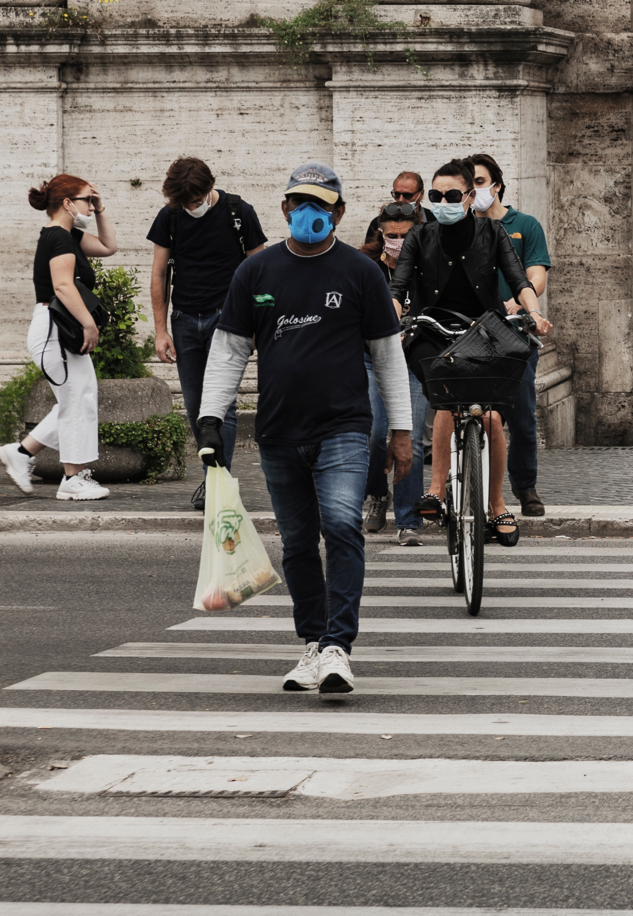
A Day in the Life
EMPLOYEE ORIENTATION | 6

Slide 7
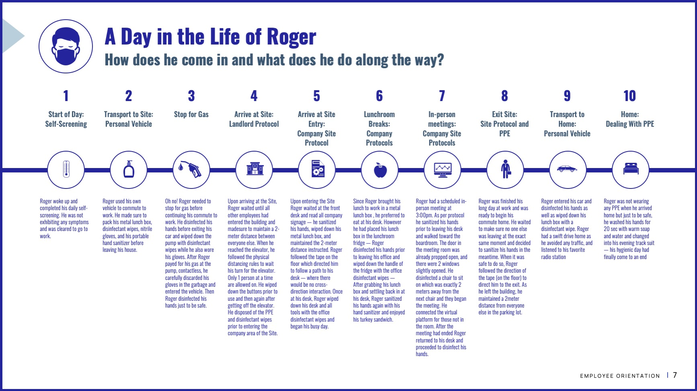
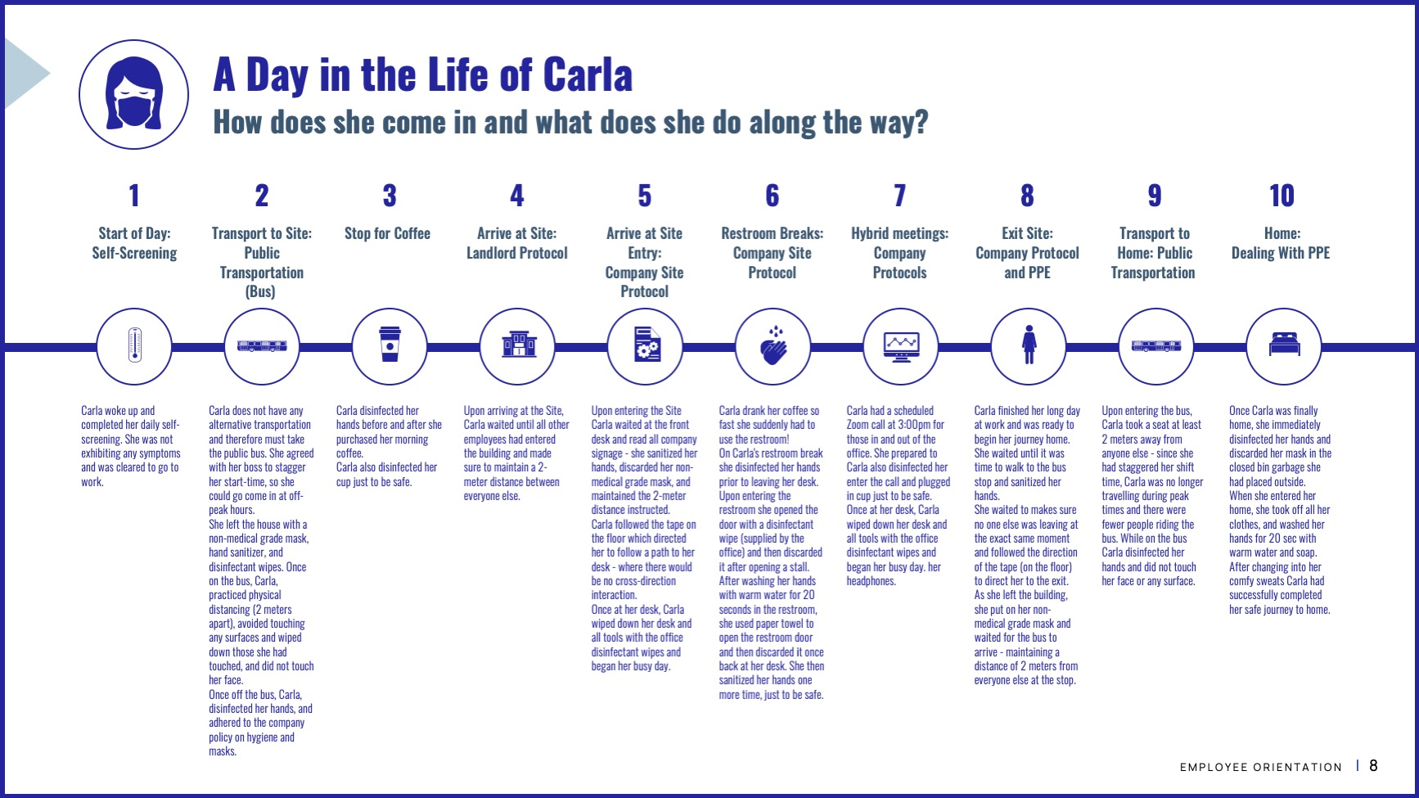
A Day in the Life
These Day in the Life personas are examples only and provide the broad context around the kinds of decisions and actions required throughout a typical day.
They are intended to look at the perspective of the personas that are routinely coming into a Company Site on an average day.
EMPLOYEE ORIENTATION | 7

Slide 8











A Day in the Life of Roger
How does he come in and what does he do along the way?
1 | 2 | 3 | 4 | 5 | 6 | 7 | 8 | 9 | 10
Start of Day: Self-Screening | Transport to Site: Personal Vehicle | Stop for Gas | Arrive at Site: Landlord Protocol | Arrive at Site Entry: Company Site Protocol | Lunchroom Breaks: Company Protocols | In-person Meetings: Company Site Protocols | Exit Site: Site Protocol and PPE | Transport to Home: Personal Vehicle | Home: Dealing With PPE
Roger woke up and completed his daily self-screening. He was not exhibiting any symptoms and was cleared to go to work. | Roger used his own vehicle to commute to work. He made sure to pack his metal lunch box, disinfectant wipes, nitrile gloves, and his portable hand sanitizer before leaving his house. | Oh no! Roger needed to stop for gas before continuing his commute to work. He disinfected his hands before exiting his car and wiped down the pump with disinfectant wipes while he also wore his gloves. After Roger payed for his gas at the pump, contactless, he carefully discarded his gloves in the garbage and entered the vehicle. Then Roger disinfected his hands just to be safe. | Upon arriving at the Site, Roger waited until all other employees had entered the building and madesure to maintain a 2-meter distance between everyone else. When he reached the elevator, he followed the physical distancing rules to wait his turn for the elevator. Only 1 person at a time are allowed on. He wiped down the buttons prior to use and then again after getting off the elevator. He disposed of the PPE and disinfectant wipes prior to entering the company area of the Site. | Upon entering the Site Roger waited at the front desk and read all company signage — he sanitized his hands, wiped down his metal lunch box, and maintained the 2-meter distance instructed. Roger followed the tape on the floor which directed him to follow a path to his desk — where there would be no cross-direction interaction. Once at his desk, Roger wiped down his desk and all tools with the office disinfectant wipes and began his busy day. | Since Roger brought his lunch to work in a metal lunch box , he preferred to eat at his desk. However he had placed his lunch box in the lunchroom fridge — Roger disinfected his hands prior to leaving his office and wiped down the handle of the fridge with the office disinfectant wipes — After grabbing his lunch box and settling back in at his desk, Roger sanitized his hands again with his hand sanitizer and enjoyed his turkey sandwich. | Roger had a scheduled in-person meeting at 3:00pm. As per protocol he sanitized his hands prior to leaving his desk and walked toward the boardroom. The door in the meeting room was already propped open, and there were 2 windows slightly opened. He disinfected a chair to sit on which was exactly 2 meters away from the next chair and they began the meeting. He connected the virtual platform for those not in the room. After the meeting had ended Roger returned to his desk and proceeded to disinfect his hands. | Roger was finished his long day at work and was ready to begin his commute home. He waited to make sure no one else was leaving at the exact same moment and decided to sanitize his hands in the meantime. When it was safe to do so, Roger followed the direction of the tape (on the floor) to direct him to the exit. As he left the building, he maintained a 2meter distance from everyone else in the parking lot. | Roger entered his car and disinfected his hands as well as wiped down his lunch box with a disinfectant wipe. Roger had a swift drive home as he avoided any traffic, and listened to his favourite radio station. | Roger was not wearing any PPE when he arrived home but just to be safe, he washed his hands for 20 sec with warm soap and water and changed into his evening track suit — his hygienic day had finally come to an end.
EMPLOYEE ORIENTATION | 8

Slide 9





A Day in the Life of Carla
How does she come in and what does she do along the way?
1 | 2 | 3 | 4 | 5 | 6 | 7 | 8 | 9 | 10
Start of Day: Self-Screening | Transport to Site: Public Transportation (Bus) | Stop for Coffee | Arrive at Site: Landlord Protocol | Arrive at Site Entry: Company Site Protocol | Restroom Breaks: Company Site Protocol | Hybrid Meetings: Company Protocols | Exit Site: Company Protocol and PPE | Transport to Home: Public Transportation | Home: Dealing With PPE
Carla woke up and completed her daily self-screening. She was not exhibiting any symptoms and was cleared to go to work. | Carla does not have any alternative transportation and therefore must take the public bus. She agreed with her boss to stagger her start-time, so she could go come in at off-peak hours. She left the house with a non-medical grade mask, hand sanitizer, and disinfectant wipes. Once on the bus, Carla, practiced physical distancing (2 meters apart), avoided touching any surfaces and wiped down those she had touched, and did not touch her face. Once off the bus, Carla, disinfected her hands, and adhered to the company policy on hygiene and masks. | Carla disinfected her hands before and after she purchased her morning coffee. Carla also disinfected her cup just to be safe. | Upon arriving at the Site, Carla waited until all other employees had entered the building and made sure to maintain a 2-meter distance between everyone else. | Upon entering the Site Carla waited at the front desk and read all company signage - she sanitized her hands, discarded her non-medical grade mask, and maintained the 2-meter distance instructed. Carla followed the tape on the floor which directed her to follow a path to her desk - where there would be no cross-direction interaction. Once at her desk, Carla wiped down her desk and all tools with the office disinfectant wipes and began her busy day. | Carla drank her coffee so fast she suddenly had to use the restroom! On Carla's restroom break she disinfected her hands prior to leaving her desk. Upon entering the restroom she opened the door with a disinfectant wipe (supplied by the office) and then discarded it after opening a stall. After washing her hands with warm water for 20 seconds in the restroom, she used paper towel to open the restroom door and then discarded it once back at her desk. She then sanitized her hands one more time, just to be safe. | Carla had a scheduled Zoom call at 3:00pm for those in and out of the office. She prepared to Carla also disinfected her enter the call and plugged in cup just to be safe. Once at her desk, Carla wiped down her desk and all tools with the office disinfectant wipes and began her busy day. her headphones. | Carla finished her long day at work and was ready to begin her journey home. She waited until it was time to walk to the bus stop and sanitized her hands. She waited to makes sure no one else was leaving at the exact same moment and followed the direction of the tape (on the floor) to direct her to the exit. As she left the building, she put on her non-medical grade mask and waited for the bus to arrive - maintaining a distance of 2 meters from everyone else at the stop. | Upon entering the bus, Carla took a seat at least 2 meters away from anyone else - since she had staggered her shift time, Carla was no longer travelling during peak times and there were fewer people riding the bus. While on the bus Carla disinfected her hands and did not touch her face or any surface. | Once Carla was finally home, she immediately disinfected her hands and discarded her mask in the closed bin garbage she had placed outside. When she entered her home, she took off all her clothes, and washed her hands for 20 sec with warm water and soap. After changing into her comfy sweats Carla had successfully completed her safe journey to home.
EMPLOYEE ORIENTATION | 9

Slide 10
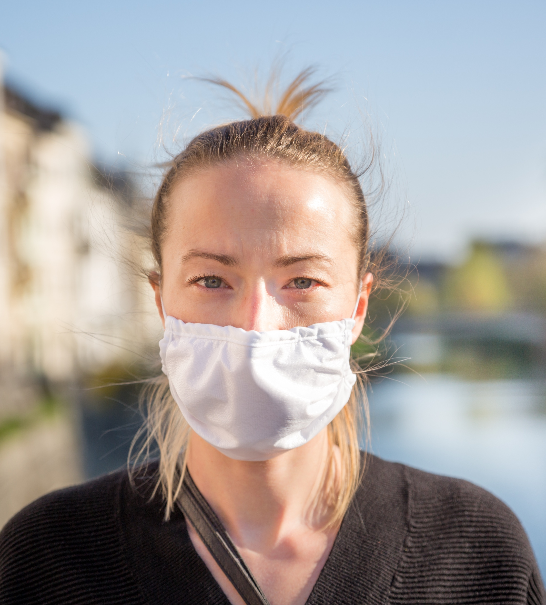
Our COVID-19 Response
EMPLOYEE ORIENTATION | 10

Slide 11
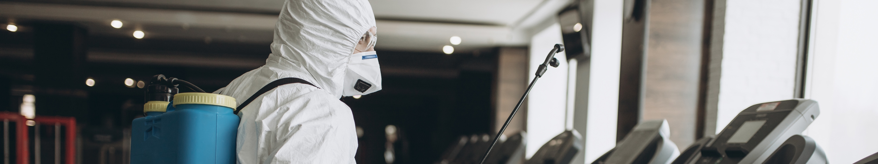
Our COVID-19 Response
Changes to Schedule, Facility, Cleaning and Responsibilities
What was done during shutdown? | Work schedule changes (staggered shifts, job rotation, meetings, etc.) | Facility changes (doors, timeclocks, cafeteria, work-station changes, etc.) | Dedicated cleaning resources | What is everyone’s role when returning to work (physical distancing, cleaning, personal hygiene)? | Remember, if you are feeling ill at any time during your shift, tell the Isolation Coordinator, Local HR rep or Executive Leadership immediately.
EMPLOYEE ORIENTATION | 11

Slide 12

Physical Changes to Site
The safety and well-being of staff, clients and the communities we are a part of, are paramount in our approach to Re-Opening safely.
These are physical changes that Company Leadership and Site Management may need to consider in executing to the Guidance and Protocols in the Playbook.
Each office location must assess physical changes required to maintain protocols of safety, physical distancing and disinfection/cleanliness.
These include, but are not limited to:
Visitor/Client Interaction
Physical Changes for Internal Distancing Protocols
Physical area for Isolation Protocols and Quarantine
Physical Changes to Common Bathrooms, Kitchen facilities
Inventory Supply Intake and Storage
HVAC/Ventilation System maintenance and Compliance to Protocol
Door, Cupboard, Handle Maintenance and Disinfection – How to and What to do?
PPE Disposal (storage in-between, handling, etc.)
Common use items throughout Facilities
Use of common elements (Fridge, Lockers, Cupboards, Coffee Machines, and Other Appliances)
Entering, Exiting protocols and Material/Contracting required
Physical Signage
EMPLOYEE ORIENTATION | 12

Slide 13


Employee Training
It is essential that ALL employees at all Sites understand the safety requirements, protocols and expectations that are in the Playbook to ensure everyone and their communities stay safe and prevent the spread of COVID-19.
Ensure all employees have read, understood and acknowledged the materials provided.
The acknowledgement, initial training and sign-off of having read and understood all documentation received must be completed, received and compiled prior to Return to Work.
EMPLOYEE ORIENTATION | 13

Slide 14
Employee Training
Topic | Audience | Content Included
Overview of company’s Re-Opening Safely Playbook response protocols and resources | All of Site’s salaried employees working remotely | Virtual Overview of Re-Opening Safely Playbook Can be reviewed through Skype Virtual Training or other Virtual platform (1 week prior) or Daily review with Local Site Leaders Discuss Next Steps: Checklist Items, First Day Back Training, Other Trainings
Disinfection Team Training | Varies (internal cleaning crew or external vendor) | In-depth review of the role, responsibilities, and safety requirements for the disinfection team PPE – content from Personal Protective Equipment Section Deep Cleaning – Understand protocol, but external vendor will perform
Isolation Coordinator and Health Screening Leads | On-Site health screeners and volunteer Isolation Coordinator(s) | In-depth review of the role, responsibilities, and safety requirements for the Isolation Coordinator and on-site health screeners PPE Isolation Protocol Self-Screening (daily & on-site) Self-Quarantine
HR/Attendance Policy | HR Team | In-depth review of the protocols related to: Employee attendance Isolation Protocol Self-Quarantining and Return to Work Protocol Visitors and Contractors Self-Screening
Pre-Return to Work Training and Topics must be delivered to, and reviewed, by all Sites at least 1 week prior to Re-Opening.
Host First Day Trainings/Orientation:
Modify and localize Playbook presentation & materials to be consistent with the Site needs and geography
Host first-day training orientation for all staff as they return to Site
If rotating staff, host the orientation for all new returnees to Site until all employees have been oriented
Deliver the Training for all the content described below to all Site employees
EMPLOYEE ORIENTATION | 14

Slide 15

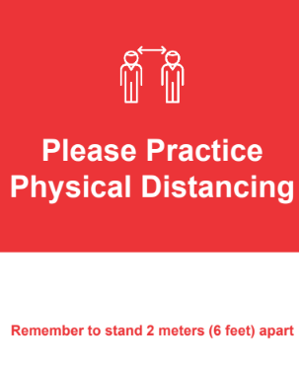
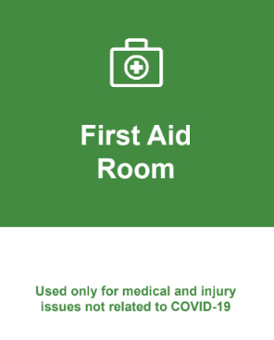
Health and Wellness
Signage
The review, printing, and posting of Facility signage is an important component of reminding and guiding all Site employees in the when, where, why, what and how to maintain a constant hygienic state and remain safe when on the Company premises.
All signage is available in a separate document and can be edited for Site specific information in conformity with local guidelines. Examples are provided below and can be provided in a separate file for use.
Colour Significance:
Blue signage symbolizes sanitized areas
Red signage symbolizes guidelines that must be followed to remain safe
Green signage symbolizes for non COVID-19 related use
EMPLOYEE ORIENTATION | 15

Slide 16
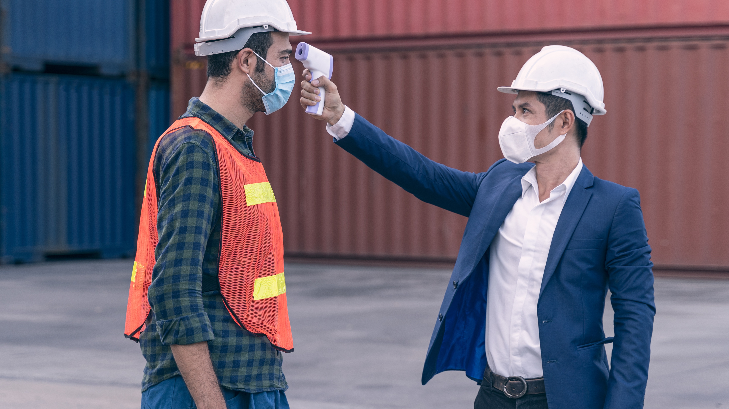
Signs & Symptoms of COVID-19 and Screening Protocols
EMPLOYEE ORIENTATION | 16

Slide 17
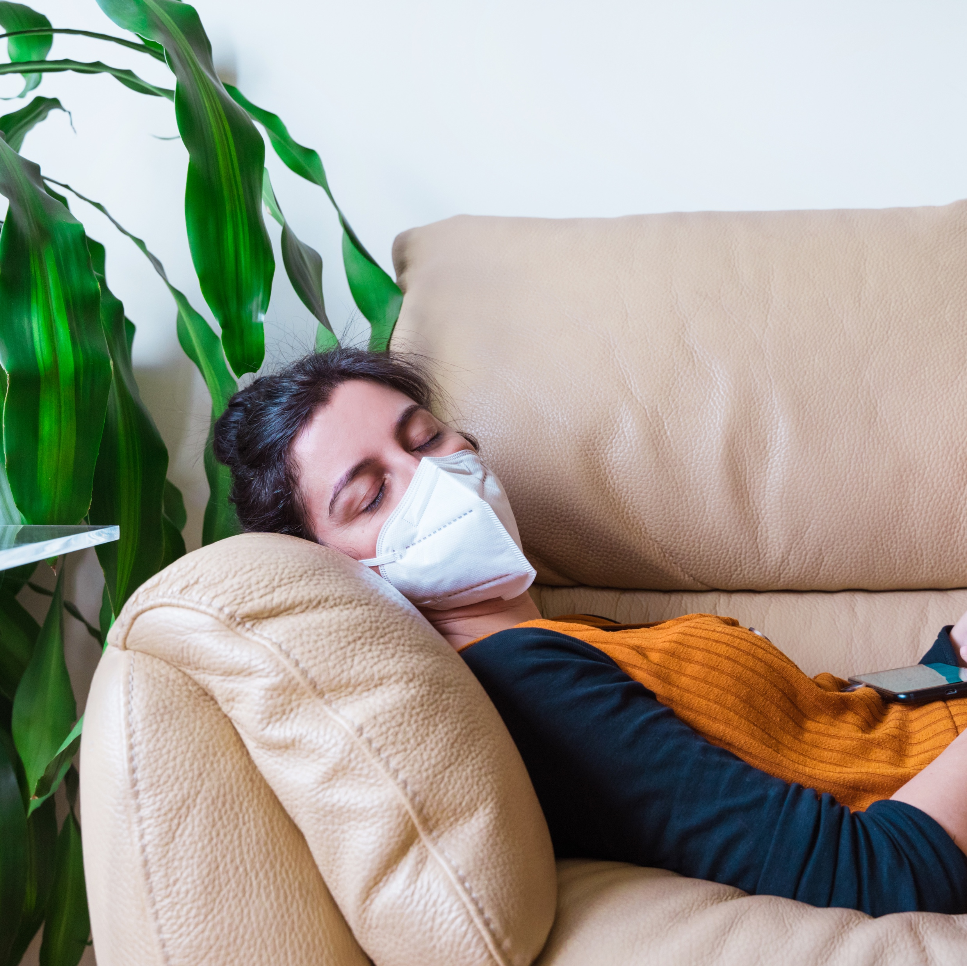


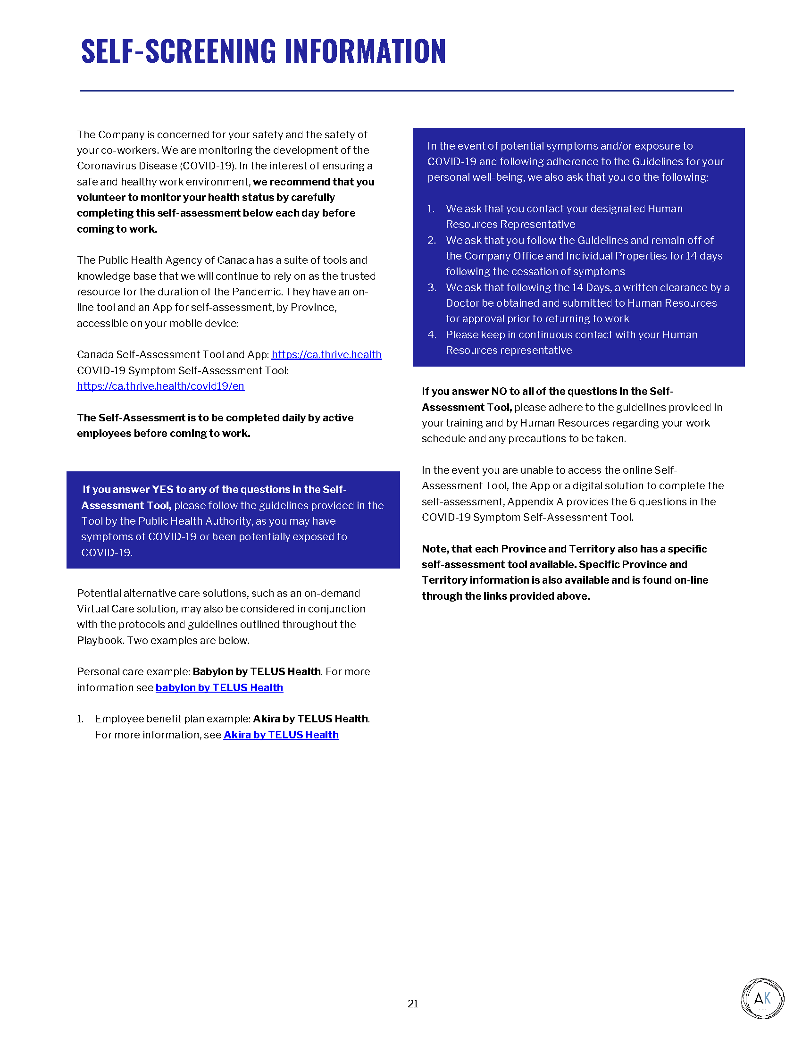
Signs and Symptoms
Screening for Symptoms of COVID-19
Symptoms can include fever, cough and shortness of breath
In the interest of ensuring a safe and healthy work environment, we recommend that you voluntarily monitor your health by completing a Daily Self-Assessment before coming to work ► see the Self-Screening Information hand-out/email
EMPLOYEE ORIENTATION | 17

Slide 18
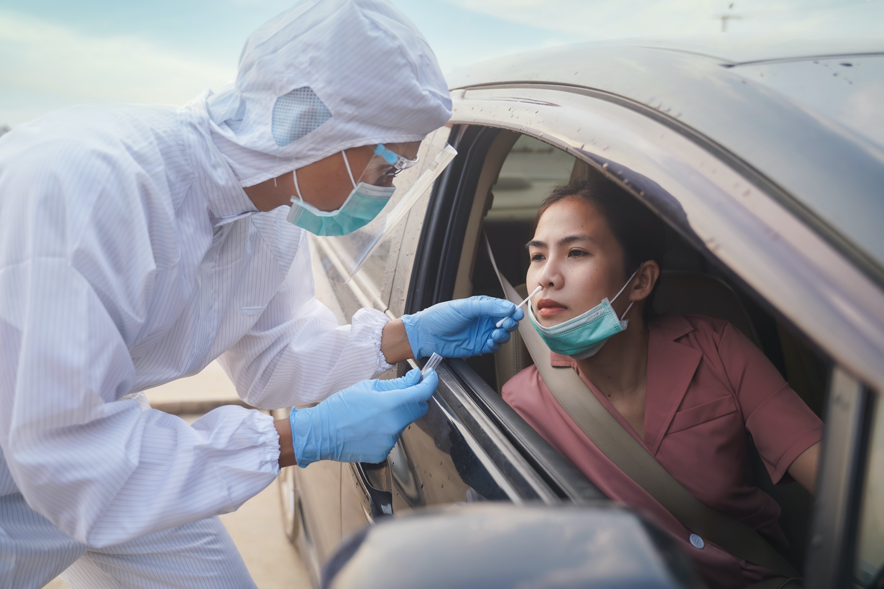
Signs and Symptoms
Daily & On-Site Screening for Symptoms of COVID-19
To help prevent the spread of COVID-19 and reduce the potential risk of exposure to our employees and visitors: Daily Self-Screening and on-Site Screening Protocols will be in place until the Pandemic Response Team & the Executive Leadership has determined, based on guidance from the Local Health authorities and the applicable governmental requirements, that it is safe to discontinue.
Your participation is important to help us take precautionary measures to protect you and everyone in the building!
Thank you!
EMPLOYEE ORIENTATION | 18

Slide 19
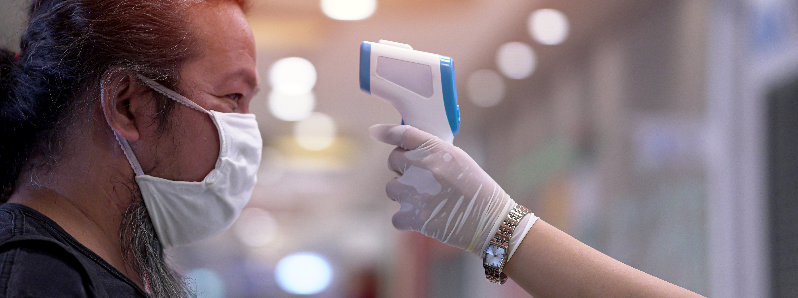
Signs and Symptoms
Daily & On-Site Screening for Symptoms of COVID-19
On-Site Screening Process supplements the Daily Self-Screening protocols (to be decided by Site location):
Where applicable, temperature taking conducted using a non-touch thermometer
Observation for any overt signs or symptoms
Confirmation of Daily Self-Screening
Follow-up with Company Protocol for symptomatic employees
Other details:
The On-Site Health Screening is co-ordinated by: the Employee Access Control Leader or Site Leader
The Daily Self-Screening process is conducted by each employee prior to the shift; the On-Site Screening will be determined by Site
Before the shift, employees should complete their Screenings prior to entry to the Site
IF employee reports symptoms or direct exposure to COVID-19, the employee will be invited to the: COVID-19 Isolation Room
IF temperature is 38ºC (100.40F) or higher, or the employee exhibits visible symptoms of illness consistent with COVID-19, the employees will be invited to the: COVID-19 Isolation Room
EMPLOYEE ORIENTATION | 19

Slide 20
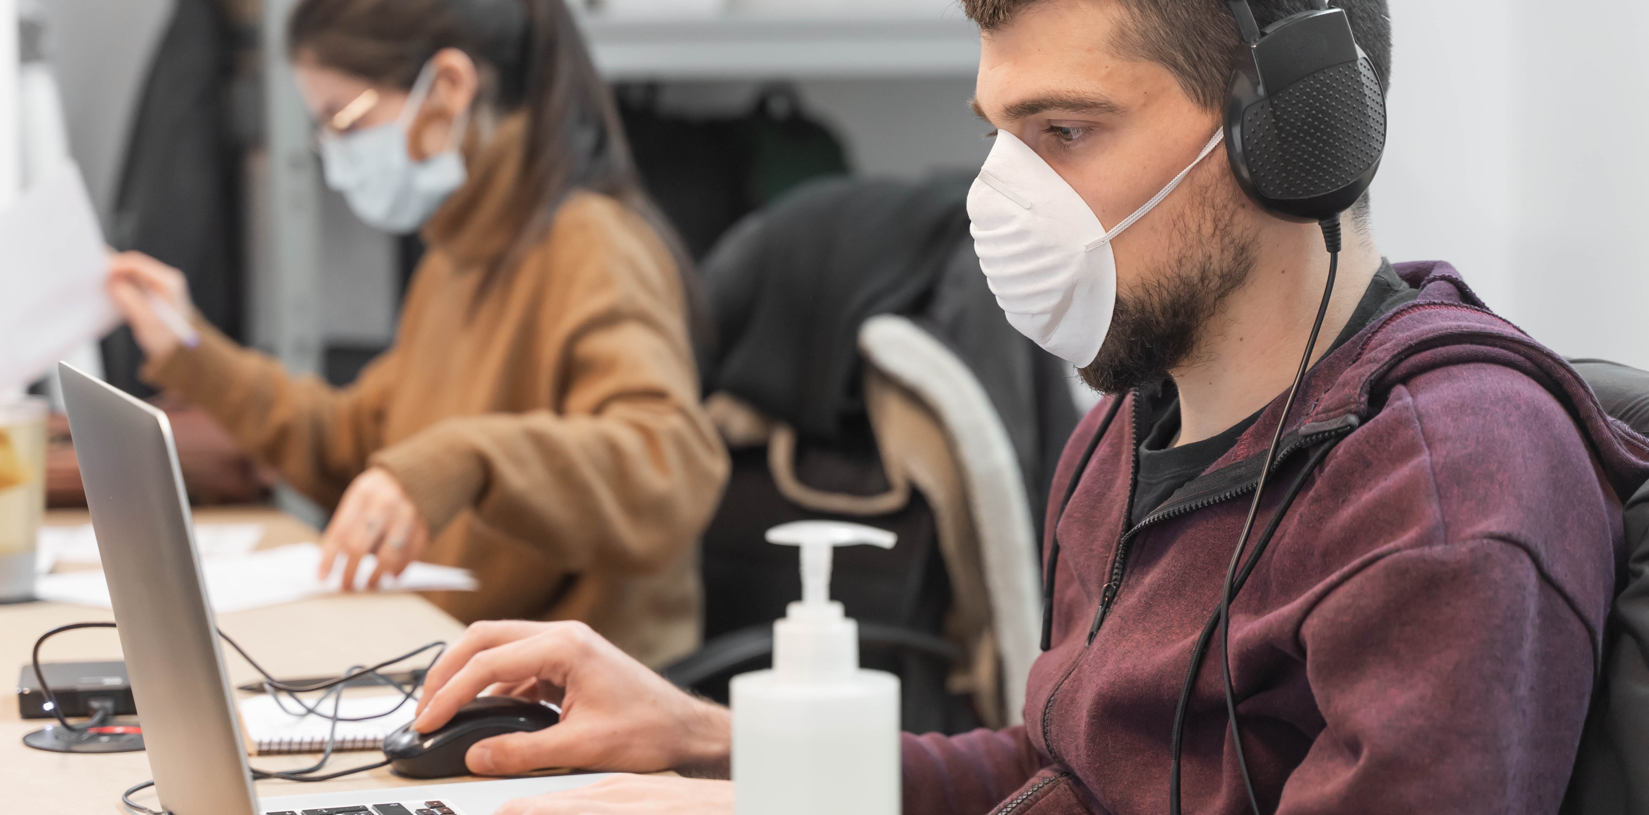
Signs and Symptoms
Suspected Symptoms / Positive COVID-19 Testing
If an employee suspects they have symptoms of COVID-19…
All Facility employees will be notified via the approved communication channel (reporting/symptomatic employee will remain anonymous)
If symptoms are suspected in the Facility, all surfaces touched by the employee will be thoroughly cleaned and disinfected
If an employee tests positive for COVID-19…
Employee is to contact local Human Resources team prior to discuss steps and documentation that may be required prior to return to Company premises
Employee must follow the “Self Quarantining and Return to Work” protocol to ensure the safety of those around them
All Facility employees will be notified via the approved communication channel (reporting/ill employee will remain anonymous)
Employees coming into direct exposure (less than 2 meters without mitigation) with the COVID-19 positive employees will be directed to follow the Self-Quarantine Protocol and must seek and provide medical clearance to Return to Work
EMPLOYEE ORIENTATION | 20

Slide 21



Signs and Symptoms
Symptomatic Employee Isolation Protocol (at work)
If you feel symptomatic for COVID-19 at work, contact your Isolation Coordinator or Site Leader immediately
Virtual/Email/Telephone communications are preferable
The Isolation Team and coordinator must don the appropriate PPE prior to providing assistance to the symptomatic employee
If the employee is suspected to have COVID-19 symptoms, the employee will be sent home and/or directly to the Local Health Center and must seek and present medical clearance to return to work
The Assigned PRT Leader will take the symptomatic employee to the designated isolation area for further evaluation
From this point forward, all employees coming into direct contact (less than 2 meters) with the symptomatic employee are required to use all PPE
The Isolation Coordinator completes a COVID-19 Case Form with the symptomatic employee
The symptomatic employee arrives at the Isolation Room
All employees always continue to maintain 2 meters (6 feet) distance
Employee is given a mask and nitrile gloves (to help protect other employees and prevent spread any potential virus)
EMPLOYEE ORIENTATION | 21

Slide 22
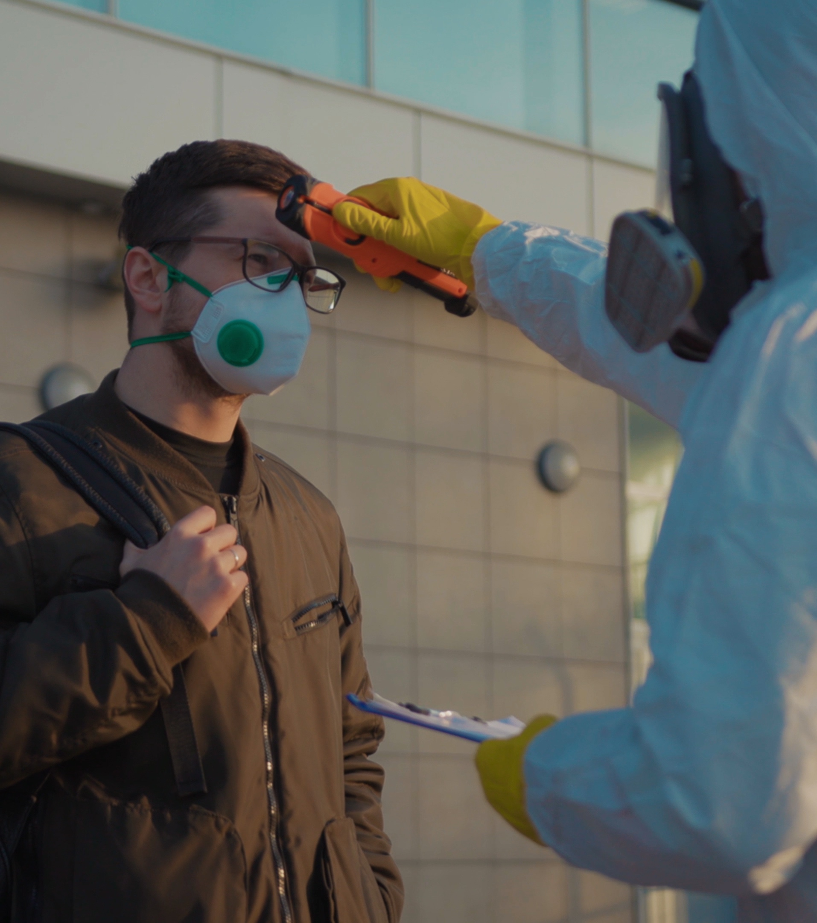
Signs and Symptoms
Timing of Protocols
This protocol will remain in effect until the Pandemic Response Team and the Executive Leadership has determined, based on guidance from the Local Health authorities and the applicable governmental requirements, that it is safe to terminate.
The Pandemic Response Team and the Executive Leadership and/or Operational Leadership will advise our Sites once this determination has been made.
EMPLOYEE ORIENTATION | 22

Slide 23
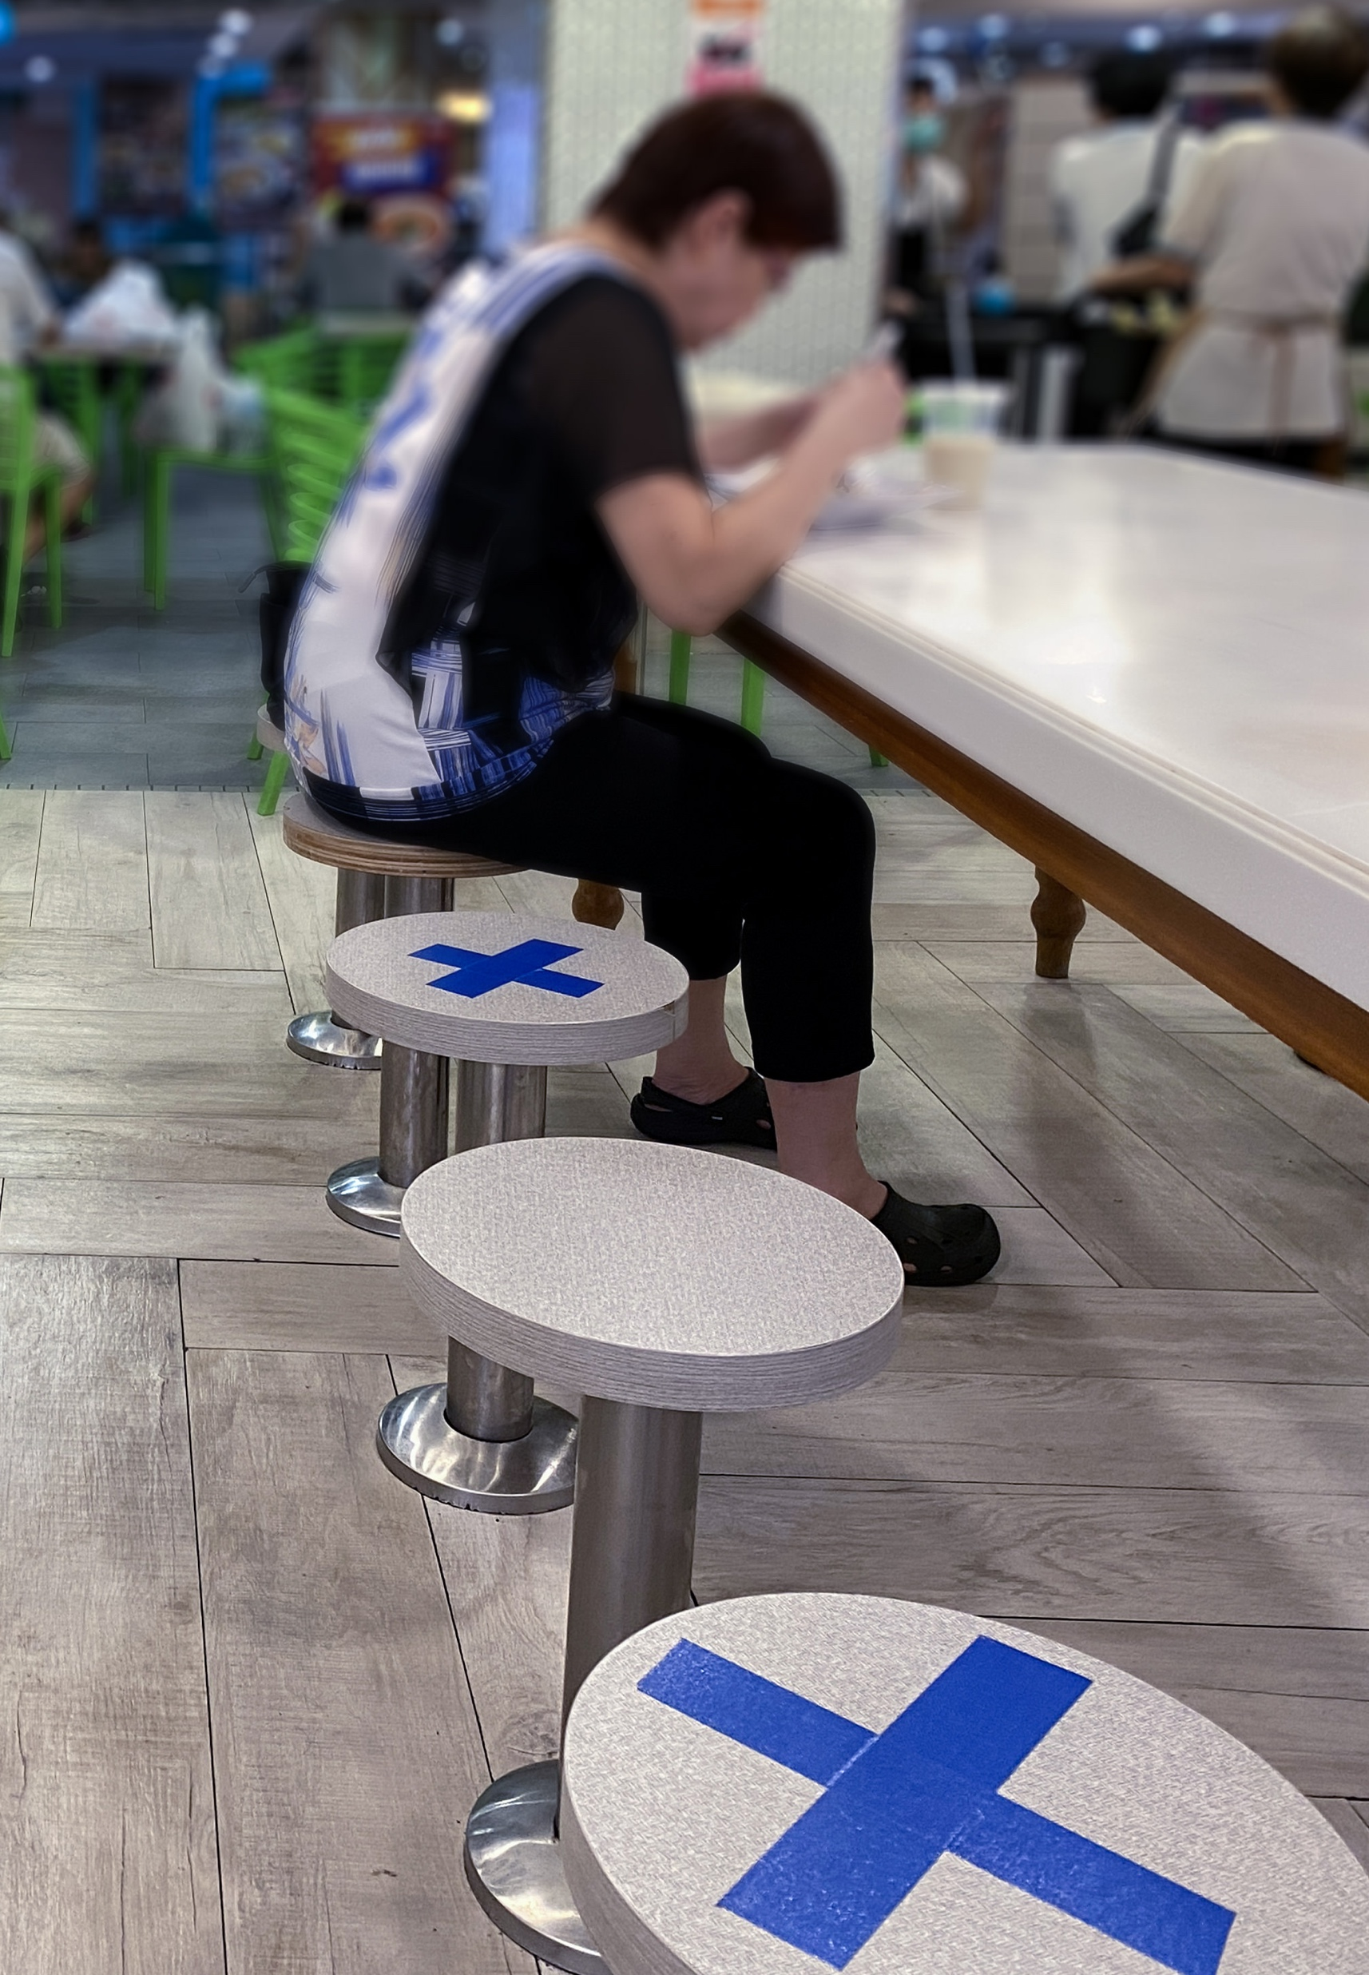
Physical Distancing & Disinfecting Protocols and Measures
EMPLOYEE ORIENTATION | 23

Slide 24
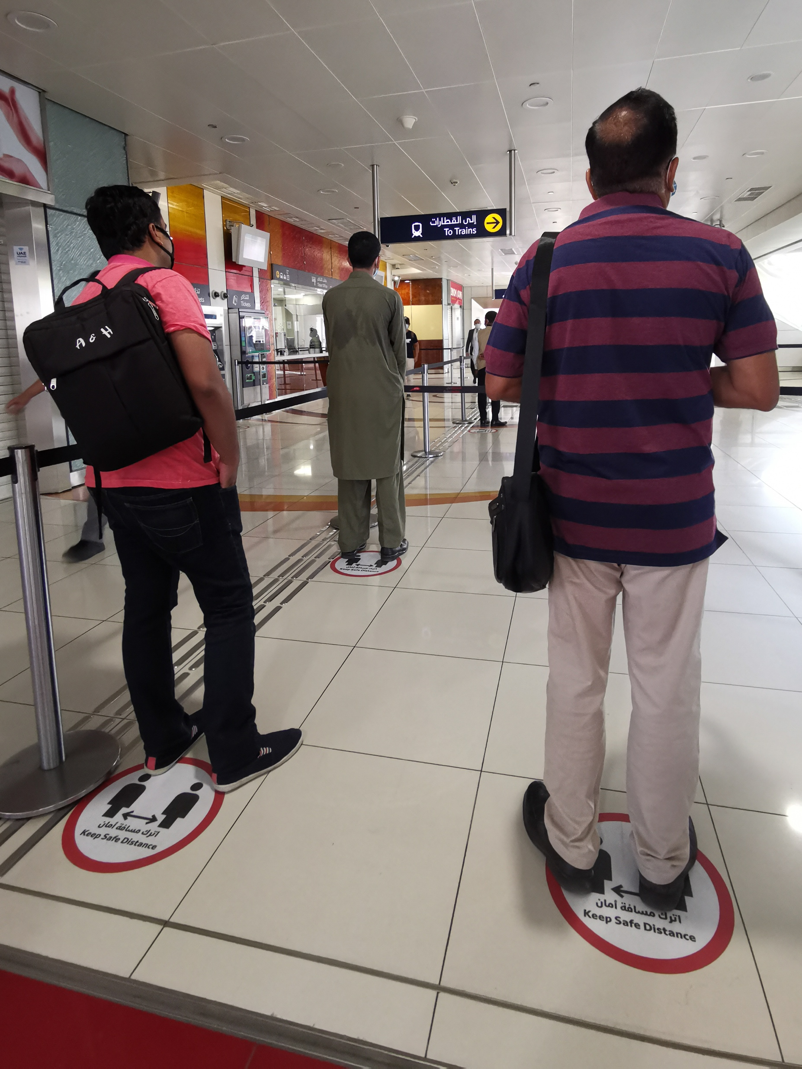
Physical Distancing & Disinfecting
Our Collective Efforts to Prevent Spread & Avoid Infection
Physical Distancing is a simple yet very effective mechanism to prevent potential infection, that relies on simple distance to avoid infection. In practice this means:
Staying at least 2 meters (6 feet) from others as a normal practice
Eliminating contact with others, such as handshakes or embracing coworkers, visitors, or friends
Avoiding touching surfaces touched by others to the extent feasible
Avoiding anyone that appears to be sick, or is coughing or sneezing
Physical Distancing in our Site environment includes work areas, lunchrooms/kitchens, restrooms, common areas, entrance/exit areas of work locations and offices areas.
EMPLOYEE ORIENTATION | 24

Slide 25
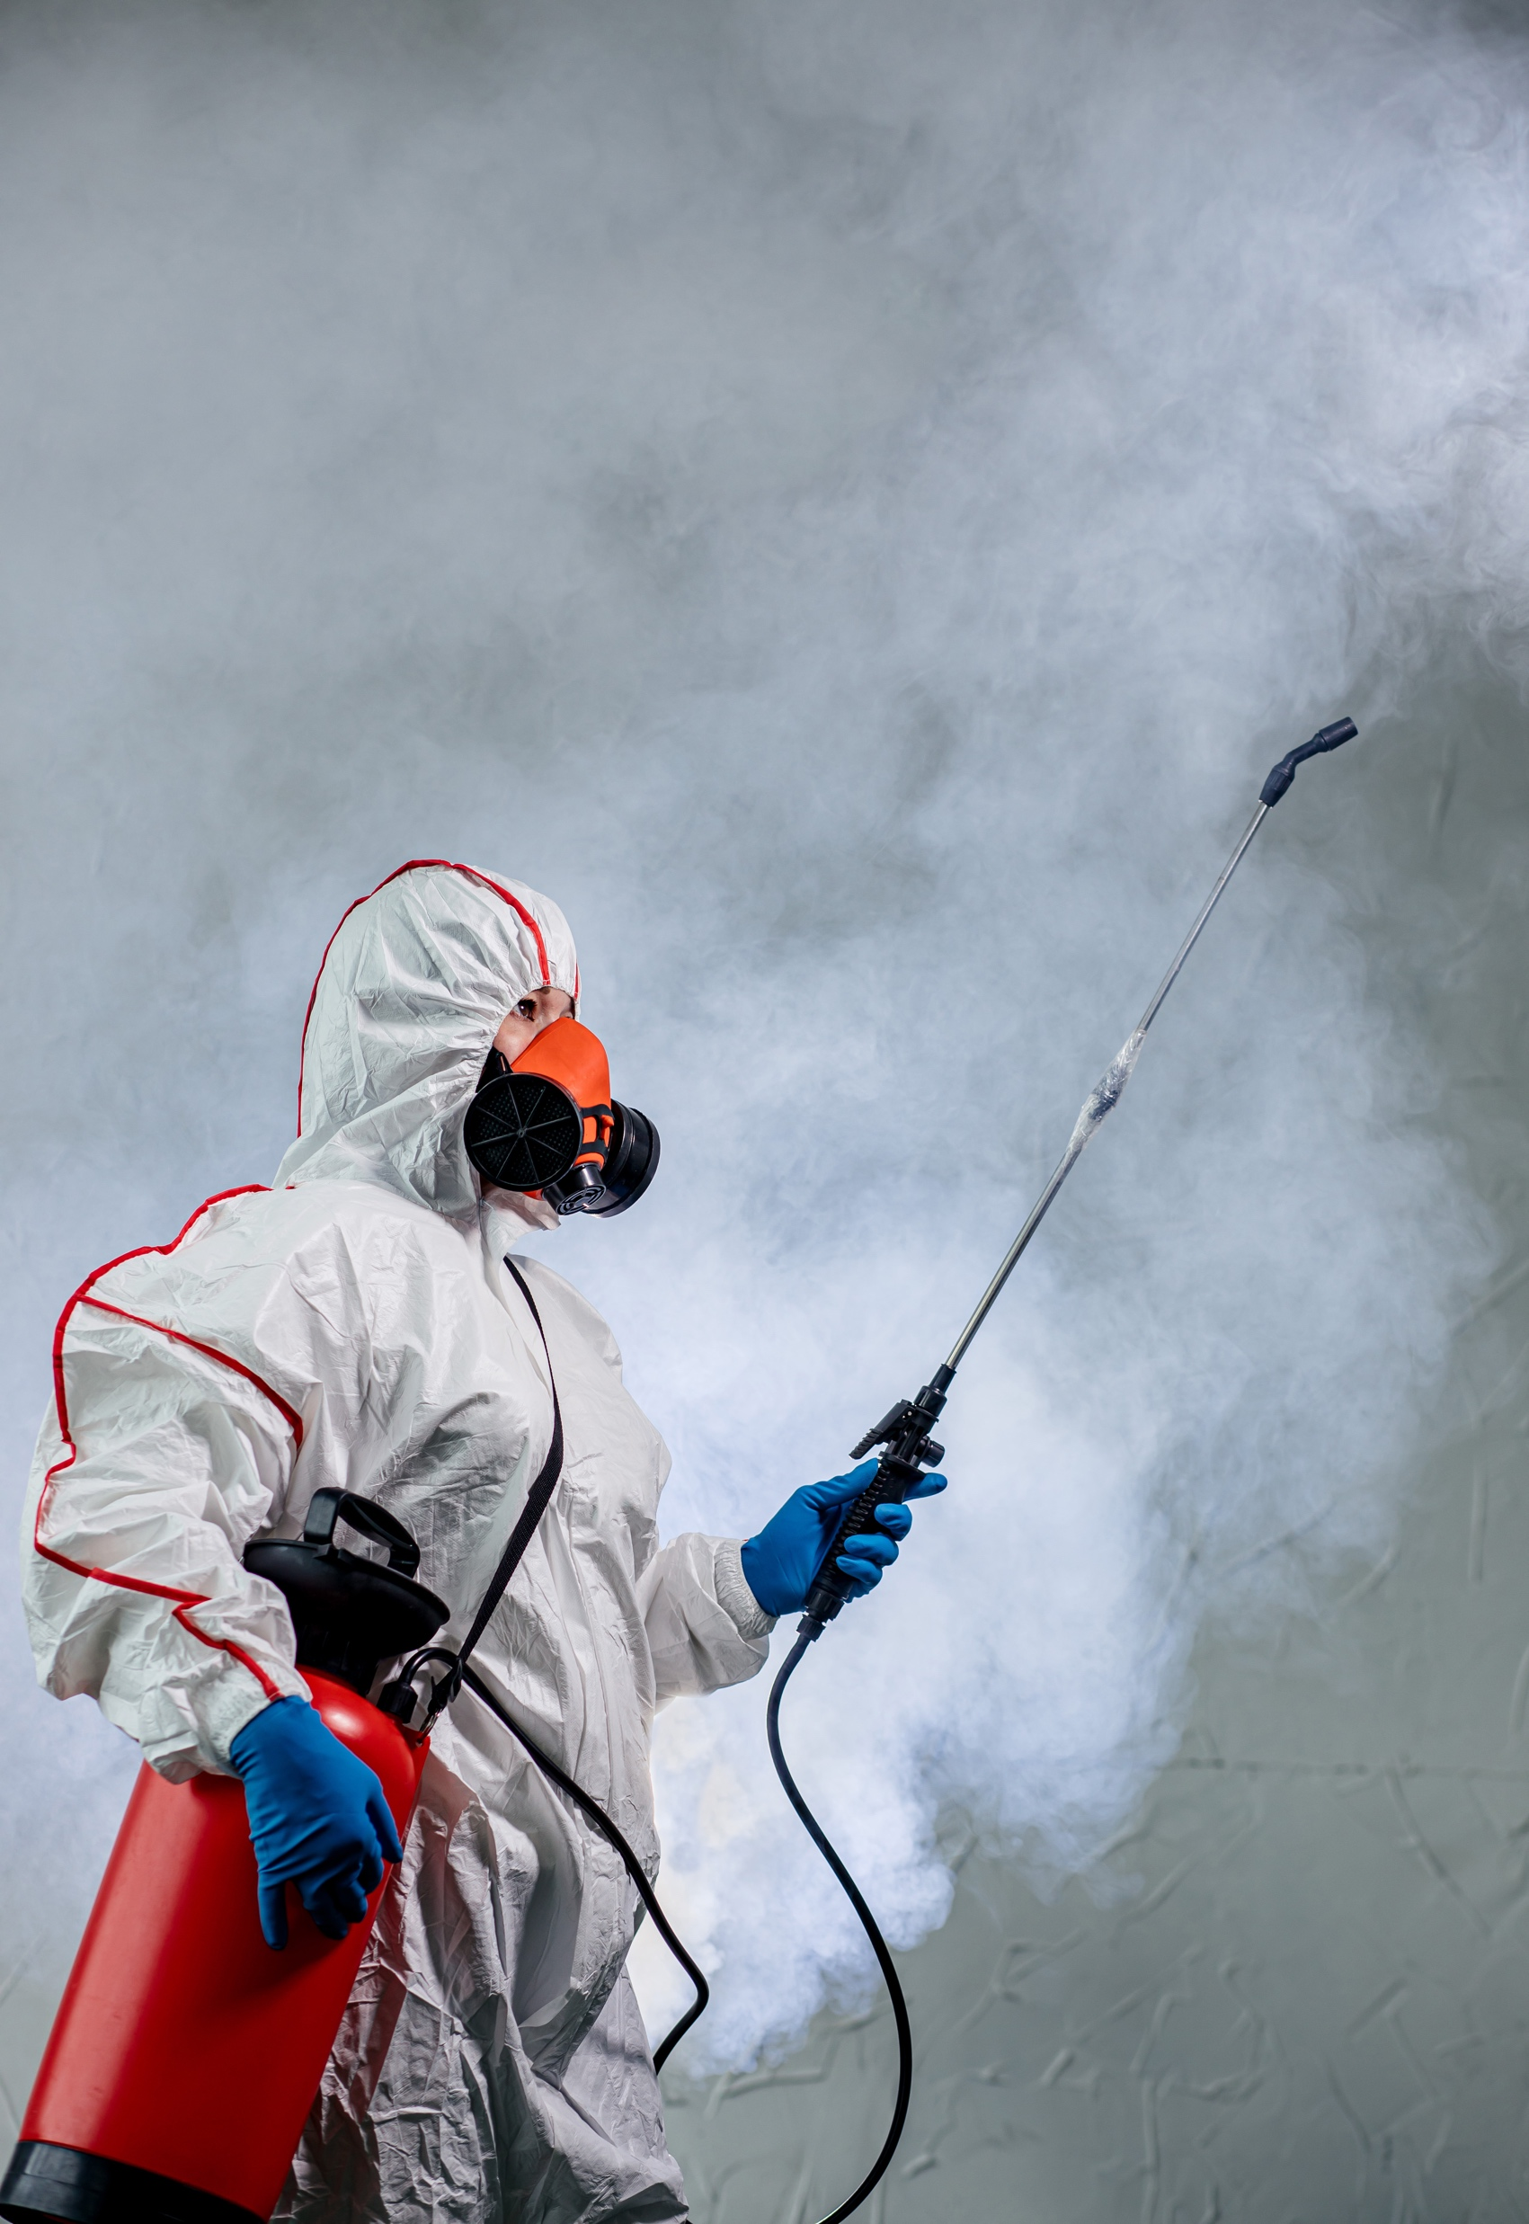
Physical Distancing & Disinfecting
Our Collective Efforts to Prevent Spread & Avoid Infection
Disinfection measures have been put in place and are taken routinely, based on frequency mentioned to disinfect workplace surfaces, chairs, tables, etc. and protect employees.
The Site was completely sanitized and disinfected before Re-Opening (where it was closed)
This baseline will be upheld with the Disinfection Protocol
The Disinfection Protocol will be followed regularly whereas the Deep-Cleaning and Disinfection Protocol is triggered when an active employee is confirmed positive for COVID-19 by a medical doctor; the deep-cleaning would be carried out by an external, professional service
2 meters
EMPLOYEE ORIENTATION | 25

Slide 26

Physical Distancing & Disinfecting
Our Collective Efforts to Prevent Spread & Avoid Infection
The Disinfection Team is led by: Sanitization and Disinfection Leader
The Disinfection Team is trained and equipped to use special Personal Protective Equipment to deal with potentially harmful chemicals used in sanitization
All employees have an active part in disinfection:
Good personal sanitary practices including washing hands after bathroom use are necessary and expected
Covering your cough, maintaining physical distancing, and cleaning your work or other visited areas are important in keeping yourself and others safe
You will be supplied with approved disinfection and sanitization materials, guidance and frequent updates
EMPLOYEE ORIENTATION | 26

Slide 27


Physical Distancing & Disinfecting
Common Areas
Physical Distancing is a simple yet very effective mechanism to prevent potential infection, that relies on simple distance to avoid infection.
Facility / Disinfectant Crew | All general walls and floors disinfected periodic, where frequently touched Hard surfaces mopped daily Doors, windows and other commonly touched objects disinfected at least 4 times per day | Chairs and space have been limited/ removed/ blocked off Signage placed on walls Max capacity is posted
All Employees | When possible, use elbow to open doors or press buttons Avoiding touching surfaces touched by others to the extent feasible | Ensure physical distancing is maintained Avoid non-essential gatherings Eliminate contact with others, such as handshakes or embracing coworkers, visitors, or friends Avoiding anyone that appears to be sick, or is coughing or sneezing
EMPLOYEE ORIENTATION | 27

Slide 28
Physical Distancing & Disinfecting
Elevators
Physical Distancing is a simple yet very effective mechanism to prevent potential infection, that relies on simple distance to avoid infection.
Coordination with the Building Site (landlord, property manager etc.) is essential to ensure protocols and responsibilities are clear and consistent.
Facility / Disinfectant Crew | All general walls and floors disinfected periodic, where frequently touched Hard surfaces mopped daily Physical markers placed at elevator entrances to determine distance apart while waiting Signage placed visibly | Elevators must be cleaned and sanitized at least once a day (more depending on resources available and local regulations) Signage placed on walls Max capacity is posted
All Employees | When possible, avoid directly touching the elevator buttons with bare hands Sanitize hands before entering elevator Once off elevator, Sanitize or wash hands for 20 sec before touching any other surface Avoiding touching surfaces touched by others to the extent feasible | Ensure Physical Distancing is maintained while waiting for or while in elevator – maintain 2 meters separation Avoiding anyone that appears to be sick, or is coughing or sneezing
EMPLOYEE ORIENTATION | 28

Slide 29
Physical Distancing & Disinfecting
Start/End Times, Shift Changes
Start/End times & Shift changes will be managed thoughtfully to reduce infection risk, and to leverage the opportunity they present to ensure optimal disinfection of the workplace.
Facility / Disinfectant Crew | Time clocks (where applicable) wiped off each time it is touched by an employee Employee is stationed to observe the time clock at a safe 2 meter distance to disinfect the clock | Start/end times staggered Designated entrances Doors propped open Security stationed near entry doors No punching in and out (where applicable) until further notice
All Employees | Do not touch the time clock or entry door handle with an exposed finger(s) or hand Do not touch your face before you have had a chance to wash your hands | Avoid gathering in crowds Remain in your car until your scheduled window of start time Ensure Physical Distancing is maintained while you wait in line to enter the Site When you talk to someone in line, do not speak directly at them
EMPLOYEE ORIENTATION | 29

Slide 30
Physical Distancing & Disinfecting
Breakrooms and Kitchen
Physical Distancing in the Site is intended to provide a safe environment reducing risk of any potential person-to-person infection.
Facility / Disinfectant Crew | Break times separated by 10 minutes to allow enough time to wipe tables, seats, all surfaces, refrigerator, vending machines and microwave ovens after each use Provide supplies for employees to clean after themselves Tables and chair surfaces, dispensers, common surfaces, etc. are cleaned generally 3 or more times per shift to include after all breaks and meals | Break times are staggered to limit number of employees Chairs and space have been limited/ removed/ blocked off Signage placed on tables Max capacity is posted One to two employees posted to observe the safe 2 meter (6 feet) distance and to disinfect
All Employees | Clean up after yourself and disinfect surfaces you touch Wash you hands or use hand sanitizer before and after lunch | Ensure Physical Distancing is maintained Do not arrive early to break
EMPLOYEE ORIENTATION | 30

Slide 31
Physical Distancing & Disinfecting
Bathrooms
Physical Distancing in the Site is intended to provide a safe environment reducing risk of any potential person-to-person infection.
Facility / Disinfectant Crew | Disinfectant supplies are provided for employees to clean up after themselves Bathrooms are disinfected at least four time per day | Urinal and sink stations have been marked for non-use so that the distance between each is 2 meters (6 feet) where multiple exist. Alternatively, capacity limits must be observed Max capacity is posted One or two employees will be stationed to observe the distancing minimum
All Employees | Wash hands When possible, use elbow to open doors or press buttons | Ensure Physical Distancing is maintained
EMPLOYEE ORIENTATION | 31

Slide 32
Physical Distancing & Disinfecting
Offices
Physical Distancing in the Site is intended to provide a safe environment reducing risk of any potential person-to-person infection.
Facility / Disinfectant Crew | All general walls and floors disinfected periodic, where frequently touched Hard surfaces mopped daily Doors, windows and other commonly touched objects disinfected at least four times per day | Desks reassigned or blocked to ensure separation of employees between 2 meters (6 feet) Cubicles have dividers when minimum distance can not be met Meeting rooms organized to hold no more than the approved number of chairs with appropriate spacing between people Remote work may be assigned when possible to reduce number of employees in facility
All Employees | When possible, use elbow to open doors or press buttons Self-cleaning of the work space is encouraged multiple times during the shift with special attention of the most used surfaces such keyboards, monitors, chair arm rest, desks, cubicle divider among others | Ensure Physical Distancing is maintained Do not share office equipment Do not share paper
EMPLOYEE ORIENTATION | 32

Slide 33
Physical Distancing & Disinfecting
Workstations
Physical Distancing in the Site is intended to provide a safe environment reducing risk of any potential person-to-person infection.
Facility / Disinfectant Crew | Common surfaces in the workstation disinfected at the end of each shift (minimum) | Work stations have been arranged 2 meters apart Signage placed in workstation about the desired position of the operators Floor limits for workstations are placed on the floor
All Employees | Self-cleaning of the work space is encouraged multiple times during the shift with special attention of the most used surfaces Avoid touching your face and wash thoroughly with soap and water several times during the work hours | Ensure Physical Distancing is maintained
EMPLOYEE ORIENTATION | 33

Slide 34
Physical Distancing & Disinfecting
Change & Locker Rooms
Physical Distancing in the Site is intended to provide a safe environment reducing risk of any potential person-to-person infection.
Facility / Disinfectant Crew | All general walls and floors disinfected periodic, where frequently touched Hard surfaces mopped daily Doors, windows and other commonly touched objects disinfected at least four times per day | Where they exist, Lockers reassigned to limit capacity and increase distancing Lockers limited to only employees with accommodations Shelves placed in lunch room to keep lunch boxes
All Employees | When possible, use elbow to open doors or press buttons | Follow shift start and end times and break and lunch schedule Ensure Physical Distancing is maintained
EMPLOYEE ORIENTATION | 34

Slide 35
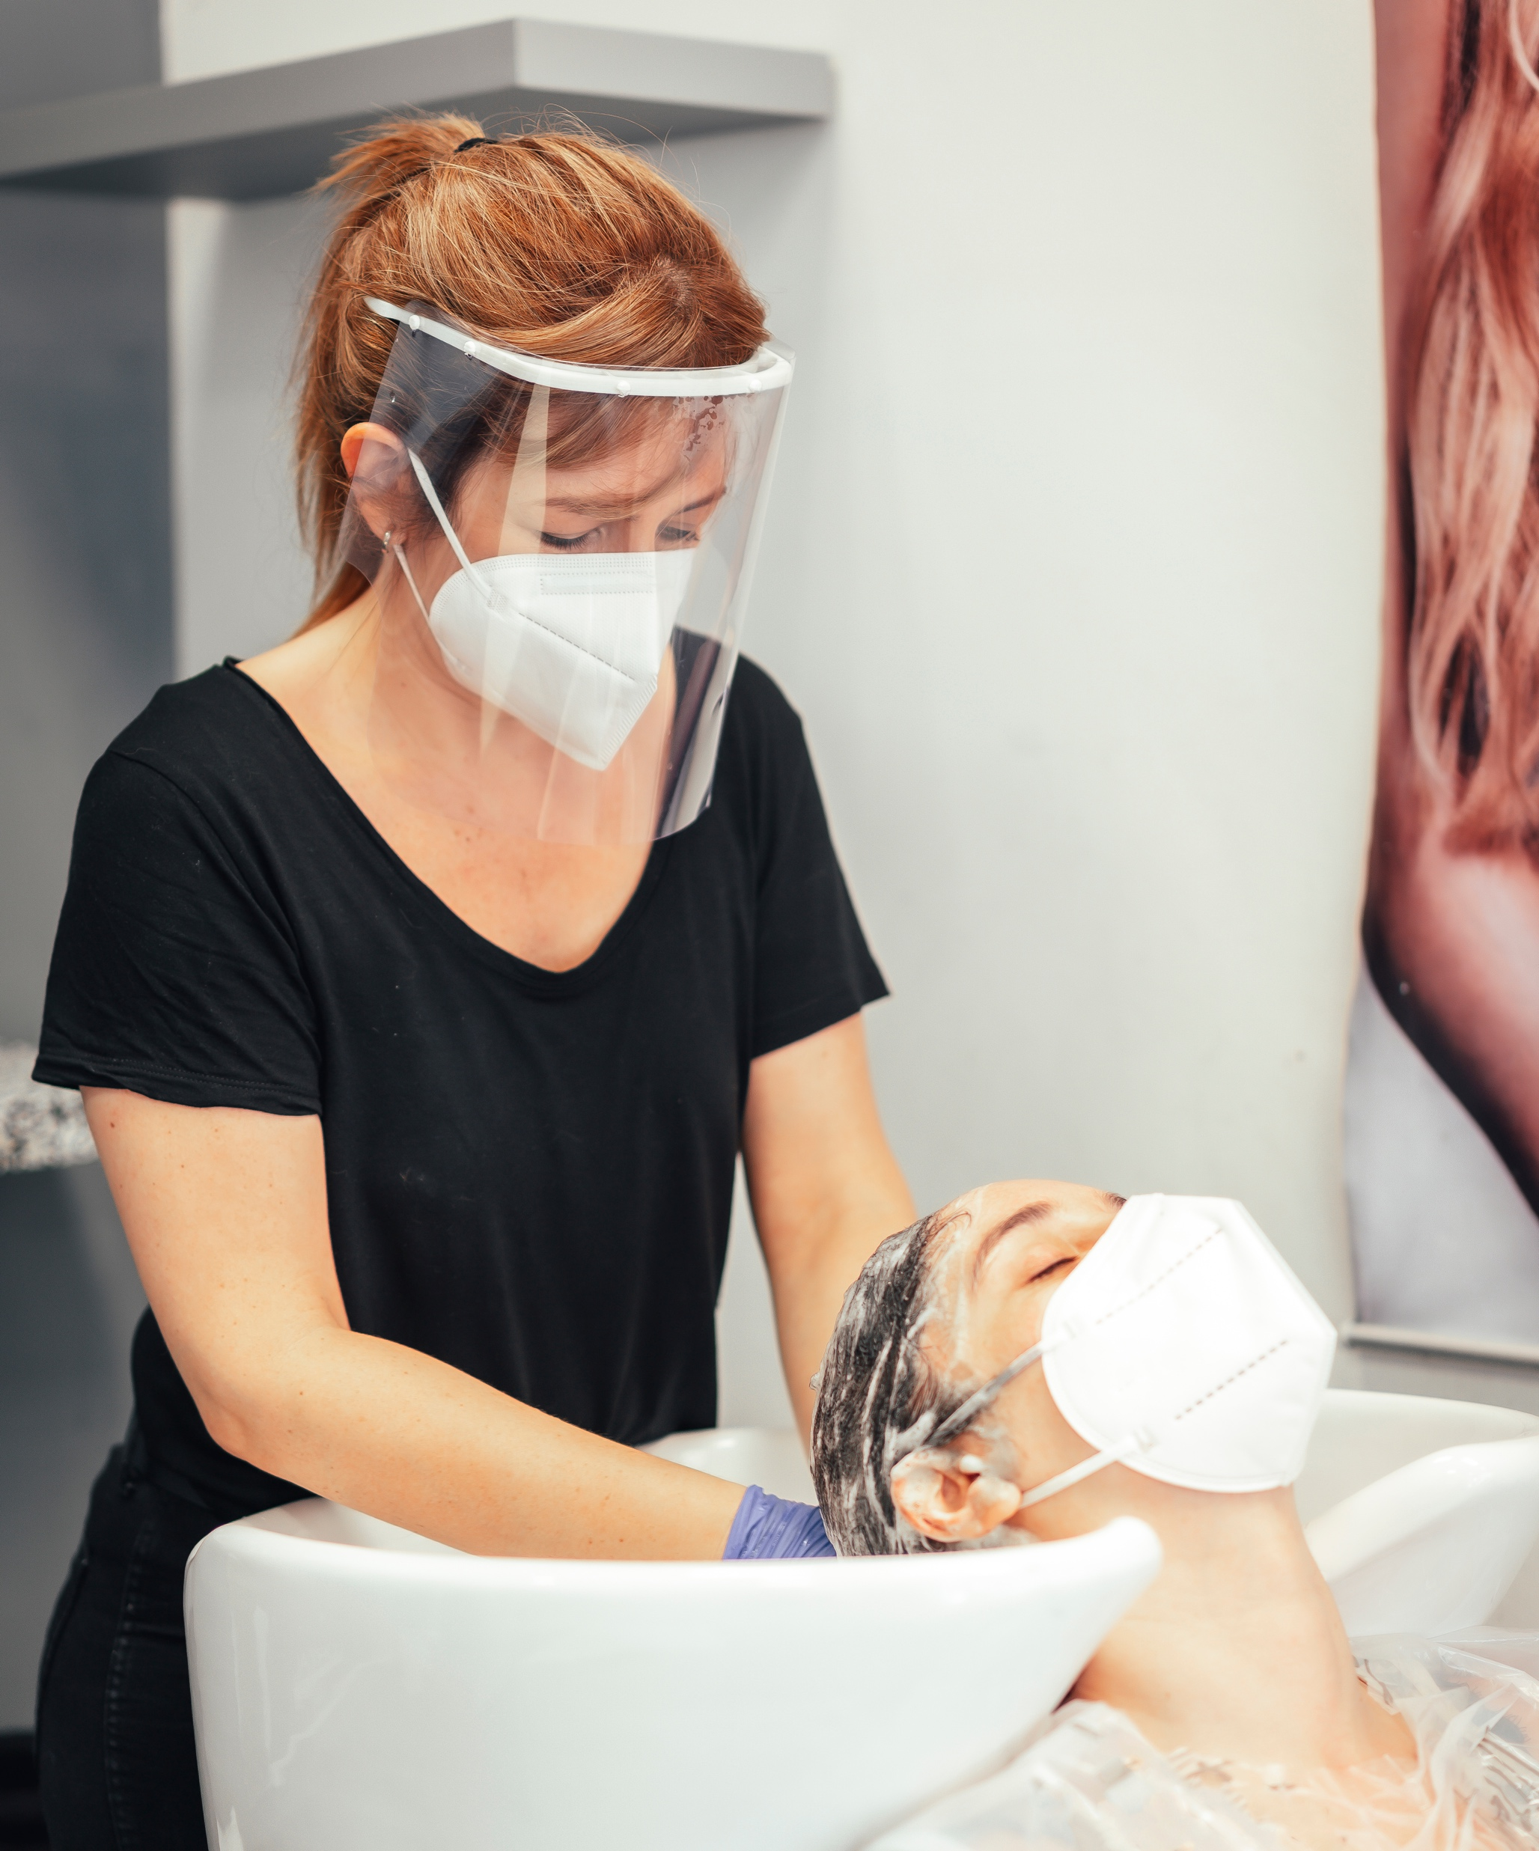
Personal Hygiene
EMPLOYEE ORIENTATION | 35

Slide 36

1) Washing hands is the most effective way to reduce the spread of infectious diseases
When washing hand with soap and water:
Wet your hands with clean running water and apply soap — use warm water if it is available
Rub hands together to make a lather and scrub all surfaces. Continue rubbing hands for 20 seconds: Sing the "Happy Birthday Song!
Rinse hands well under running water
Dry your hands using a paper towel or air-dryer
Use alcohol-based hand sanitizer liberally if soap and water are not available.
When should you wash your hands?
Presume your hands are contaminated with viruses and bacteria after touching common surfaces, as well as any surfaces you touch thereafter
Entering the Site and back to home
Before and after food preparation and before eating and drinking
Before and after treating a cut or wound
After touching your nose or mouth
Before and after toilet use
After processing garbage
After blowing your nose, coughing or sneezing
After handling an animal or animal waste
After changing diapers or cleaning up a child who has gone to the bathroom
After visiting sick people
Before taking medication
NOTE:
Presume your hands are contaminated with viruses and bacteria after touching common surfaces, as well as any surfaces you touch thereafter.
EMPLOYEE ORIENTATION | 36

Slide 37
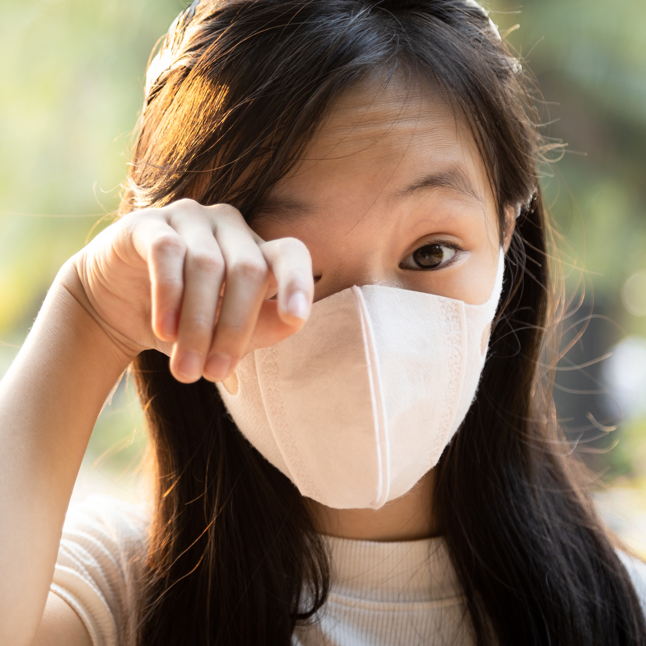
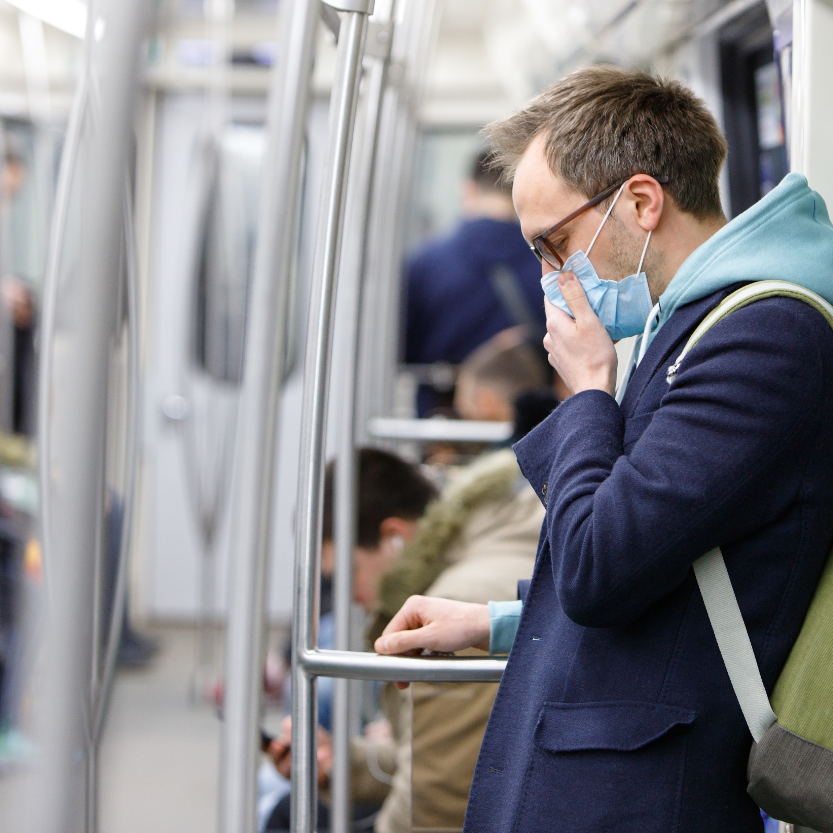
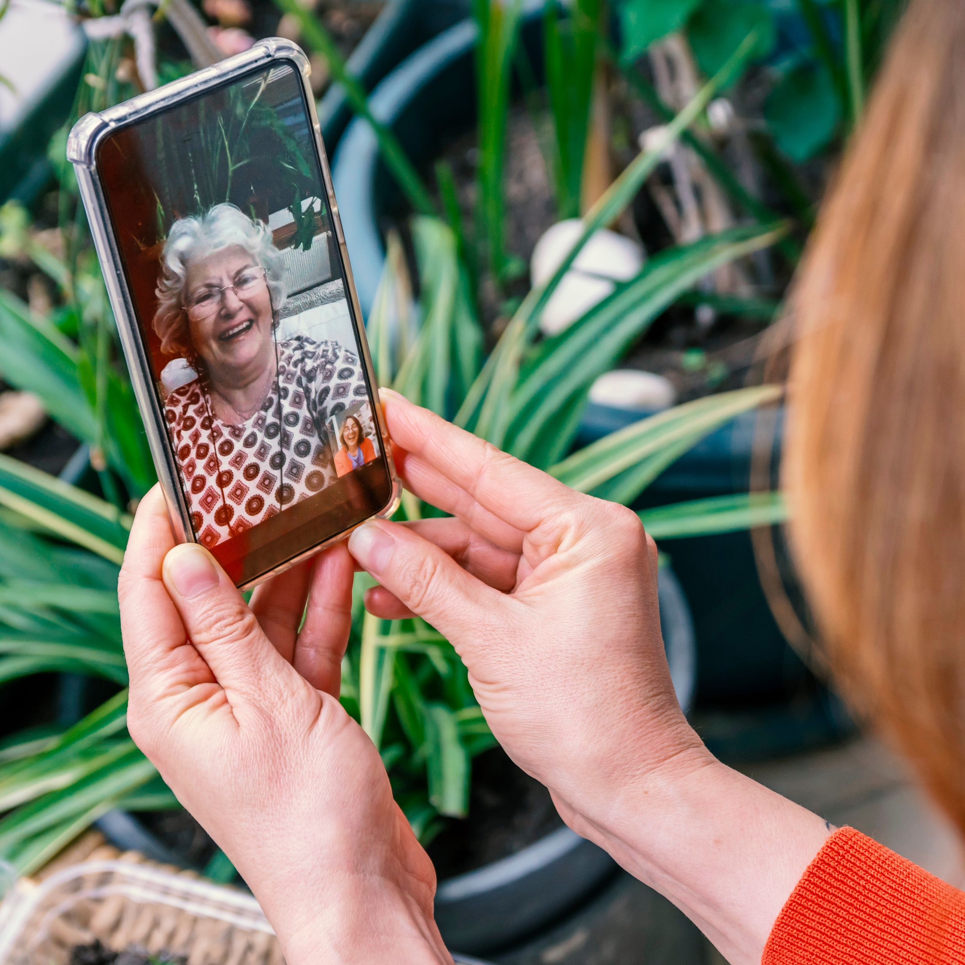
2) Do NOT touch your FACE, including your mouth, eyes, nose or ears
Viruses that get onto your hands by touching common surfaces cannot harm you unless you physically transfer them to an entry portal into the body, so do not touch your face
If you are sick, touching your face will contaminate your hands and any common surfaces you touch – continuing the chain of infection
3) Cover coughs/sneezes
Never cough or sneeze into your hands, as they then pass viruses to common surfaces and infect others
Use a tissue or cough and sneeze into the bend of your elbow
COVID-19 on your hands causes no harm, until you touch your face, or contaminate others who do so
Your eyes, nose, and mouth are the primary entry points for this and many other viruses and bacteria
If the face is inadvertently touched, it should be rinsed with soap and warm water
4) Keep personal devices clean
Ensure personal items that are touched, and especially those that touch your face (e.g. mobile phone) are kept clean
Avoid touching them after you have touched common surfaces and clean them frequently as needed
EMPLOYEE ORIENTATION | 37

Slide 38
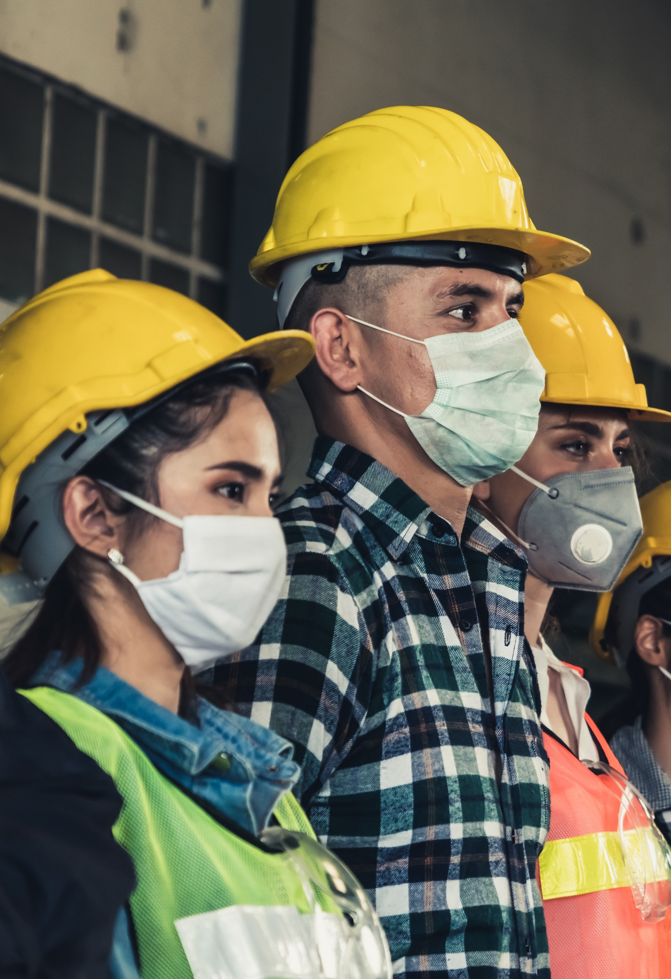
PPE
Some employees may be required to use Personal Protective Equipment
PPE is used for employees that may come into direct contact with COVID-19 positive employees and for Disinfectant Team members to protect their skin from regular use of cleaning chemicals.
Face Masks are required PPE for a limited number of Pandemic Response and Management Personnel at each Site:
Wet your hands with clean running water and apply soap — use warm water if it is available
Rub hands together to make a lather and scrub all surfaces. Continue rubbing hands for 20 seconds: Sing the “Happy Birthday Song”!
Rinse hands well under running water
Dry your hands using a paper towel or air-dryer
Gloves
Gloves are for Isolation Team Members and those members performing disinfection of common and shared areas
Gloves are not generally recommended for use unless mandated by local laws
If mandated, the Company should provide gloves
EMPLOYEE ORIENTATION | 38

Slide 39
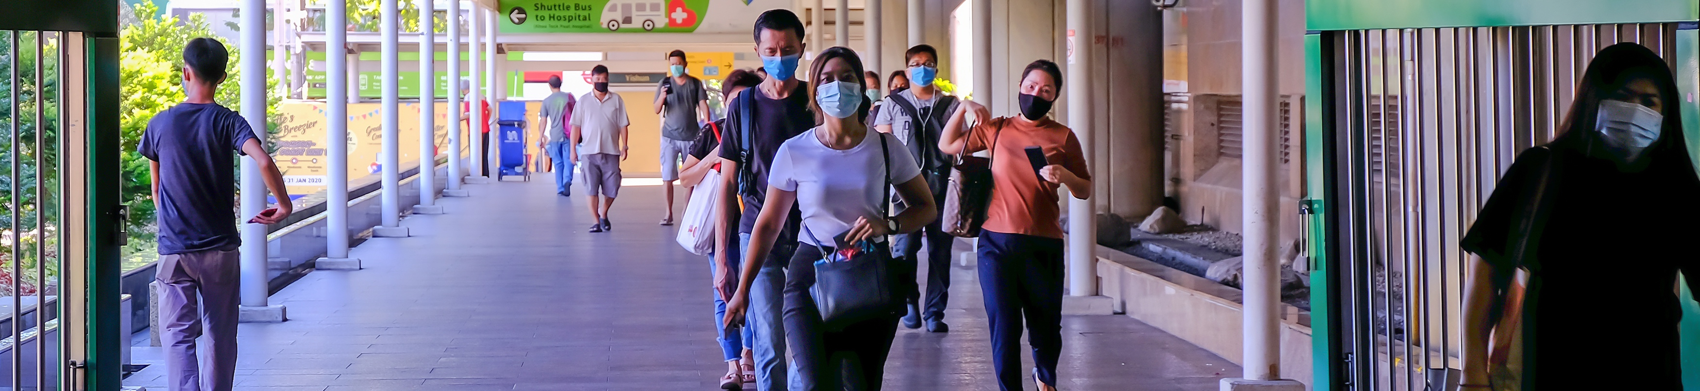
Self Quarantine & Return to Work Protocol
EMPLOYEE ORIENTATION | 39

Slide 40
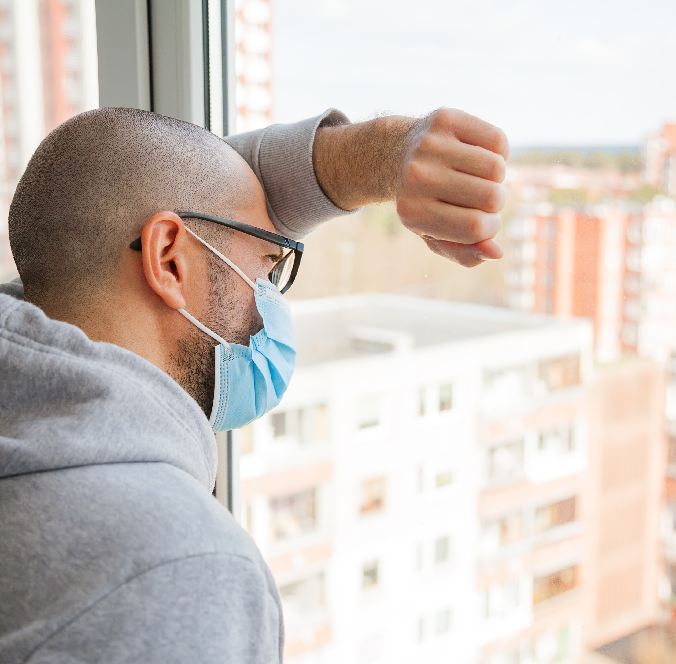
Self Quarantine & Return to Work Protocol
Self-Quarantining:
Employees are requested to remain off Company Property for 14 days if they have:
COVID-19 symptoms (see COVID-19 Self-Screening Information)
Been directly exposed to COVID-19
Have a positive test for COVID-19
Employees should avoid leaving home if possible
If necessary, they should practice Physical Distancing, and the hygiene practices that Local Health Authorities provide guidance for
Working from home is expected to continue when possible, per the direction of your Human Resource Lead
Please follow the Local Health Authority for additional Self-Quarantine Guidance.
EMPLOYEE ORIENTATION | 40

Slide 41
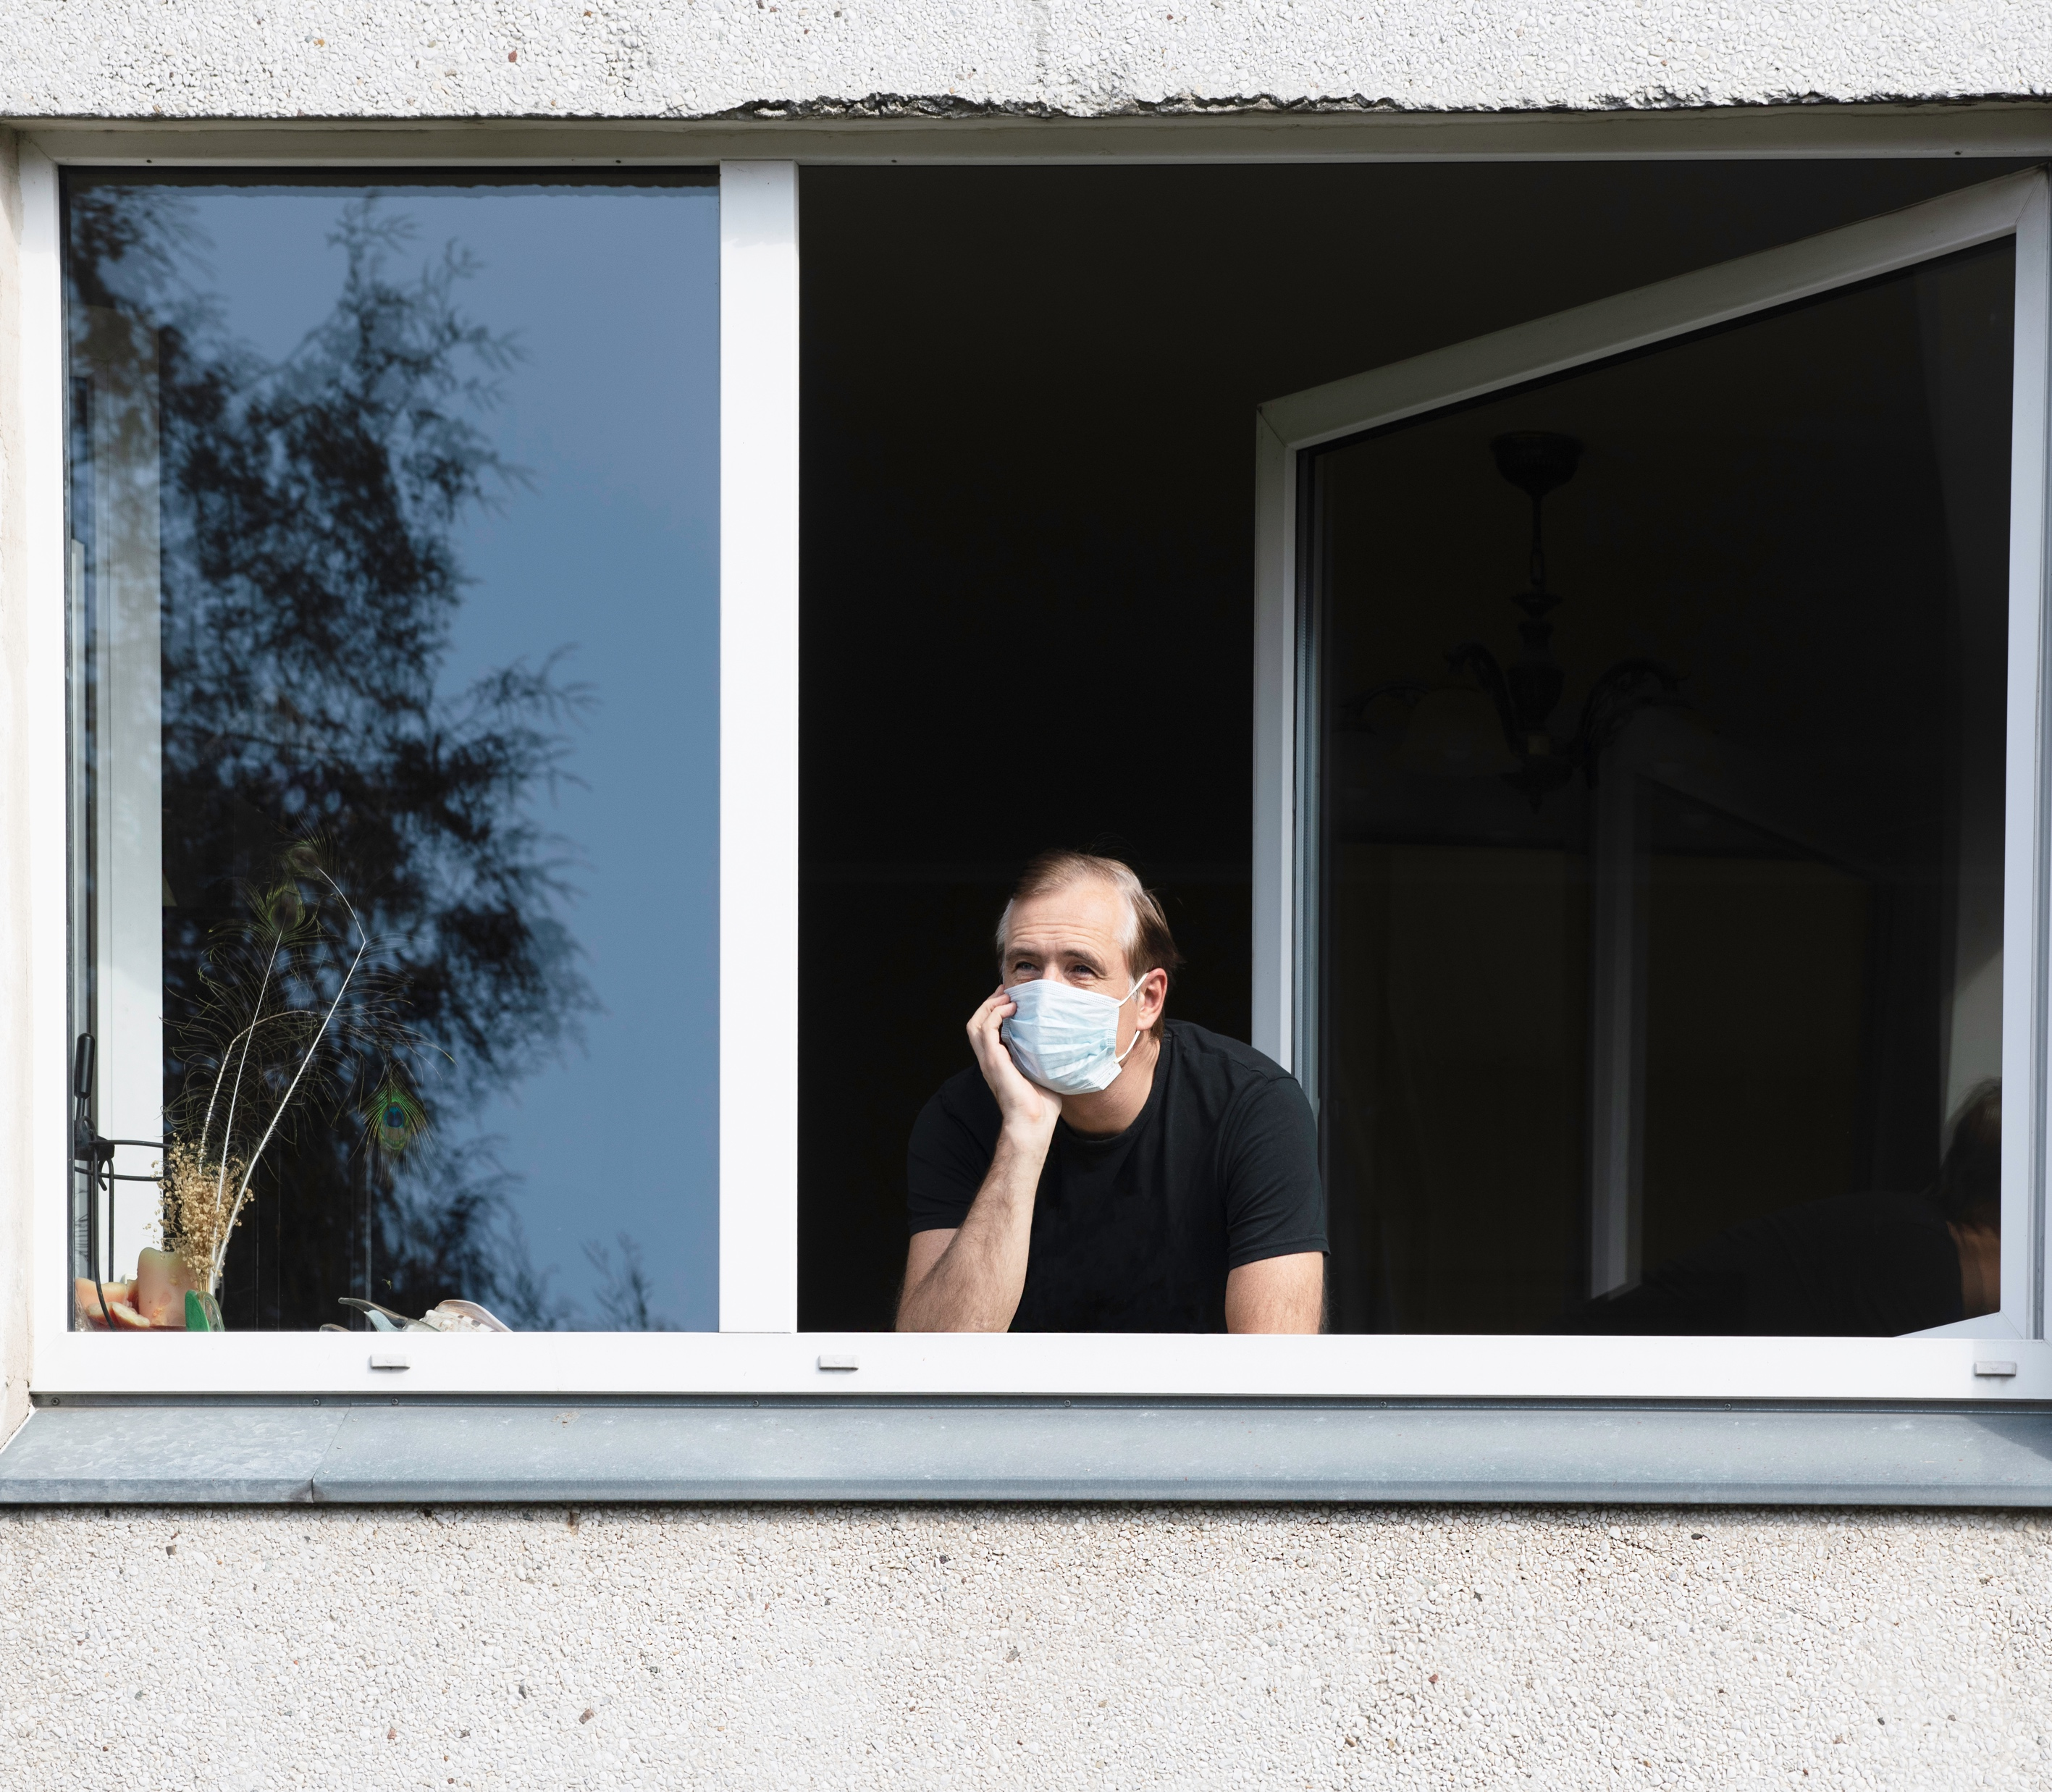
Self Quarantine & Return to Work Protocol
Return to Work Protocol:
Employees who have been under home isolation/quarantine can return to work after the mandated period under the following conditions:
NOTE: Where Local Health Authority permits, everyone should be tested before returning to work and provide a medical certificate releasing them to return to work, as determined by the Executive Leadership.
A. If you will NOT be tested to determine if you are still contagious, you can leave home after 3 points have been met:
1. You have had no fever for at least 72 hours (3 full days of no fever without the use of medication to reduce fevers), AND
2. Other identified symptoms have improved (for example respiratory, gastrointestinal and systemic have improved), AND
3. At least 10 days have passed since your symptoms first appeared
B. If you WILL be tested to determine if are still contagious, you can leave home after 3 points have been met:
1. You no longer have a fever (without the use of medication to reduce fevers), AND
2. Other identified symptoms have improved (for example respiratory, gastrointestinal and systemic have improved), AND
3. You receive 2 negative tests in a row — 24 hours apart
Please ensure your local Human Resource Team has been contacted prior to Returning to Work, to discuss and ensure that all requirements have been met before you return to the company premises.
Confirmation of adherence to the listed criterion and consistency with Local Guidelines and the Public Health Agency of Canada is essential.
EMPLOYEE ORIENTATION | 41

Slide 42
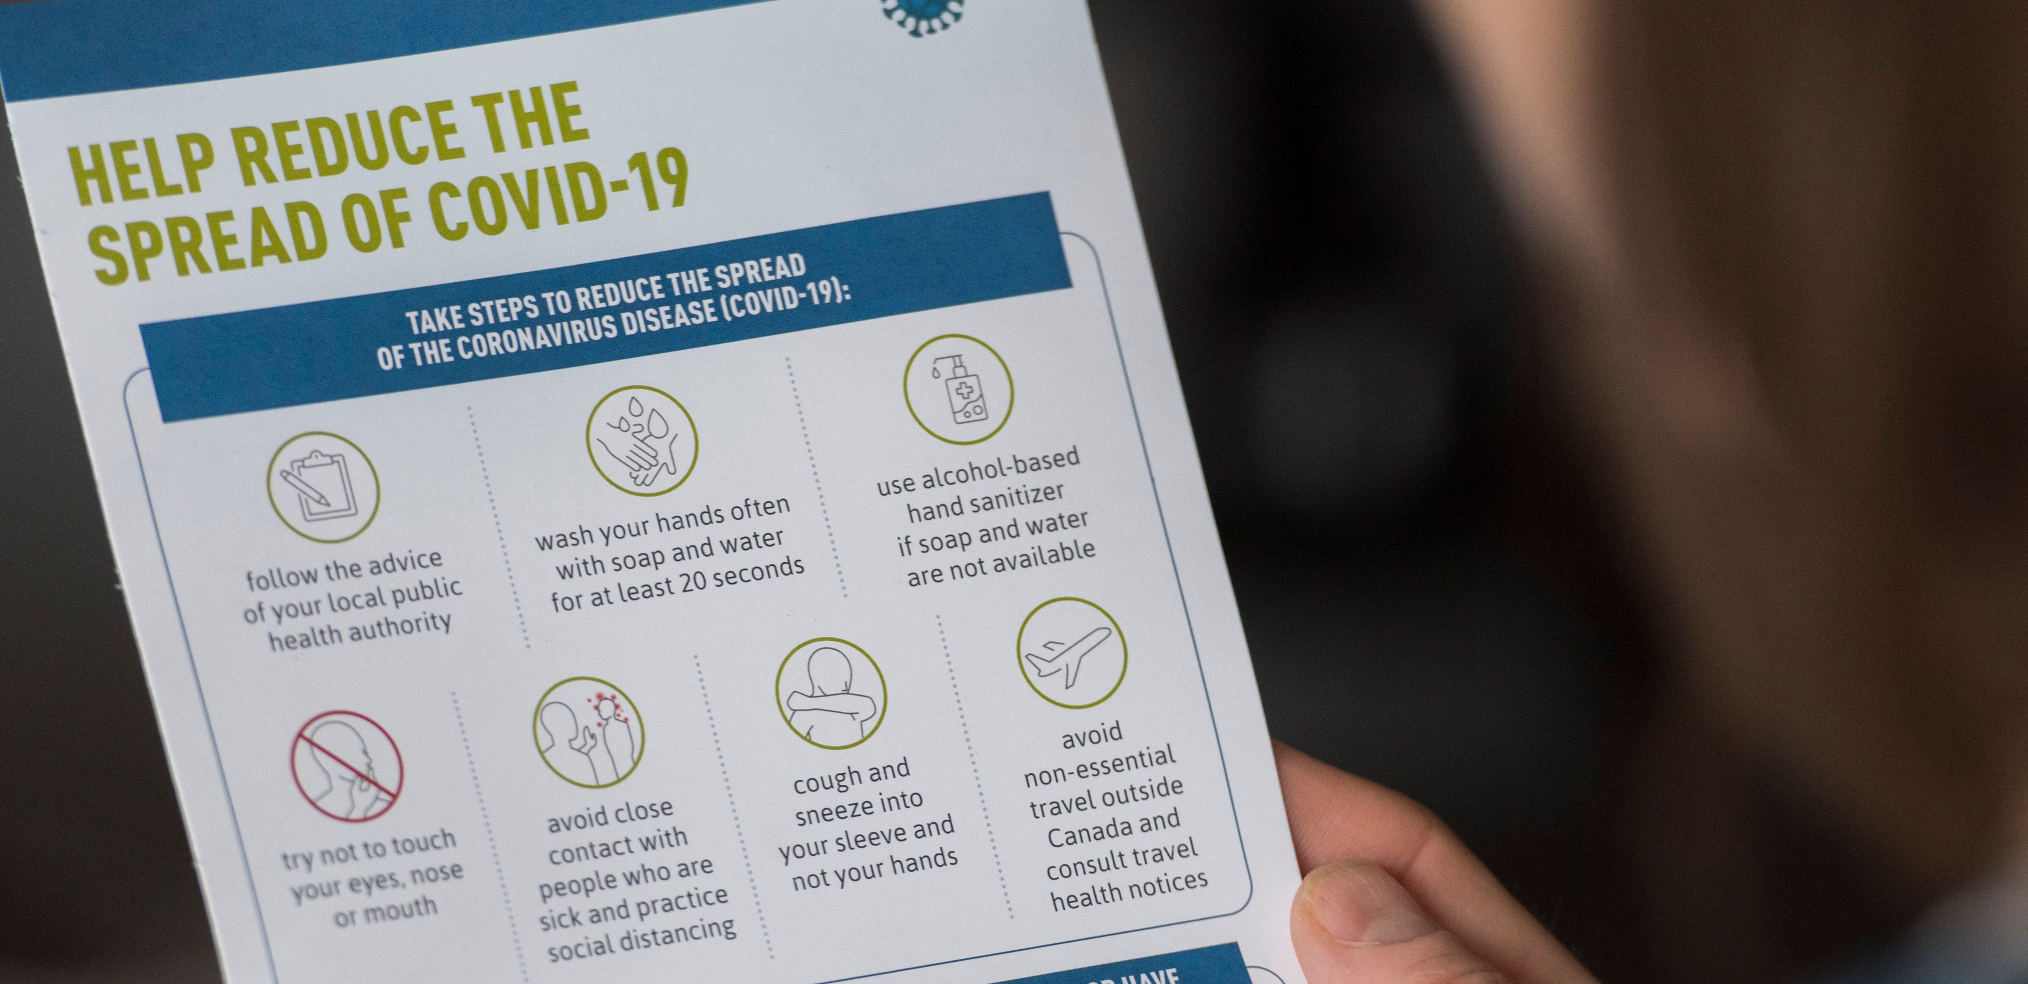

Employee Surveys
Surveys are an important form of feedback that will allow employees to openly communicate with Leadership about all sentiments related to work and changes brought upon by COVID-19.
We ask that all employees take 15 minutes out of their day to answer these questions honestly as the response can have an impact on how policy and protocol will continue in the future.
There will be 4 surveys in circulation
1 | 2 | 3 | 4
Employee Sentiment Around the COVID-19 Pandemic | Employee Sentiment Around Remote Work | Employee Sentiment Around Returning to Work | Psychological Health and Safety
EMPLOYEE ORIENTATION | 42

Slide 43




Contact Information
Local Site Leader email / phone number: XXXX-1234-1234
Local HR email / phone number: XXXX-1234-1234
Further Information
Public Health Agency of Canada https://www.canada.ca/en/public-health/services/diseases/coronavirus-disease-covid-19.html
World Health Organization (WHO) https://www.who.int/emergencies/diseases/novel-coronavirus-2019
Re-Opening Safely www.reopeningsafely.ca
www.reopeningsafely.ca

